Slide 1



AmP Parameter Estimation
Dina Lika
lika@uoc.gr
University of Crete
ΠΑΝΕΠΙΣΤΗΜΙΟ ΚΡΗΤΗΣ
UNIVERSITY
OF CRETE

Slide 2
Lecture outline
Parameter estimation
    Estimation criteria
    Loss functions
    Numerical implementation
    Pseudo-data
Estimation of a new species
    AmPeps-Guided example
    Prepare the 4 source files
    Customize option for running the estimation procedure
    Estimate parameters
Evaluation of estimation

Slide 3









Abstract World
State Variables
Core Primary Parameters
Auxiliary Parameters
Model
$$V, E,E_{R}$$
$$\dot{v},[{\dot{p}}_{M}]{,{\{\dot{p}}_{Am}\},[E}_{G}], κ, …$$
$$δ_{Μ},{μ_{E},ω_{E},d}_{ V},…$$
$$L_{m}=\frac{{κ\{\dot{p}}_{Am}\}}{[{\dot{p}}_{M}]}$$
$$\left[E_{m}\right]=\frac{{\{\dot{p}}_{Am}\}}{\dot{v}}$$
Mapping Functions
$$L_{wm}=\frac{L_{m}}{δ_{Μ}}$$
$$𝓌=\frac{\left[E_{m}\right]w_{E}}{d_{V}μ_{E}}$$
prediction
estimation
$W_{m}={d_{ V}L}_{m}^{3}(1+f𝓌$)
$$W_{w}={ d}_{ V}V+(E+E_{R})\frac{w_{E}}{μ_{E}}$$
W_{m} maximum dry mass (g)
t (time, days)
W_{W} (weight, g)
Organism data
L_{Wm} maximum body length (cm)
t₁
W_{W}(t₁)
Real World
...
t₂
W_{W}(t₂)
t₃
W_{W}(t₃)
...
Zero-variate Observations
Uni-variate Observations
Lika et al. (2011) J. Sea Research 22:270-277
doi.org/10.1016/j.seares.2011.07.010

Slide 4

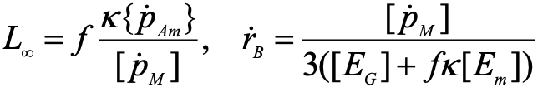
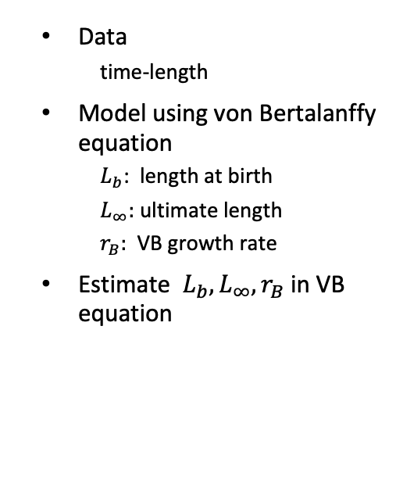
Parameter estimation
Data
  time-length
Model using von Bertalanffy equation
  $L_{b}$: length at birth
  $L_{∞}:$ ultimate length
  $r_{B}:$ VB growth rate
Estimate ${L_{b},L}_{∞}, r_{B}$ in VB equation
Von Bertalanffy equation
Compound parameters
Notes:
Simple regression

Slide 5
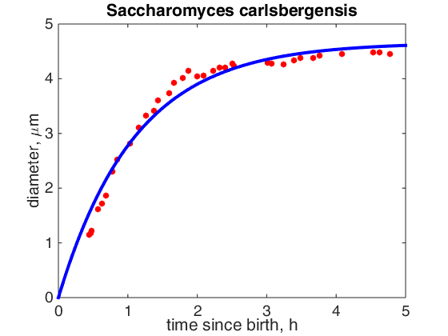


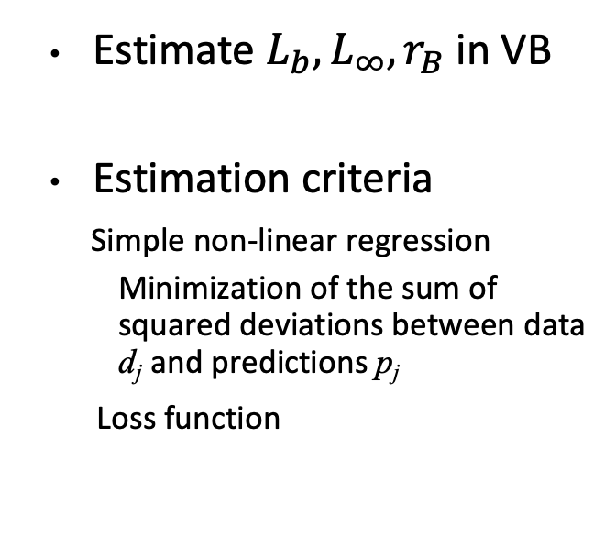

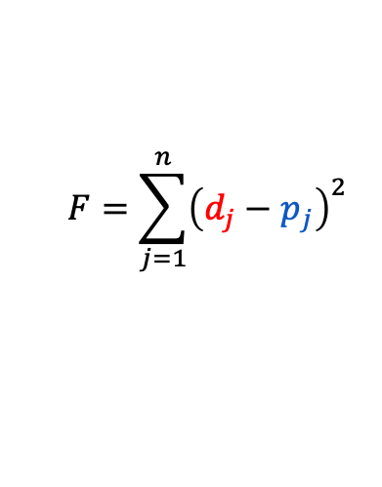
Parameter estimation
Estimate ${L_{b},L}_{∞}, r_{B}$ in VB
Estimation criteria
Simple non-linear regression
  Minimization of the sum of squared deviations between data d_{j} and predictions p_{j}
Loss function
$$d_{i}$$
$$p_{i}$$
$$d_{i}−p_{i}$$
$$F=\sum_{j=1}^{n}{{\left(d_{j}−p_{j}\right)}^{2}}$$
Von Bertallanfy equation
Compound parameters

Slide 6

AmP Parameter estimation
Data for Lasaea rubra
Data
  time-length
  Length-fecundity
  age at birth
Fitting multiple models, which share parameters, to multiple data sets, which may differ in dimensions, in a single parameter estimation.
Estimation criteria
  Minimization of a weighted sum of squared deviations between data and predictions
Age at birth $a_{b}=60 d$
Data from Grath & Foighil (1986) Ophelia, 25(3):209--219

Slide 7
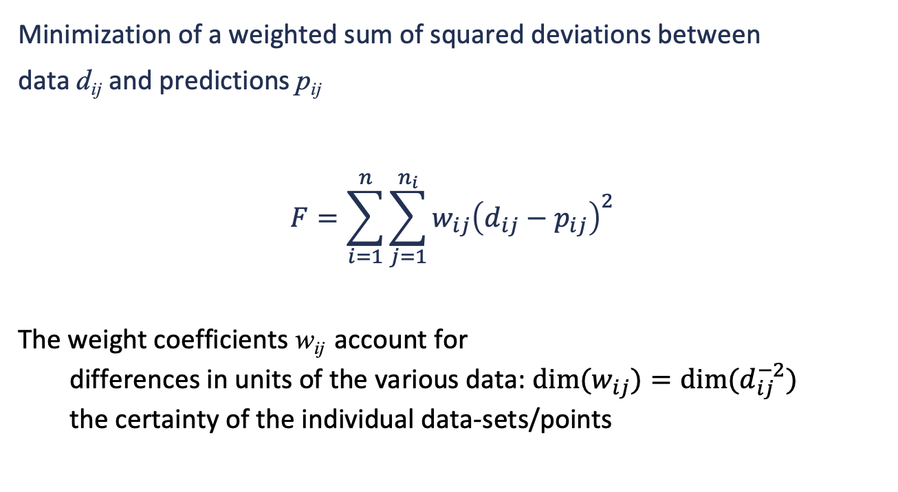
Estimation Criteria
Minimization of a weighted sum of squared deviations between
data d_{ij} and predictions p_{ij}
$$F=\sum_{i=1}^{n}{\sum_{j=1}^{n_{i}}{w_{ij}{\left(d_{ij}−p_{ij}\right)}^{2}}}$$
The weight coefficients w_{ij} account for
  differences in units of the various data: ${dim⁡(w}_{ij})=dim⁡(d_{ij}^{−2})$
  the certainty of the individual data-sets/points
Marques et al. (2019) J Sea Research, 143: 48-56 doi.org/10.1016/j.seares.2018.07.004
DEB Video: Point parameter estimation

Slide 8
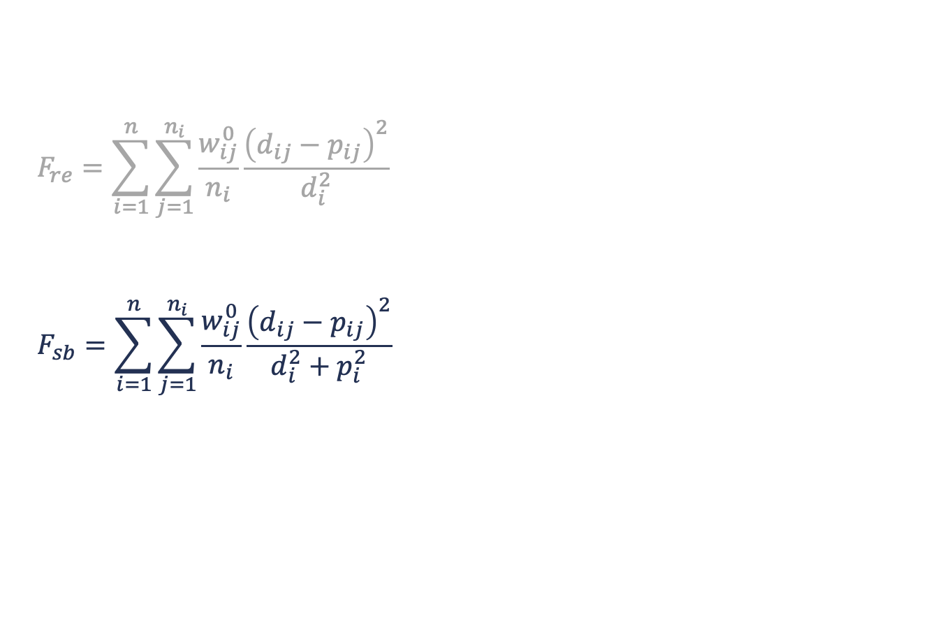
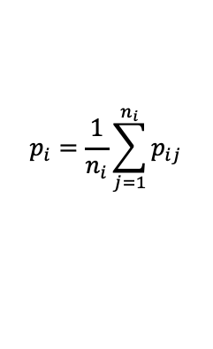
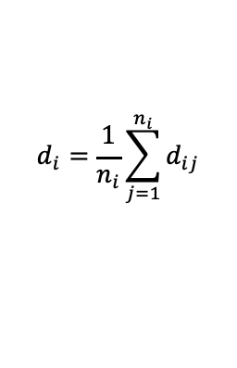
Loss functions
$$F_{re}=\sum_{i=1}^{n}{\sum_{j=1}^{n_{i}}{\frac{w_{ij}^{0}}{n_{i}}\frac{{\left(d_{ij}−p_{ij}\right)}^{2}}{d_{i}^{2}}}}$$
$$F_{sb}=\sum_{i=1}^{n}{\sum_{j=1}^{n_{i}}{\frac{w_{ij}^{0}}{n_{i}}\frac{{\left(d_{ij}−p_{ij}\right)}^{2}}{d_{i}^{2}+p_{i}^{2}}}}$$
non-symmetric
symmetric bounded
$$d_{i}=\frac{1}{n_{i}}\sum_{j=1}^{n_{i}}{d_{ij}}$$
$$p_{i}=\frac{1}{n_{i}}\sum_{j=1}^{n_{i}}{p_{ij}}$$
means
Notes:
The default wij0= 1, or give it a larger values but not more that 5.
You can choose wij0 =0 if some particular datapoint is not trusted
Divides for the number of point. Which mean that overall each data set has the same contribution, independent of the data point

Slide 9
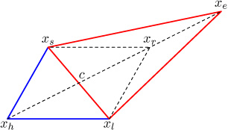
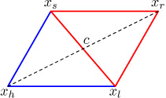
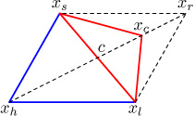
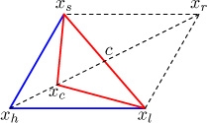
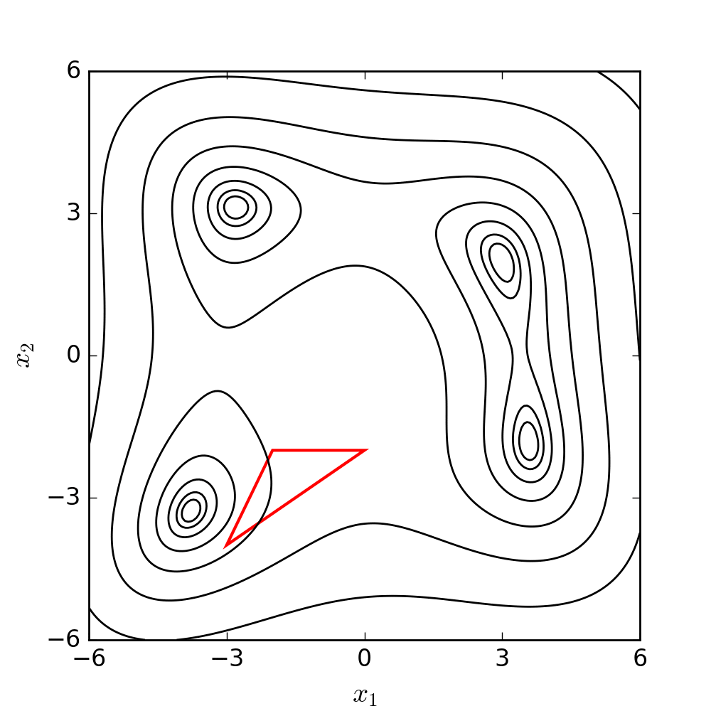
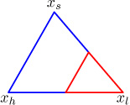
Numerical implementation
Nelder-Mead method
Reflection
Expansion
A simplex method for ﬁnding a parameter set that minimizes the loss function F
For 2 parameters, a simplex is a triangle (1+No. of free parameters)
The function is evaluated at the vertices of the simplex
The worst vertex x_{h} , where F is largest, is rejected and replaced with a new vertex x_{C} obtained via a sequence of transformations (reflect, expand or contract) or shrink the triangle towards the best.
The process generates a sequence of triangles (different shapes), for which the function values at the vertices get smaller and smaller.
The size of the triangles is reduced and the coordinates of the minimum point are found.
Stopping rules
Contraction outside
Contraction inside
Shrinking

Slide 10
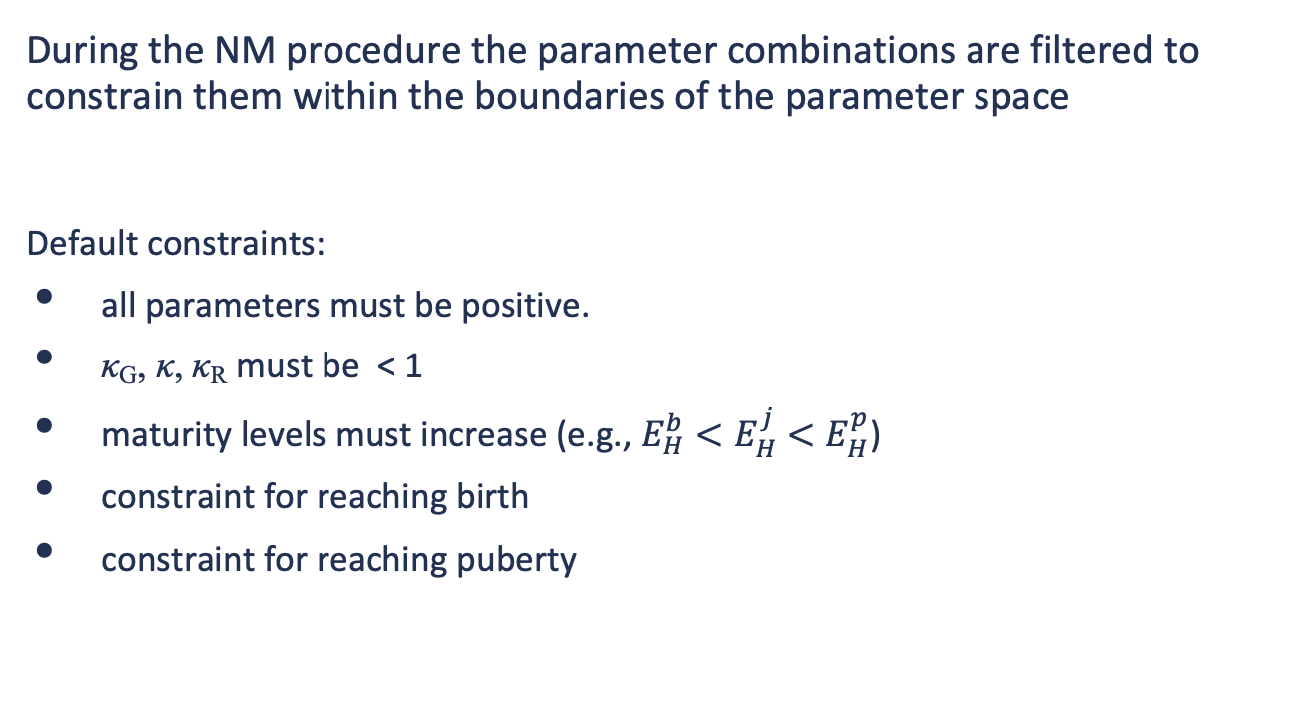
The N-M method with constraints
During the NM procedure the parameter combinations are filtered to constrain them within the boundaries of the parameter space
Default constraints:
all parameters must be positive.
κ_{G}, κ, κ_{R} must be < 1
maturity levels must increase (e.g., $E_{H}^{b}<E_{H}^{j}$ ${<E}_{H}^{p}$)
constraint for reaching birth
constraint for reaching puberty
MATLAB functions
debtool/lib/pet/filter_dmod.m
dmod : typified model (std, abj, etc)

Slide 11

Pseudo-data
Set of zero-variate data for the generalized animal
Species-specific parameters and parameters that depend on max body size should not be used as pseudo-data
Define the area of the parameter space where the parameter values are reasonable
Decrease non-identifiability of parameters
Reduce ill-posedness of parameter estimation
Small weight coefficients to prevent pseudo-data playing a major role when real data determine parameters well.
$\dot{v}$0.02 cm d⁻¹ energy conductance
κ 0.80 - allocation fraction to soma
κ_{R} 0.95 - reproduction efficiency
$[{\dot{p}}_{M}]$ 18 d⁻¹cm⁻³ volume-spec. som. maint. costs
${\dot{k}}_{J}$ 0.002 d⁻¹ maturity maint. rate coefficient
κ_{G} 0.80 - growth efficiency

Slide 12
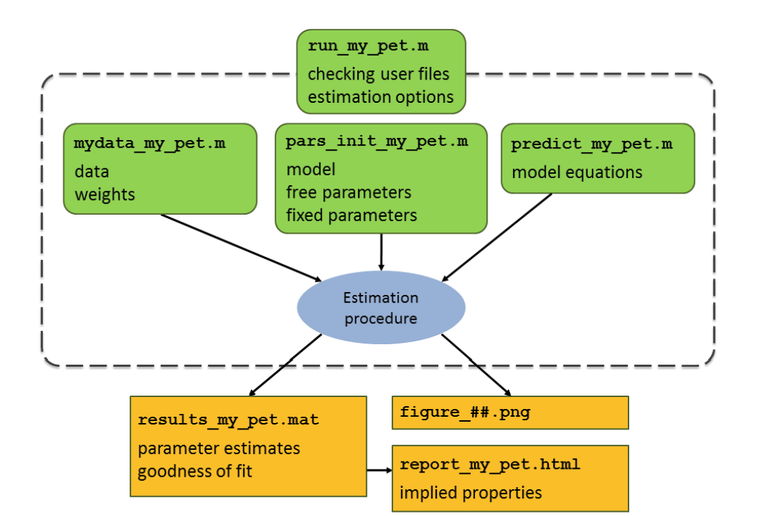
Code structure
Input-Output files
mydata_my_pet
  Sets metaData (classification, eco-codes, links, references etc)
  Sets the data (real data, pseudo data, auxiliary data)
  Sets weight coefficients
predict_my_pet
  Computes the predictions for the data sets in mydata-file given parameter values
pars_init_my_pet
  Sets the model
  Sets the initial parameter values to start the estimation procedure
run_my_pet
  Checks the user's files
  Sets the estimation options
  Runs the estimation procedure
my_pet_res.html
Implied properties
related species
population traits
Notes:
h4 source files

Slide 13
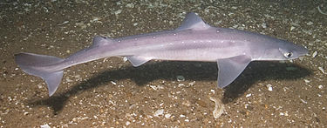
Our pet
British Sea Fishing
Phylum: | Chordata
Class: | Chondrichthyes
Order: | Squaliformes
Family: | Squalidae
Scientific name: | Squalus acanthias
English name: | Spurdog

Slide 14
Data for Squalus acanthias
code | value | unit | label | temp ºC | bibkey*
ab | 690 | d | age at birth | 9 | JoneGeen1977
tp | 2190 | d | time since birth at puberty | 9 | Avsa2001
am | 29200 | d | life span | 9 | Steh2007
Lb | 24 | cm | total length at birth | - | JoneGeen1977
Lp | 72 | cm | total length at puberty | - | Avsa2001
Li | 136 | cm | ultimate total length | - | Avsa2001
Ww0 | 35 | g | wet weight at start (egg) | - | YigiIsme2013
Wwp | 950 | g | wet weight at puberty | - | Avsa2001
Wwi | 9900 | g | ultimate wet weight | - | Avsa2001
Ri | 0.019 | #/d | maximum reprod rate | 9 | Avsa2001
* Full citation in the appendix

Slide 15
ecoCodes
climate | MB, MC | subtropical: average surface temp (SST) >15 °C, < 25 °C temperate: average surface temp (SST) >5 °C, < 15 °C
ecozone | MAN, MAm, MAS | Atlantic ocean, N; Mediterranean Sea; Atlantic ocean, S
habitat | 0iMcd | marine coastal demersal
embryo | Mv | (ovo)viviparous, born in marine water
migrate | Mo | oceanodromous: live and migrate wholly in the sea
food | biCi, biCvf | living invertebrates (Ci) and living vertebrates (Cvf) from birth to ultimate size (bi)
gender | D | dioecy (either male or female, also called gonochoric)
reprod | O | homogamy (no alternating generations, fertilisation obligatory)
Read and watch the video about ecoCodes AmP Ecology coding

Slide 16
AmP entry prepare system
The AmPeps writes the 4-source files
if the species exists in AmP collection
  it loads the files from the web which can be post-edited
if the species does not exist in AmP collection
  it searches the CoL for the nomenclature and classification
  if it cannot be found in CoL you can proceed with hand-filling

Slide 17
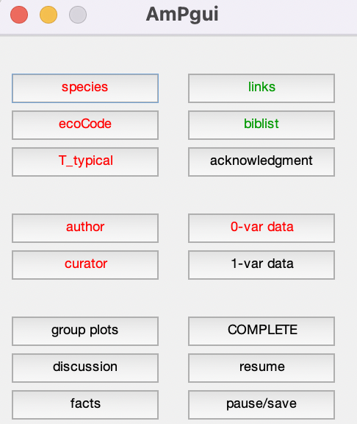

Work on the AmPeps¹
Follow the steps:
    Create an empty folder
    cd in Matlab to that folder
    type AmPeps in the Matlab command window
    Click on “species” in the AmPgui

Slide 18
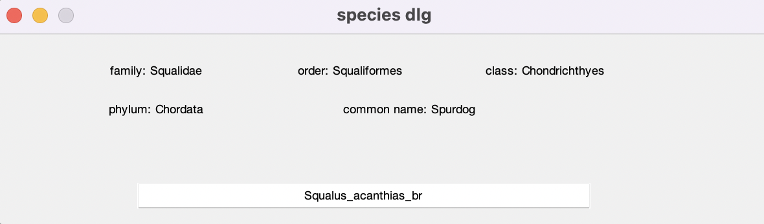
Work on the AmPeps²
Follow the steps:
    In the “species dlg” give the name Squalus_acanthias_br
      Note: Squalus acanthias is in AmP collection
      Squalus_acanthias_br does not exist in CoL
    Proceed with hand-filling the classification (click on “OK”)
    Continue with filling the rest of information (click on “OK”)

Slide 19
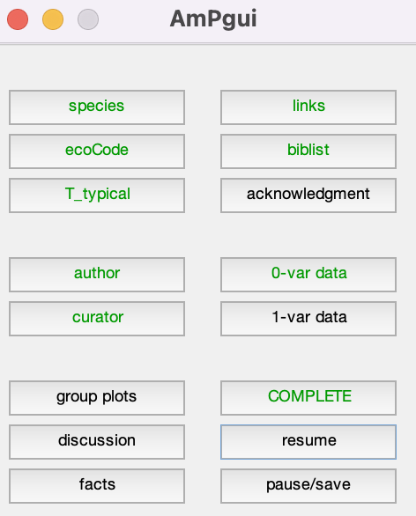
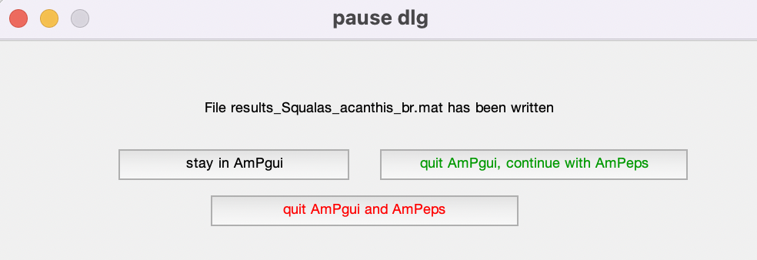
Work on the AmPeps³
Fill in the ecoCodes, T_typical, author, curator, 0-var data, biblist …
Click on “pause/save” in the AmPgui
Click on “quit AmPgui, continue with AmPeps” in the pause dlg

Slide 20
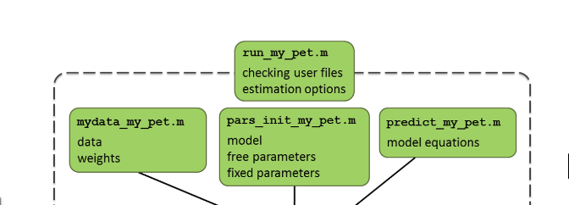
AmPeps-create the 4-source files
15 min

Slide 21
run-file
Set estimation options and run the estimation procedure
close all;
global pets
pets = {'Squalus_acanthias'};
check_my_pet(pets);
estim_options('default');
estim_options('max_step_number', 5e2);
estim_options('max_fun_evals', 5e3);
estim_options('pars_init_method', 2);
estim_options('results_output', 3);
estim_options('method', 'no’);
estim_pars;
my_pet_res.html
Implied properties
related species
population traits

Slide 22
run-file
Different options to get initial parameter values for parameter
estimation, specified with
estim_option('pars_init_method', n)
where
n=1 - read initial estimates from .mat file (for continuation)
n=2 - read initial estimates from pars_init-file (default)
With the DEBtool function mat2pars_init you can copy the values from the results_my_pet.mat file to pars_init_my_pet.m

Slide 23
run-file
Many options to output the results
estim_option('results_output', n)
n | Description
0 | only saves data to .mat (no printing to html or screen and no figures) - use this for (automatic) continuations
1, -1 | no saving to .mat file, prints results to html (1) or screen (-1), shows figures but does not save them
2, -2 | saves to .mat file, prints results to html (2) or screen (-2), shows figures but does not save them
3, -3 | like 2 (or -2), but also prints graphs to .png files (default is 3)
4, -4 | like 3 (or -3), but also prints html with implied traits
5, -5 | like 4 (or -4), but includes related species in the implied traits
6 | like 5, but also prints html with population traits

Slide 24
Estimation
Activate the estimation method
    estim_options('method', 'nm');
Save results in .mat file by setting
estim_options('results_output’, 2 or -2);
Run
run_my_pet

Slide 25
Estimation
>> run_Squalus_acanthias
step 1 ssq 1.339-1.604 initial
step 10 ssq 1.2488-1.3711 reflect
step 20 ssq 1.0901-1.2488 reflect
step 30 ssq 0.99753-1.1191 reflect
step 40 ssq 0.82861-1.022 expand
.
.
step 440 ssq 0.11305-0.11312 reflect
step 450 ssq 0.11295-0.11308 expand
step 460 ssq 0.11295-0.11304 reflect
step 470 ssq 0.11288-0.11296 reflect
step 480 ssq 0.11281-0.11291 expand
step 490 ssq 0.11245-0.11276 reflect
step 500 ssq 0.11219-0.11255 expand
No convergences with 500 steps
min value of loss function
max value of loss function

Slide 26
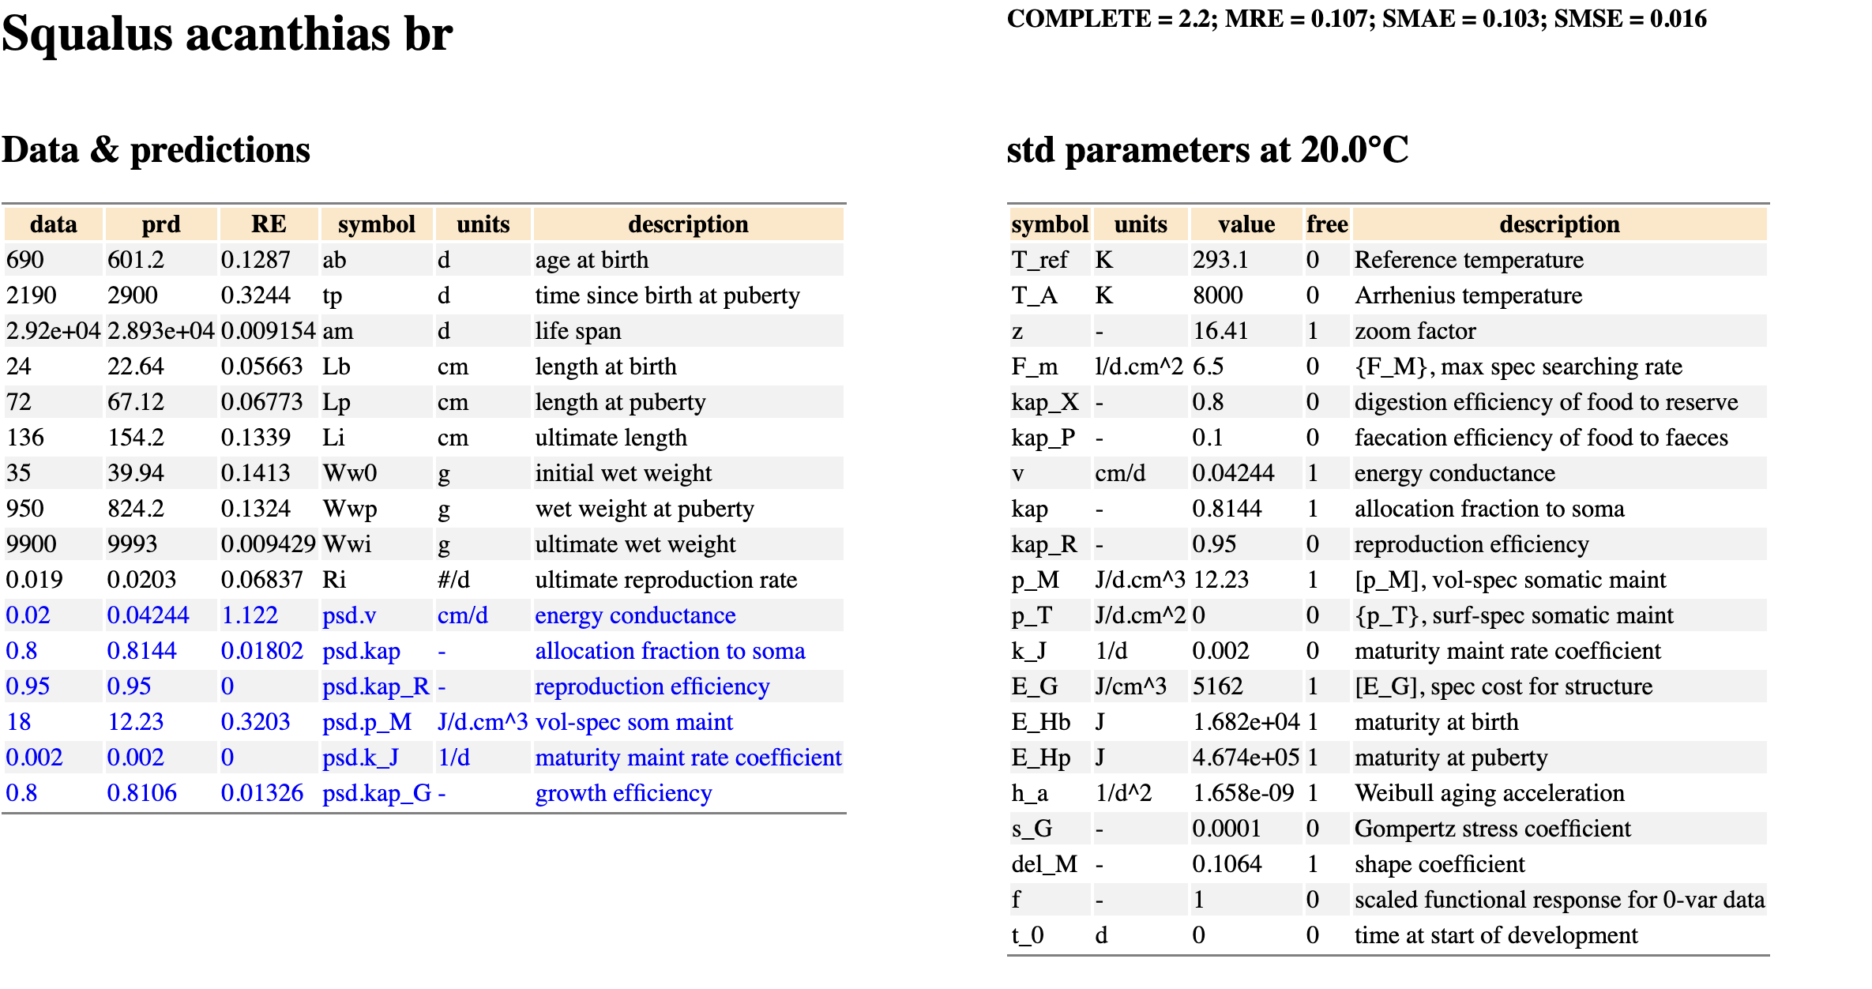
my_pet_res.html report

Slide 27
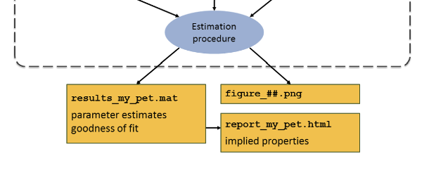
Estimation – “1 continuation”
Continue the estimation procedure;
read parameter values from the .mat file by setting
estim_options('pars_init_method', 1);
my_pet_res.html
Implied properties
related species
population traits
5 min
Notes:
Compare the html files

Slide 28
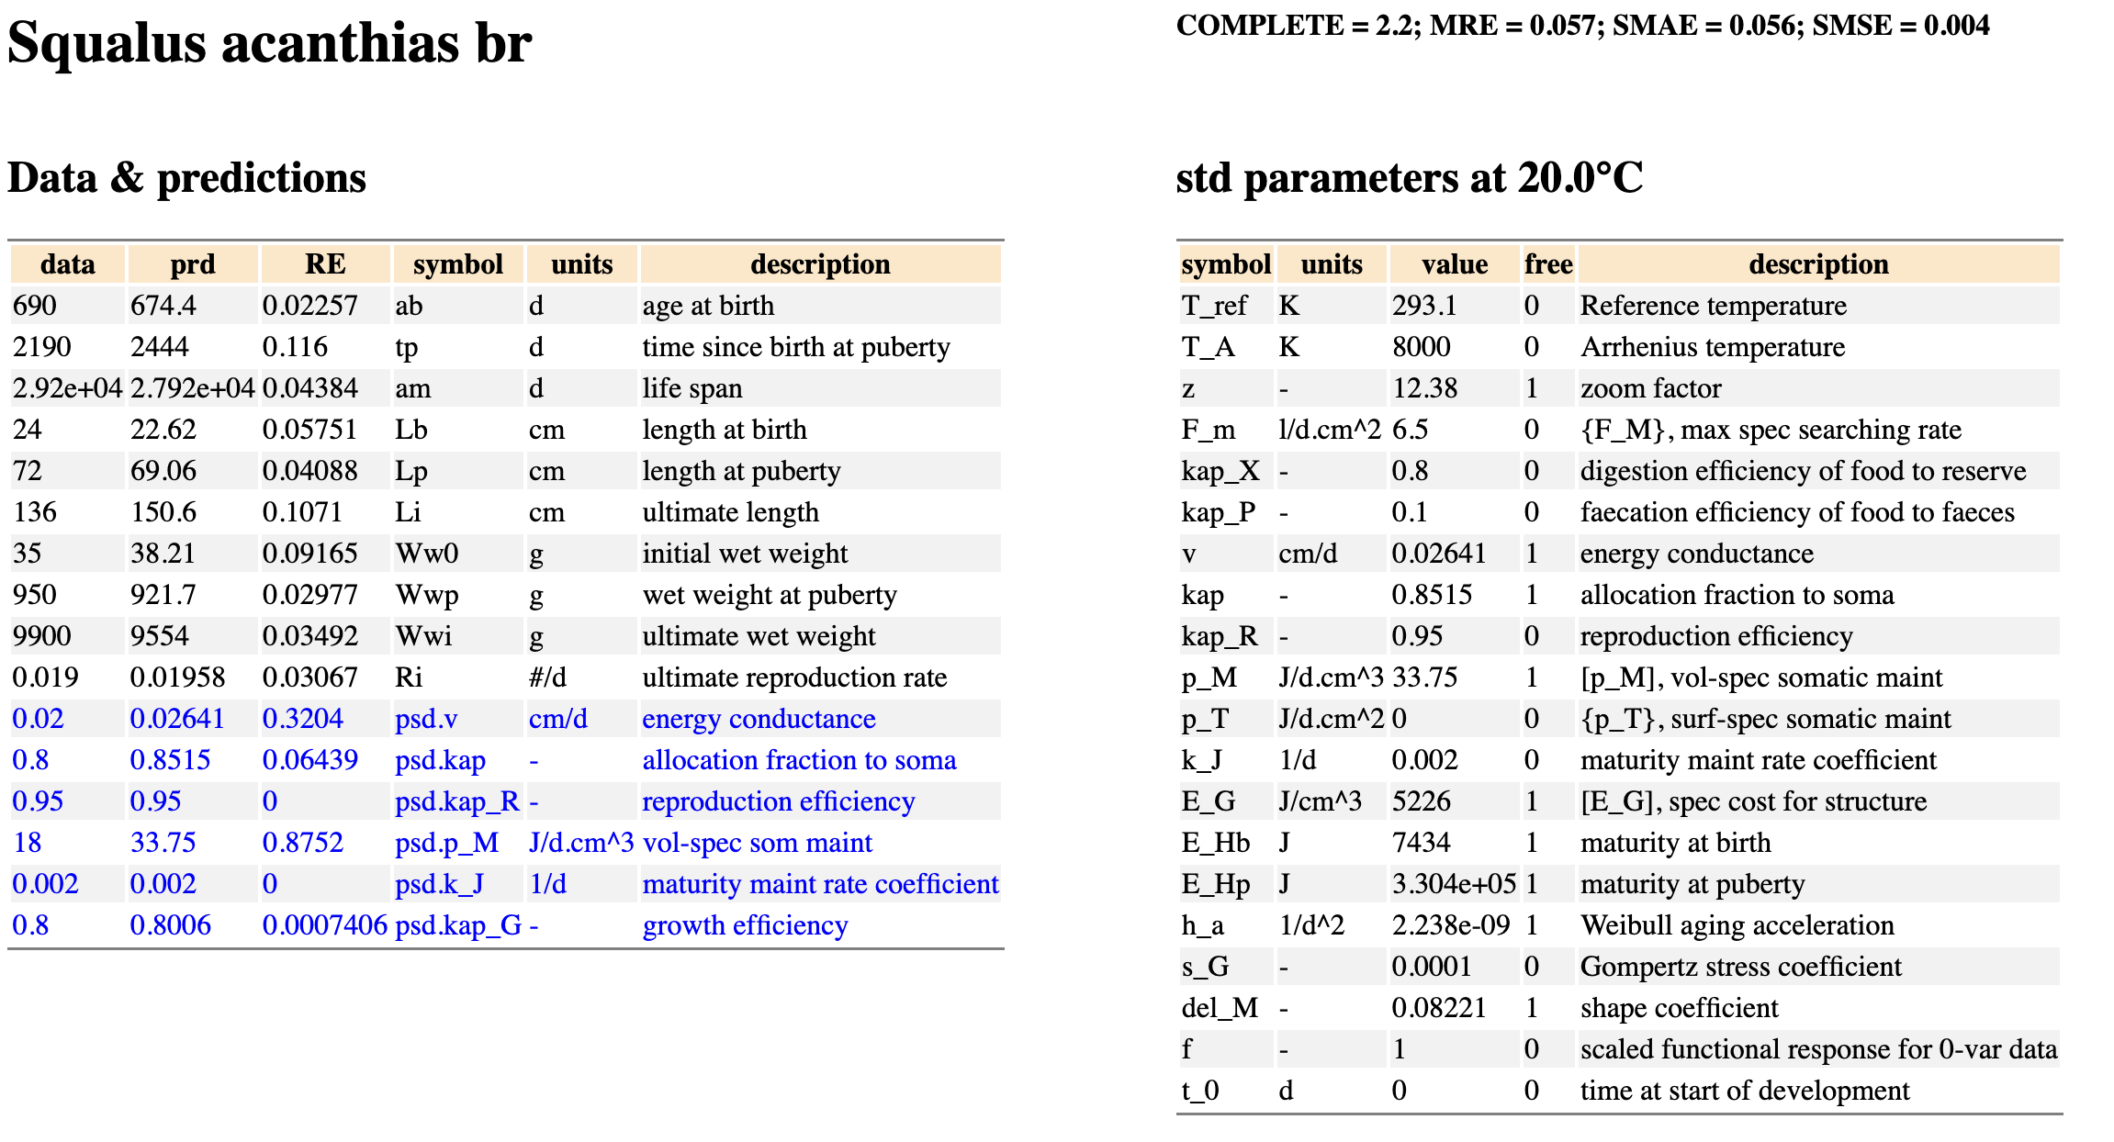
my_pet_res.html report
Results after 1 continuation

Slide 29
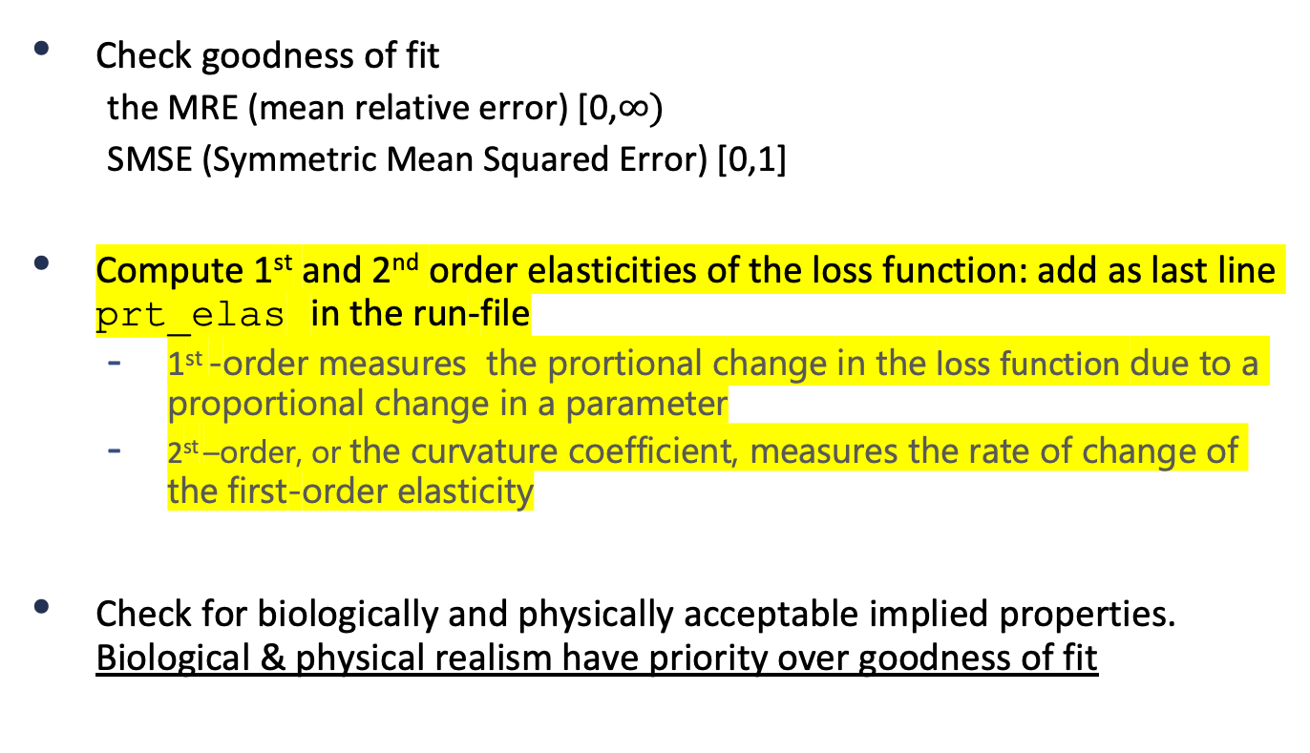
After estimation…¹
Check goodness of fit
  the MRE (mean relative error) [0,$∞)$
  SMSE (Symmetric Mean Squared Error) [0,1]
Compute 1st and 2nd order elasticities of the loss function: add as last line prt_elas in the run-file
  1st -order measures the prortional change in the loss function due to a proportional change in a parameter
  2st –order, or the curvature coefficient, measures the rate of change of the first-order elasticity
Check for biologically and physically acceptable implied properties. Biological & physical realism have priority over goodness of fit

Slide 30
After estimation…²
  Overwriting the pars_init-file
  With the DEBtool function mat2pars_init you can copy the values
  from the results_my_pet.mat file to pars_init_my_pet.m
Compute implied properties to judge credibility and consistency for the resulting parameter combination
Run with estim_options('results’, 4 or -4);
Compare parameters and implied properties with those of related species
  Run with estim_options('results’, 5 or -5);

Slide 31
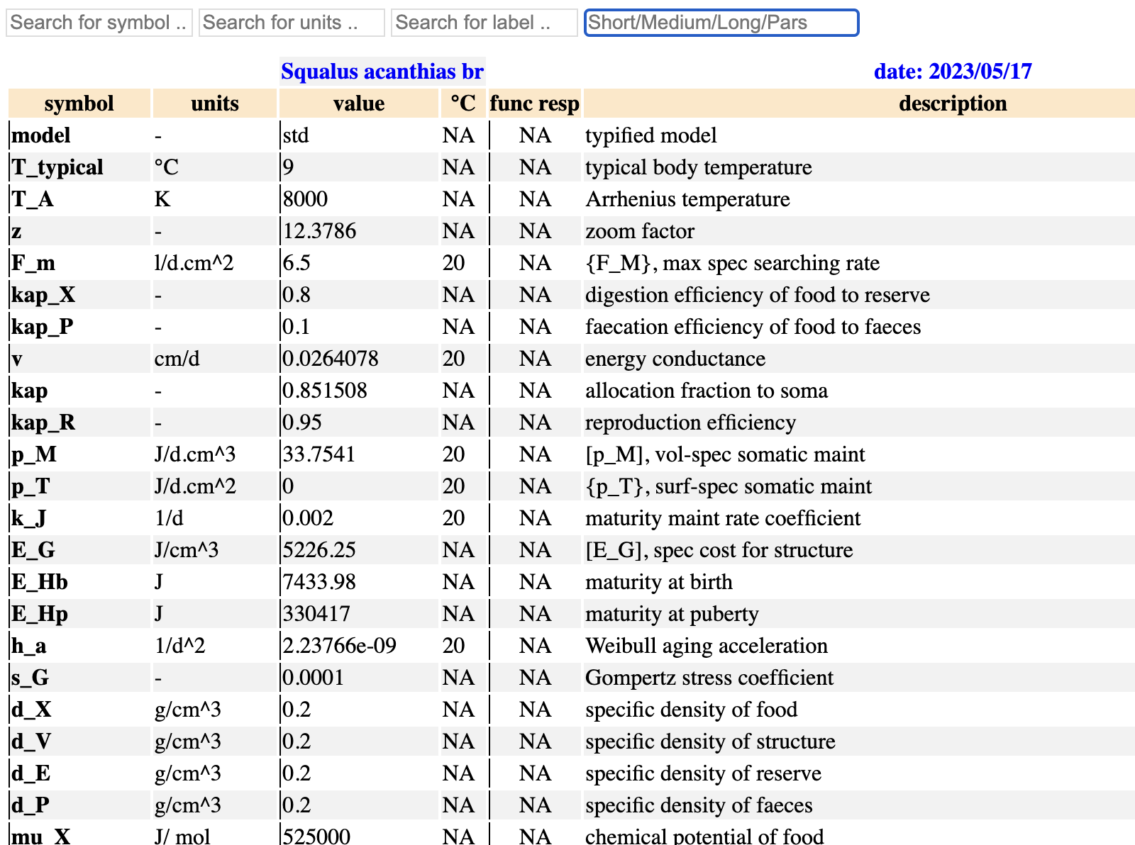
my_pet_res.html report
estim_options('results’, 4 or -4)

Slide 32
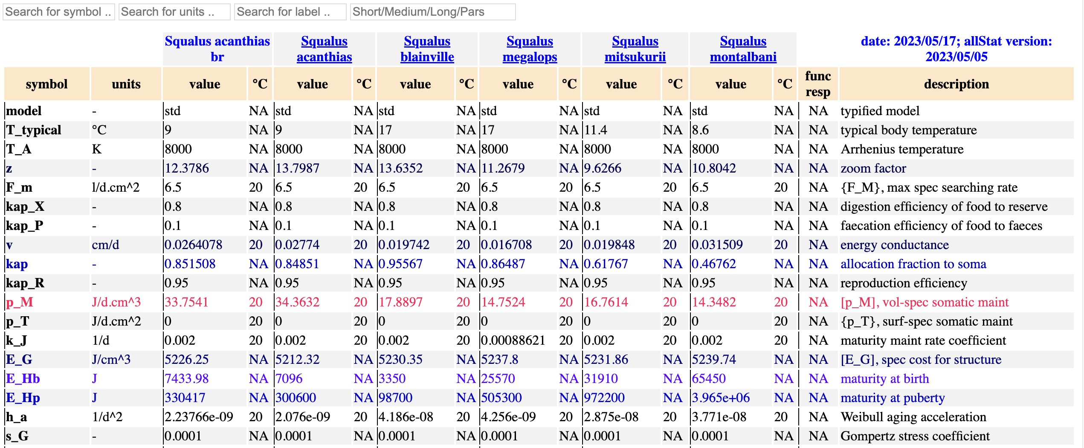
my_pet_res.html report
estim_options('results’, 5 or -5)

Slide 33
Add a uni-variate dataset
Follow the steps:
    In your working folder type AmPeps in the Matlab command window
    Click on “resume” in the AmPgui
    Add the 1-var data
    Redo estimation
    Check changes in the goodness of fit
2nd
1st

Slide 34
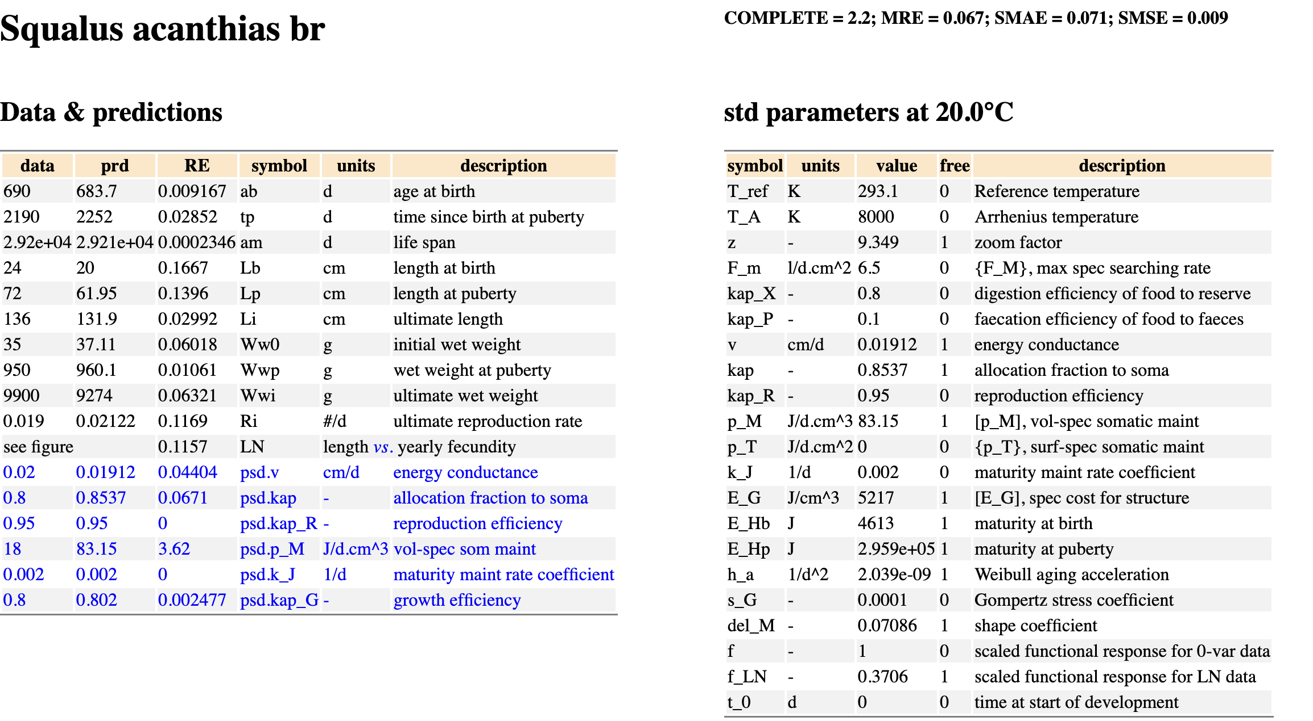
my_pet_res.html report
Results after 3 continuations

Slide 35
Appendix
References for Squalus acanthias
[Avsar2001] D. Avsar. 2001. Age, Growth, Reproduction and Feeding of the Spurdog (Squalus acanthias Linnaeus, 1758) in the South-eastern Black Sea Estuarine, Coastal and Shelf. Science, 52: 269-278
[JoneGeen1977 ] Jones, B. C. and Geen, G. H. 1977. Reproduction and Embryonic Development of Spiny Dogfish (Squalus acanthias) in the Strait of Georgia, British Columbia. J Fish Res Board Can, 34: 1286-1292
[Steh2007] L. L. Stehlik. 1972. Spiny Dogfish, Squalus acanthias, Life History and Habitat Characteristics. NOAA Technical Memorandum, NMFS-NE-203
[YigiIsme2013] Yigin, C.C. and Ismen, A. 2013. Reproductive Biology of Spiny Dogfish Squalus acanthias, in the North Aegean Sea. Turkish Journal of Fisheries and Aquatic Sciences, 13:169-177

Slide 36

Thank you for your attention!!!
Dina Lika
lika@uoc.gr
University of Crete
ΠΑΝΕΠΙΣΤΗΜΙΟ ΚΡΗΤΗΣ
UNIVERSITY
OF CRETE

Slide 37
Learning objectives
Understand and apply the concept of fitting multiple models, which share parameters, to multiple data sets, which may differ in dimensions, in a single parameter estimation.
Be able to prepare the 4 AmP source files to do the AmP parameter estimation.
Learn how to configure and customize the options for running the parameter estimation procedure.
Develop skills for evaluating the quality of parameter estimates and model fit by comparing simulated and observed data, assessing goodness-of-fit.

