Slide 1
Synthesizing Units
Gonçalo Marques
goncalo.marques@tecnico.ulisboa .pt
MARETEC, LARSyS, University of Lisbon

Slide 2
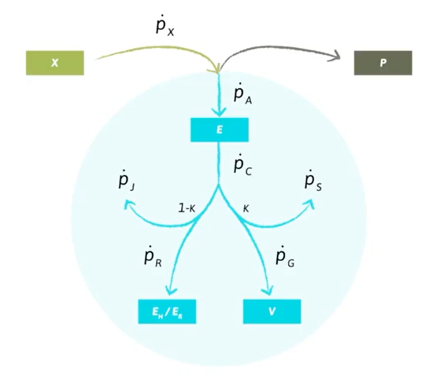
Conservation
- Energy

Slide 3
Conservation
- Energy
- Mass

Slide 4
Conservation
- Energy
- Mass
- Time

Slide 5
What is an SU?
An entity that gets substrate(s) and processes them into product(s)
- Enzyme
- Organism
- Factory

Slide 6
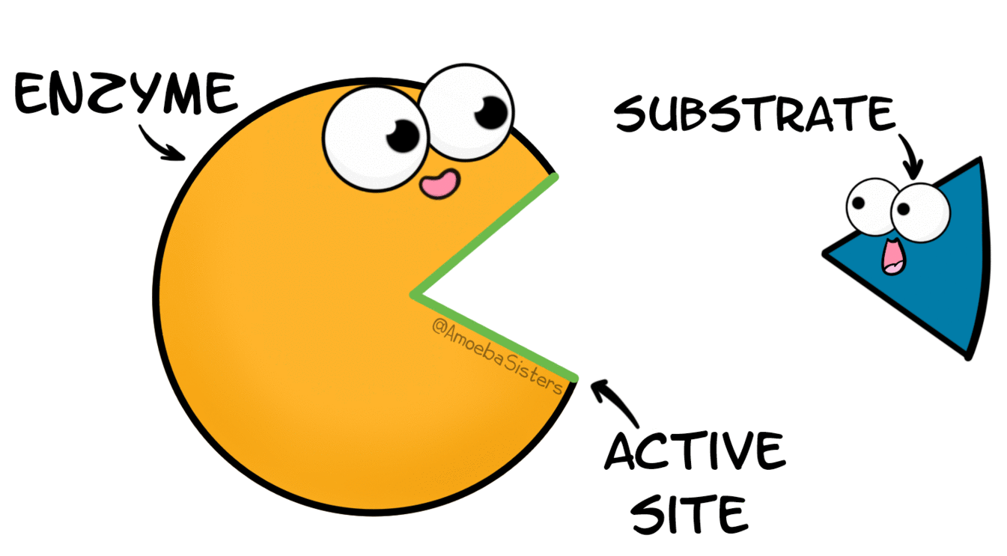
What is an SU?
An entity that gets substrate(s) and processes them into product(s)
Passive

Slide 7
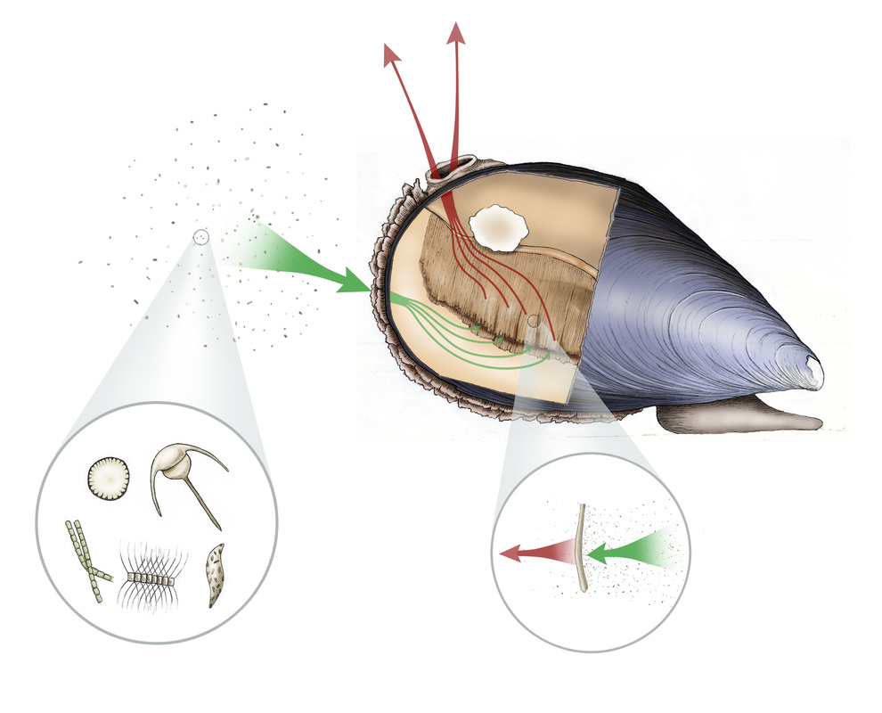
What is an SU?
An entity that gets substrate(s) and processes them into product(s)
Passive
Active

Slide 8
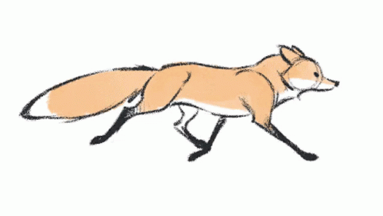
What is an SU?
An entity that gets substrate(s) and processes them into product(s)
Passive
Active

Slide 9
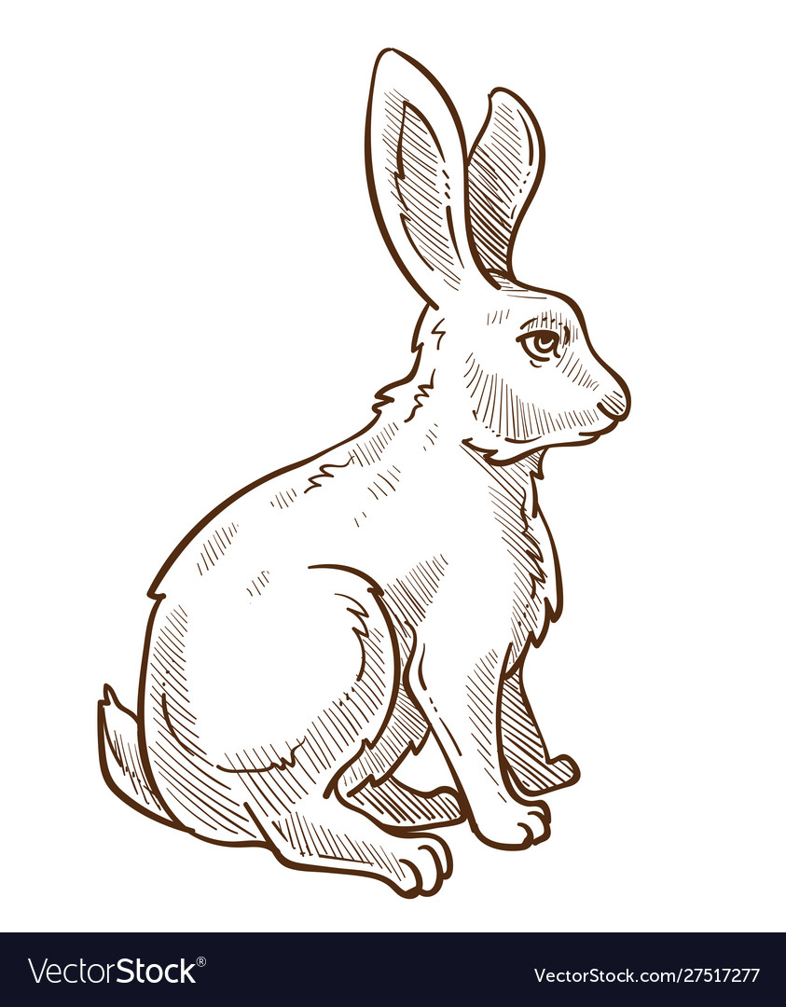
What is an SU?
An entity that gets substrate(s) and processes them into product(s)
Passive
Active

Slide 10
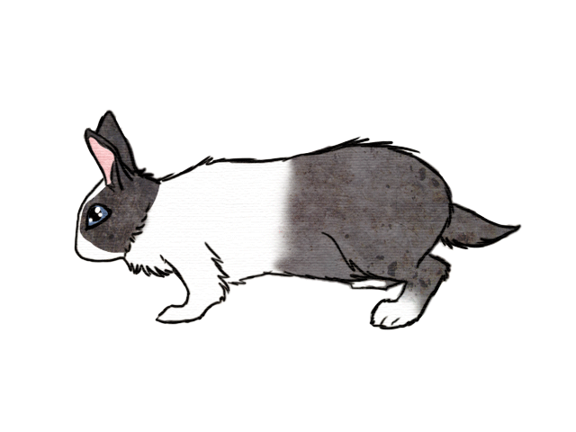
What is an SU?
An entity that gets substrate(s) and processes them into product(s)
Passive
Active

Slide 11
What is an SU?
An entity that gets substrate(s) and processes them into product(s)
Passive
Active

Slide 12
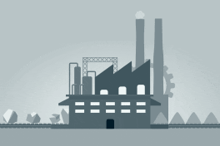
What is an SU?
An entity that gets substrate(s) and processes them into product(s)
Passive
Active
Unconstrained

Slide 13
What is an SU?
An entity that gets substrate(s) and processes them into product(s)
Passive
Handshake protocols
Open
Closed
See section 7.1
Active
Unconstrained

Slide 14
What is an SU?
An entity that gets substrate(s) and processes them into product(s)
Handshake protocols for carriers
Open
Closed
See section 7.1

Slide 15
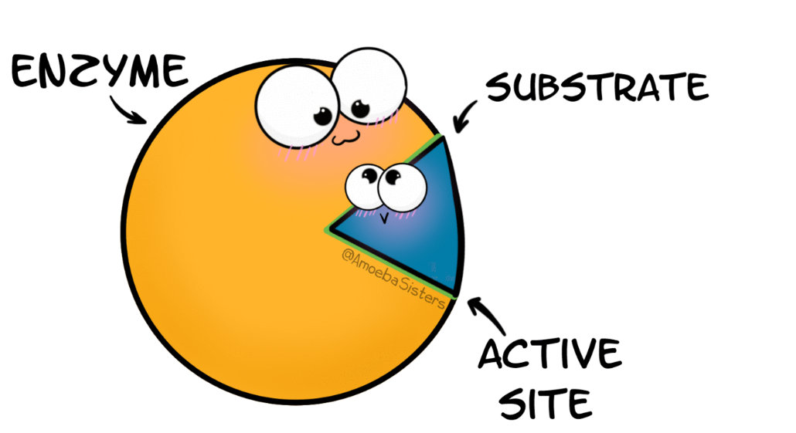
What is an SU?
An entity that gets substrate(s) and processes them into product(s)
binding phase
prossessing phase

Slide 16
One substrate
$$θ_{.}$$
$θ_{.}$ proportion in binding
$$θ_{S}$$
$θ_{S}$ proportion in processing

Slide 17
One substrate
$$θ_{.}$$
$θ_{.}$ proportion in binding
$$θ_{S}$$
$θ_{S}$ proportion in processing
of time of one SU in state
proportion
of number of SUs in state

Slide 18
Examples of SUs

Slide 19
One substrate
$$θ_{.}$$
$θ_{.}$ proportion in binding
$$S$$
$$θ_{S}$$
$$P$$
$θ_{S}$ proportion in processing
of time of one SU in state
proportion
of number of SUs in state

Slide 20
One substrate
$$θ_{.}$$
Conservation
$$S$$
$$θ_{.}+θ_{S}=1$$
$$θ_{S}$$
$$P$$

Slide 21
One substrate
$$θ_{.}$$
Conservation
$$S$$
$$θ_{.}+θ_{S}=1$$
$$θ_{S}$$
$$P$$
$$j_{P}={\left(\frac{1}{\dot{k}}+\frac{1}{\dot{b}S}\right)}^{−1}$$

Slide 22
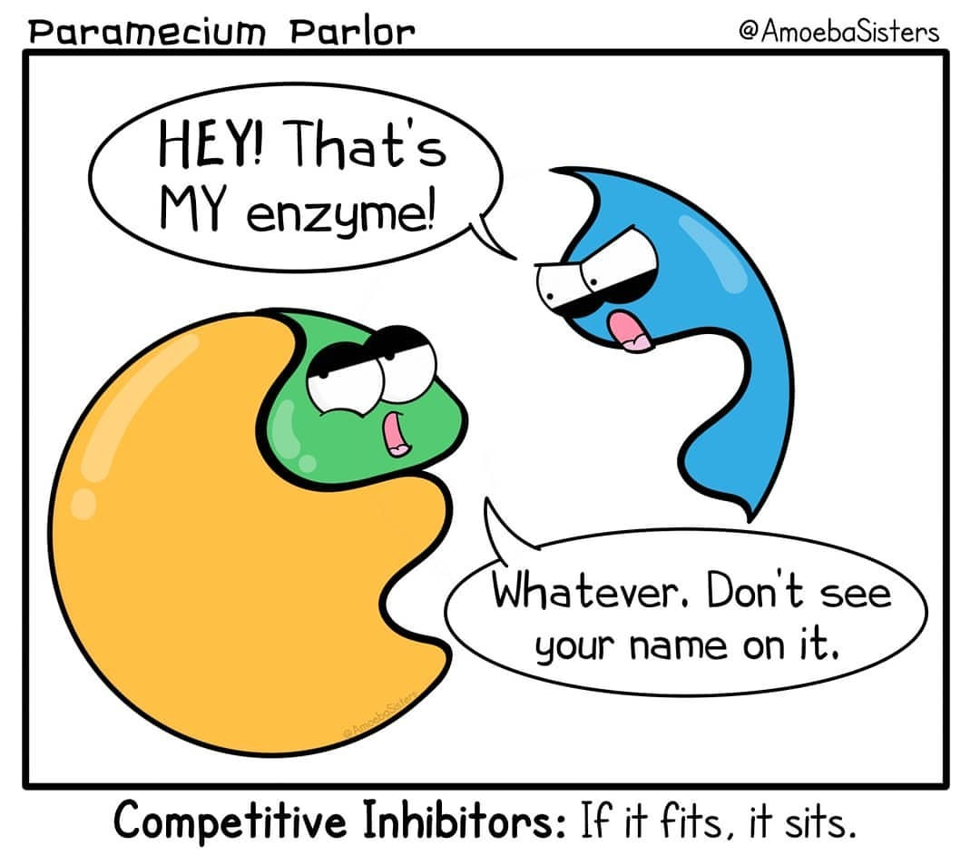
Inhibition example

Slide 23
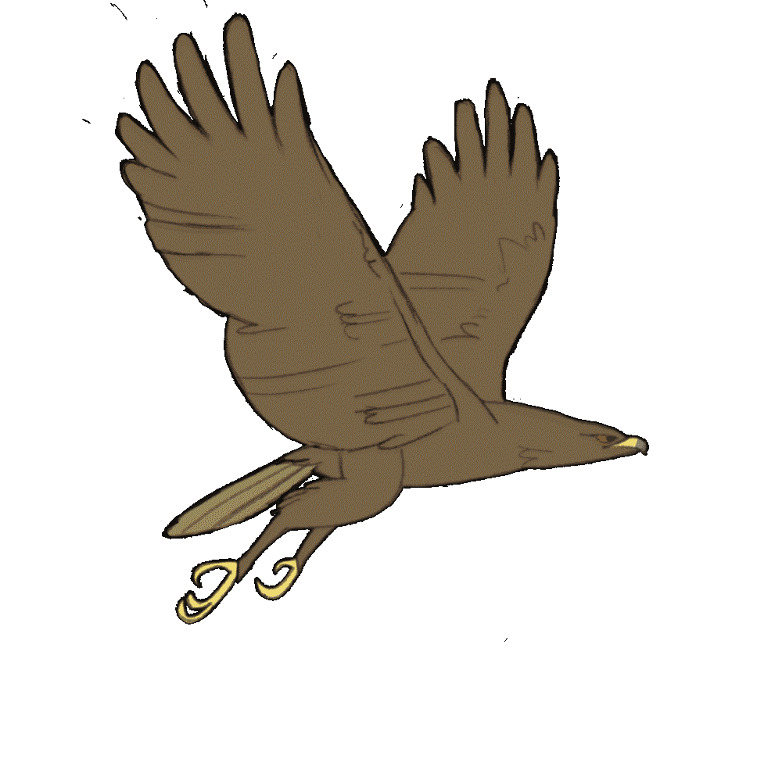
Inhibition example

Slide 24
Inhibition example
$$θ_{.}$$
$$S$$
$$I$$
$$θ_{S}$$
$$I$$
$$θ_{I}$$
$$P$$

Slide 25
Inhibition example
$$\frac{dθ_{.}}{dt}=$$
$$θ_{.}$$
$$\frac{dθ_{S}}{dt}=$$
$$S$$
$$I$$
$$θ_{S}$$
$$I$$
$$θ_{I}$$
$$\frac{dθ_{I}}{dt}=$$
$$P$$

Slide 26
Inhibition example
$$\frac{dθ_{.}}{dt}=−{\dot{b}}_{S}Sθ_{.}$$
$$θ_{.}$$
$$\frac{dθ_{S}}{dt}={\dot{b}}_{S}Sθ_{.}$$
$$S$$
$$I$$
$$θ_{S}$$
$$I$$
$$θ_{I}$$
$$\frac{dθ_{I}}{dt}=$$
$$P$$

Slide 27
Inhibition example
$$\frac{dθ_{.}}{dt}=−{\dot{b}}_{S}Sθ_{.}+{\dot{k}}_{s}θ_{S}$$
$$θ_{.}$$
$$\frac{dθ_{S}}{dt}={\dot{b}}_{S}Sθ_{.}−{\dot{k}}_{s}θ_{S}$$
$$S$$
$$I$$
$$θ_{S}$$
$$I$$
$$θ_{I}$$
$$\frac{dθ_{I}}{dt}=$$
$$P$$

Slide 28
Inhibition example
$$\frac{dθ_{.}}{dt}=−{\dot{b}}_{S}Sθ_{.}+{\dot{k}}_{s}θ_{S}−{\dot{b}}_{I}Iθ_{.}$$
$$θ_{.}$$
$$\frac{dθ_{S}}{dt}={\dot{b}}_{S}Sθ_{.}−{\dot{k}}_{s}θ_{S}$$
$$S$$
$$I$$
$$θ_{S}$$
$$I$$
$$θ_{I}$$
$$\frac{dθ_{I}}{dt}={\dot{b}}_{I}Iθ_{.}$$
$$P$$

Slide 29
Inhibition example
$$\frac{dθ_{.}}{dt}=−{\dot{b}}_{S}Sθ_{.}+{\dot{k}}_{s}θ_{S}−{\dot{b}}_{I}Iθ_{.}+{\dot{k}}_{I}θ_{I}$$
$$θ_{.}$$
$$\frac{dθ_{S}}{dt}={\dot{b}}_{S}Sθ_{.}−{\dot{k}}_{s}θ_{S}$$
$$S$$
$$I$$
$$θ_{S}$$
$$I$$
$$θ_{I}$$
$$\frac{dθ_{I}}{dt}={\dot{b}}_{I}Iθ_{.}−{\dot{k}}_{I}θ_{I}$$
$$P$$

Slide 30
Inhibition example
Fast dynamics assumption
$$0=−{\dot{b}}_{S}Sθ_{.}+{\dot{k}}_{s}θ_{S}−{\dot{b}}_{I}Iθ_{.}+{\dot{k}}_{I}θ_{I}$$
$$θ_{.}$$
$$0={\dot{b}}_{S}Sθ_{.}−{\dot{k}}_{s}θ_{S}$$
$$S$$
$$I$$
$$θ_{S}$$
$$I$$
$$θ_{I}$$
$$P$$
$$0={\dot{b}}_{I}Iθ_{.}−{\dot{k}}_{I}θ_{I}$$

Slide 31
Inhibition example
$$θ_{.}+θ_{S}+θ_{I}=1$$
$$θ_{.}$$
$$0={\dot{b}}_{S}Sθ_{.}−{\dot{k}}_{s}θ_{S}$$
$$S$$
$$I$$
$$θ_{S}$$
$$I$$
$$θ_{I}$$
$$P$$
$$0={\dot{b}}_{I}Iθ_{.}−{\dot{k}}_{I}θ_{I}$$

Slide 32
Inhibition example
$$j_{P}={\dot{k}}_{s}θ_{S}$$
$$θ_{.}$$
$$S$$
$$I$$
$$θ_{S}$$
$$I$$
$$θ_{I}$$
$$P$$

Slide 33
Inhibition example
$$j_{P}={\dot{k}}_{s}θ_{S}={\left(\frac{1}{{\dot{k}}_{s}}+\frac{1}{\dot{b}S}\left(1+\frac{{\dot{b}}_{I}}{{\dot{k}}_{I}}I\right)\right)}^{−1}$$
$$θ_{.}$$
$$S$$
$$I$$
$$I=0$$
$$θ_{S}$$
$$I$$
$$θ_{I}$$
$$j_{P}={\left(\frac{1}{\dot{k}}+\frac{1}{\dot{b}S}\right)}^{−1}$$
$$P$$

Slide 34
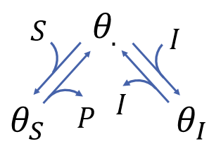
Step-by-step summary
1. Draw the scheme
2. Write the equations
3. Use the fast dynamics assumption
4. Add the conservation constraint
5. Compute the flux
6. Check consistency of the solution

