Slide 1


Remarkable AmP entries
Bas Kooijman, Starrlight Augustine & Dina Lika
salm.kooijman@gmail.com
A-Life, VU University Amsterdam
4036 @ 2023/06/15
Symposium: 15-17 June 2023
Baton Rouge, Louisiana, United States

Slide 2
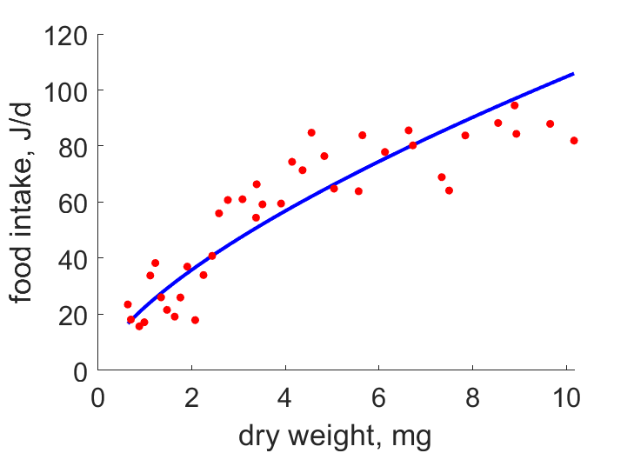
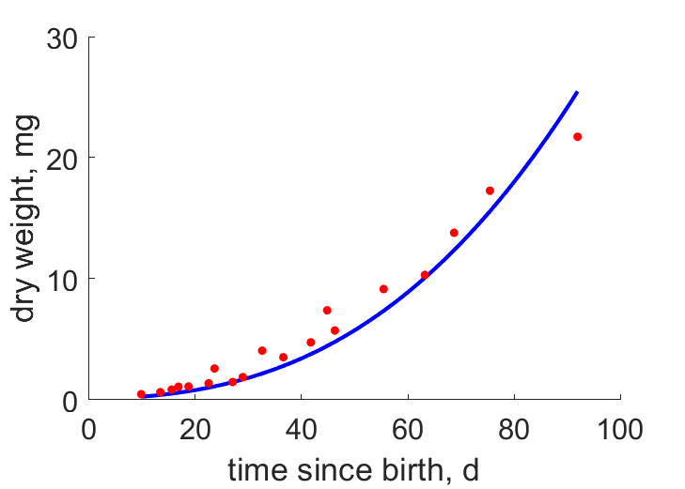
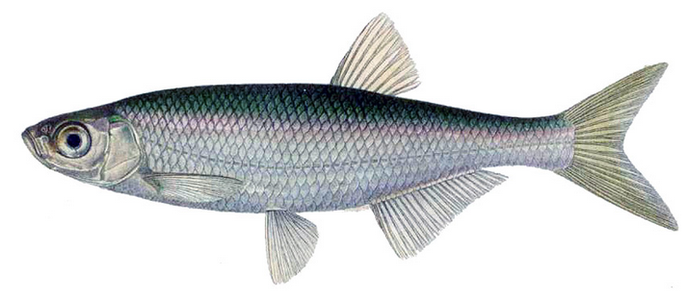
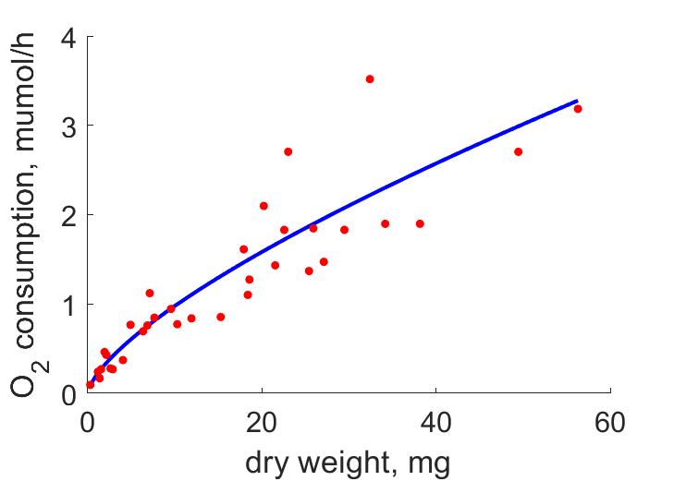
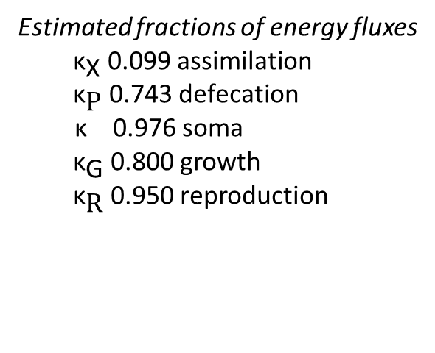
Remarkable
AmP entry
bleak
Alburnus alburnus
Other data
4, 2555 d age at birth, death
9.9, 25 cm length at puberty, max
0.18, 60 mg, g weight at birth, max
19.18 #/d max reproduction rate
Estimated fractions of energy fluxes
${ \text{κ}}_{\text{X}}$ 0.099 assimilation
${ \text{κ}}_{\text{P}}$ 0.743 defecation
κ 0.976 soma
${ \text{κ}}_{\text{G}}$ 0.800 growth
${ \text{κ}}_{\text{R}}$ 0.950 reproduction
Data from
Keckeis & Schiemer (1990)
J . Fish Biol. 36(6):841–851
Notes:
Remarkable: DEB allows to decompose JO into the various contributions, in combination with Wd-JX and t-Wd
Food: Artemia salina, 2400 ind/L.
Wd-JX gives info on kap_X
Wd-JO gives info on kap_P

Slide 3
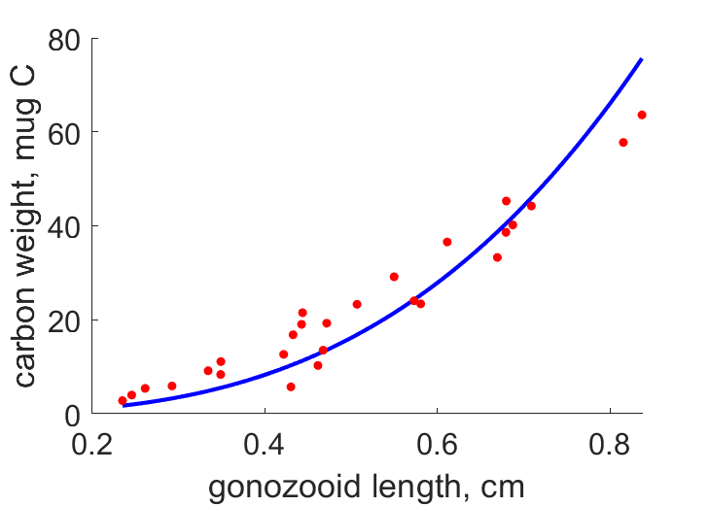
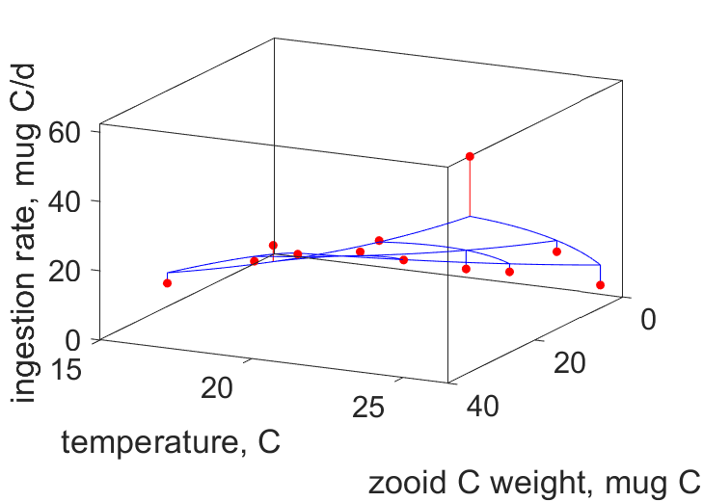
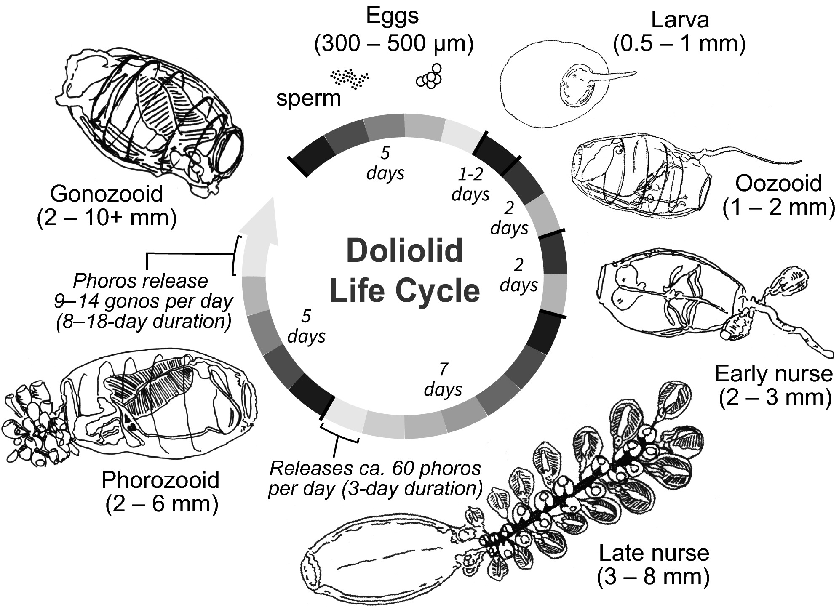
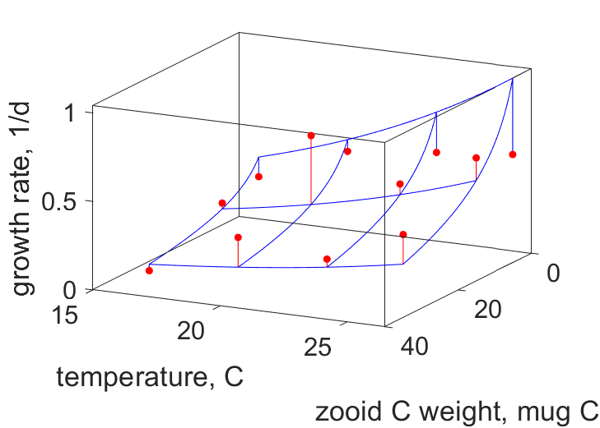
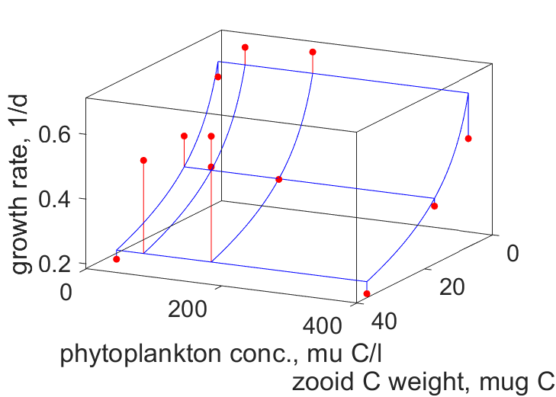
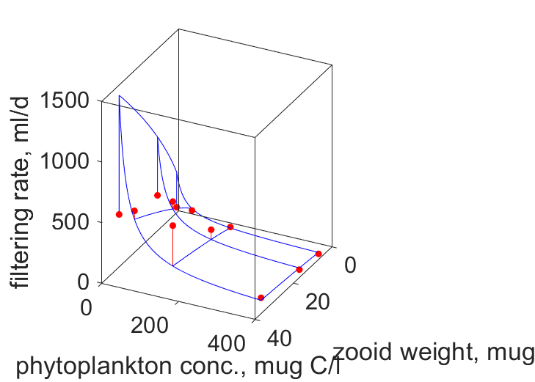
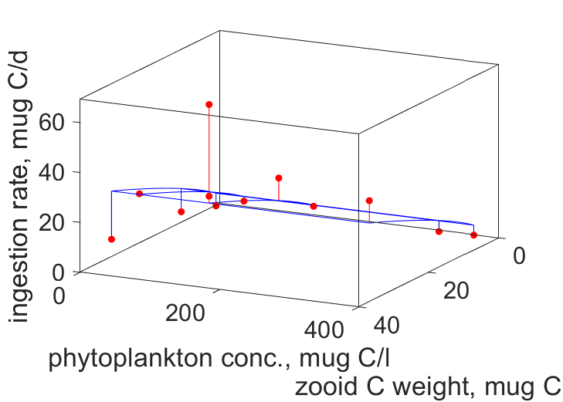
Dolioletta gegenbauri
MRE = 0.231
Data from Gibson & Paffenhöfer
J. Plankton Res. (2000) 22:1485–1500
& (1999) 21: 21:1193–1189
Notes:
Remarkable: DEB allows to link many variables of organisms with complex life cycles
L-Wc, T-r-Wc; X-Wc-F; X-Wc-r; T-Wc-JX

Slide 4
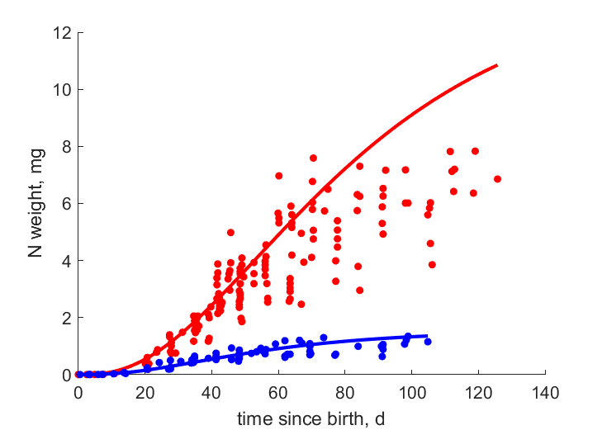
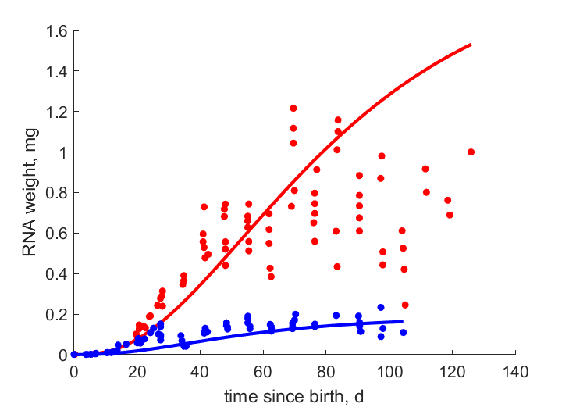
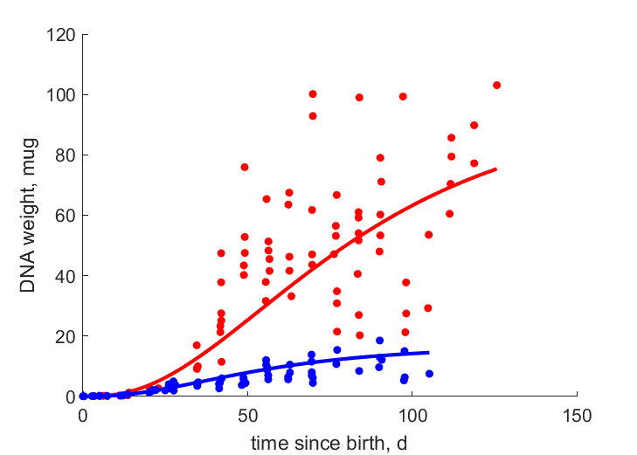
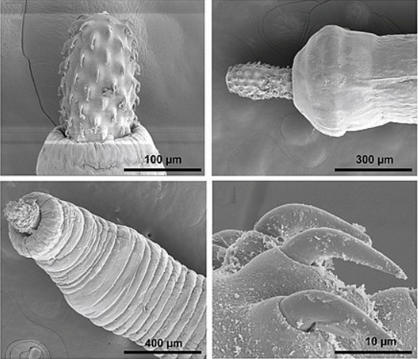
Moniliformis dubius
Data from Crompton 1972
J. Exp. Biol., 56:19--29.
Adults in intestines of rodents or carnivorans
Juveniles in beetles and cockroaches
No digestive tract; causes acanthocephaliasis
Length females 20 cm, males 6 cm
RNA: marker for reserve
Y_{RNA,E} = 0.0157 g/g
DNA: marker for structure
Y_{DNA,V} = 0.0029 g/g
Notes:
Remarkable: Biomarkers exist for reserve and structure, which can be used as proxies for their quantities

Slide 5
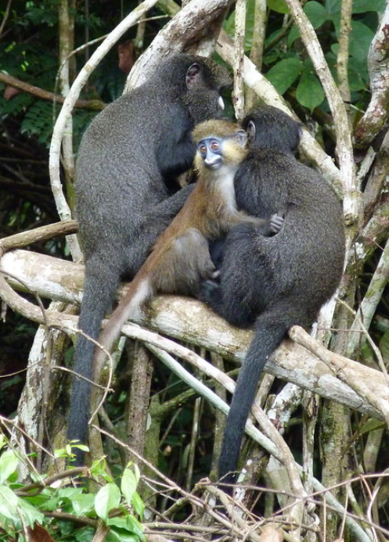
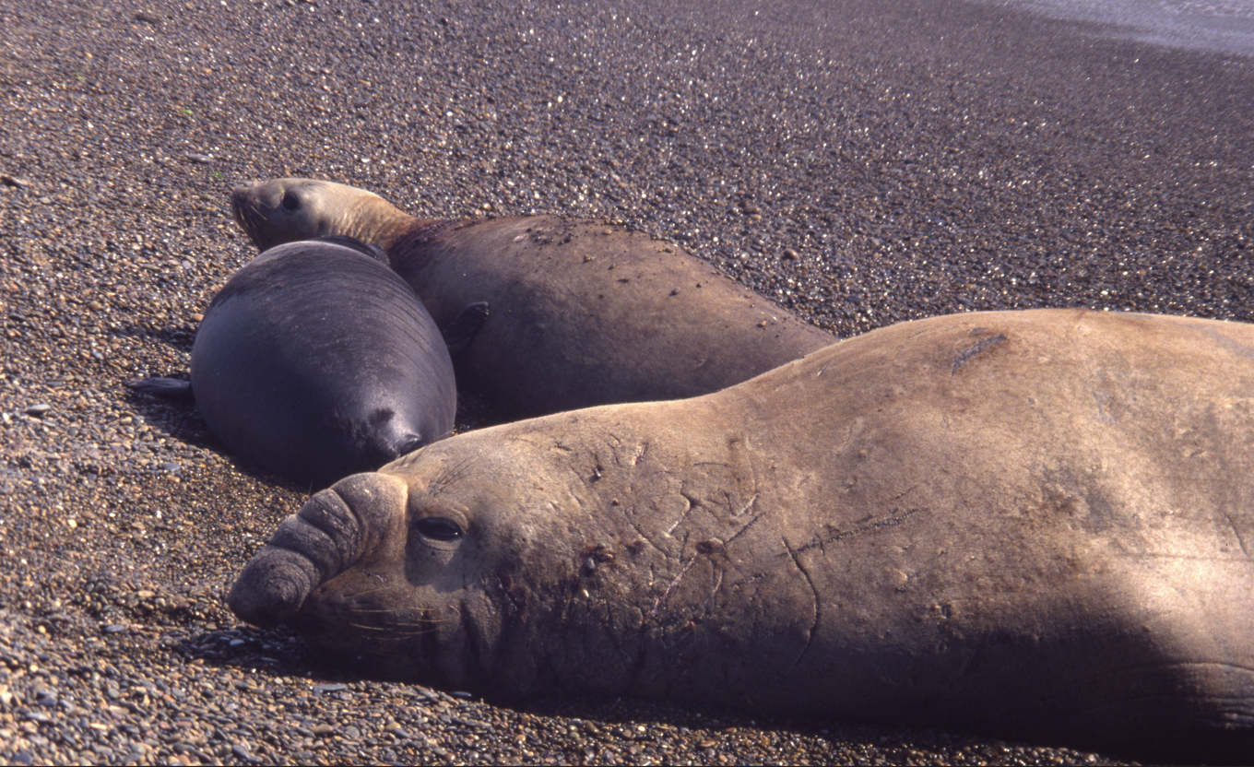
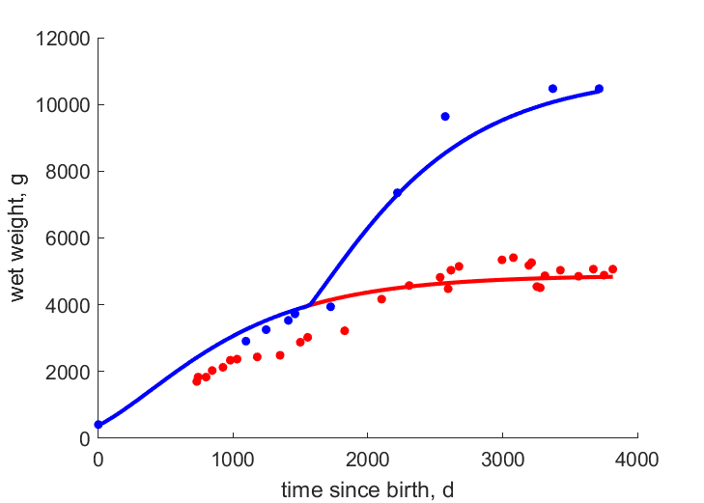
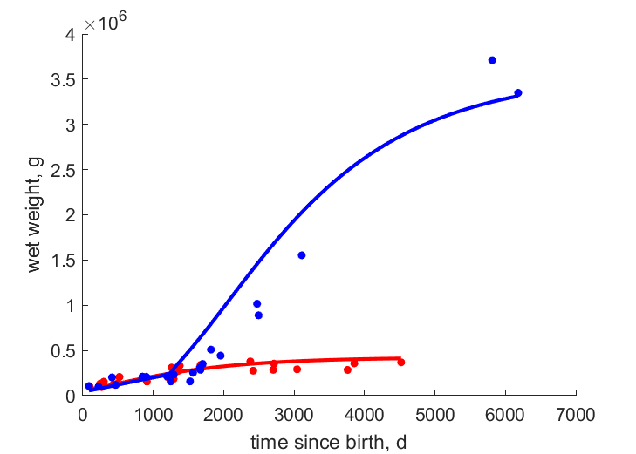
Type A acceleration
Specific assimilation jumps at puberty for males
Photo:
Motsch
Photo: Kooijman
Data from Bryden 1969
Growth, 33:69--82.
Data from Gautier-Hion & Gautier 1976
Folia Primatologica, 26:165–184.
Greater spot-nosed monkey
Cercopithecus nictitans
Southern elephant seal
Mirounga leonina
Notes:
Remarkable: Type A acceleration exists in various mammals

Slide 6
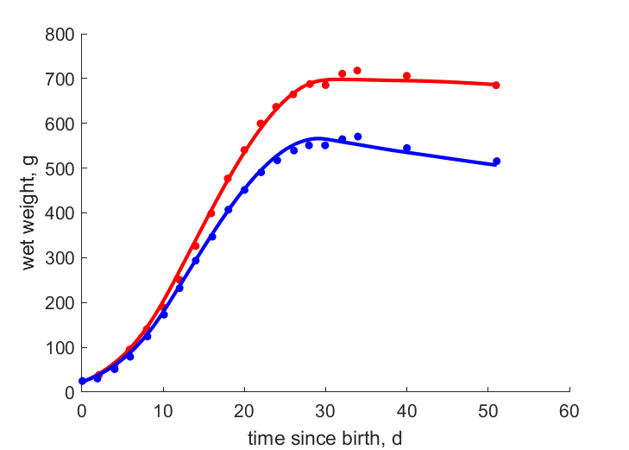
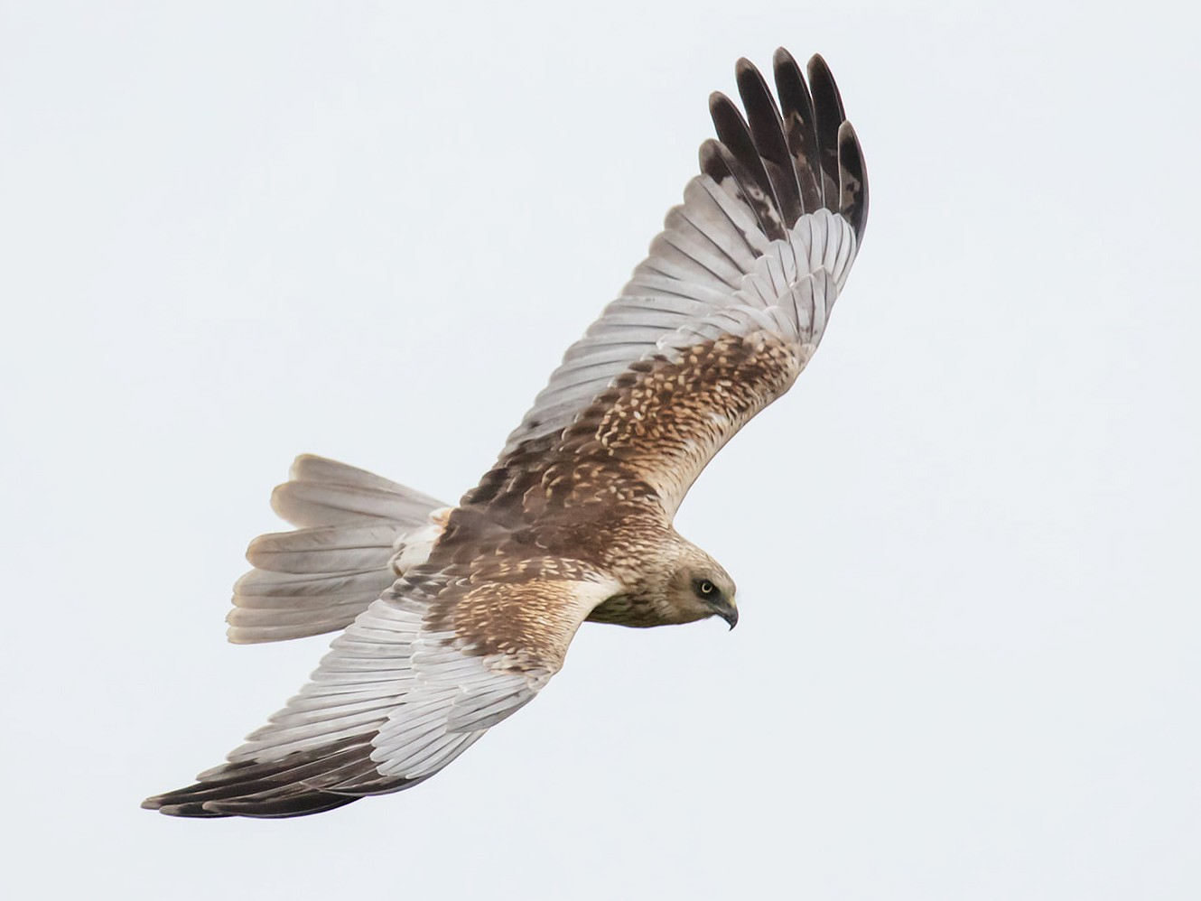
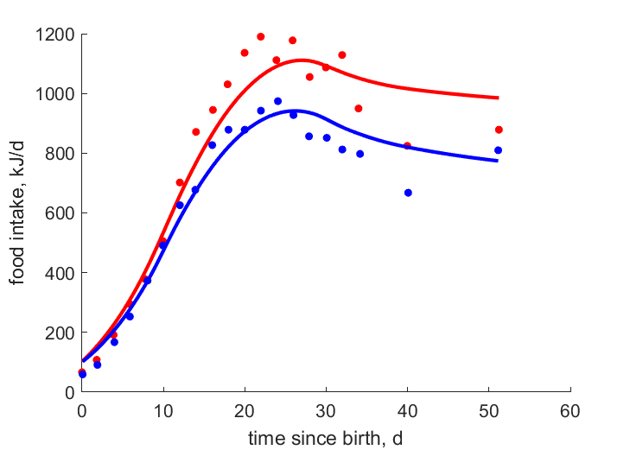
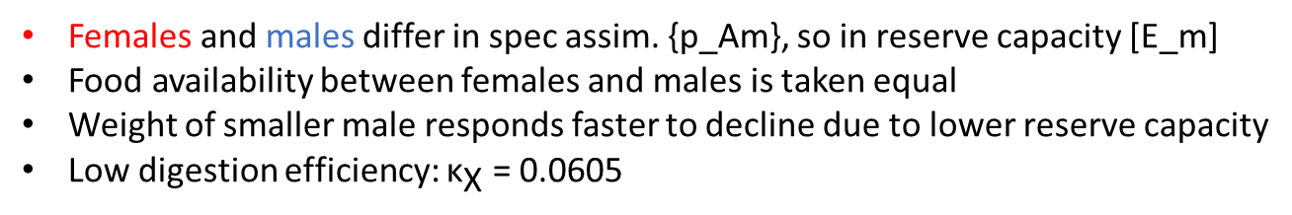
Circus aeruginosus
Western marsh harrier
Data from Krijgsveld et al 1989
Physiol. Zool. 71:693--702
ebird
Females and males differ in spec assim. {p_Am}, so in reserve capacity [E_m]
Food availability between females and males is taken equal
Weight of smaller male responds faster to decline due to lower reserve capacity
Low digestion efficiency: ${\text{κ}}_{\text{X}}$ = 0.0605
Notes:
Remarkable: when food intake varies, the lighter gender follows fluctuations faster

Slide 7
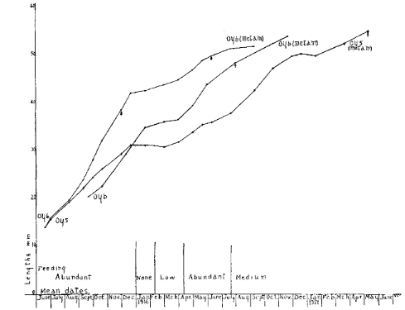
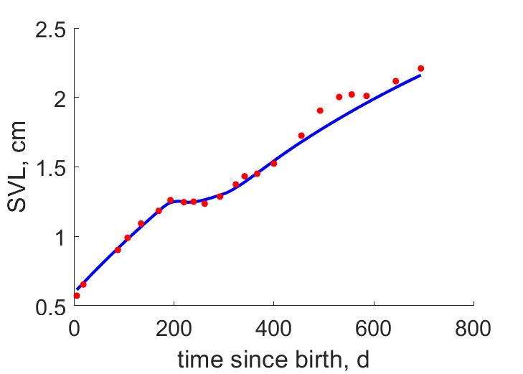
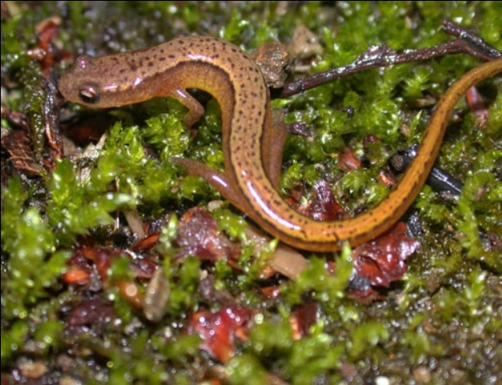
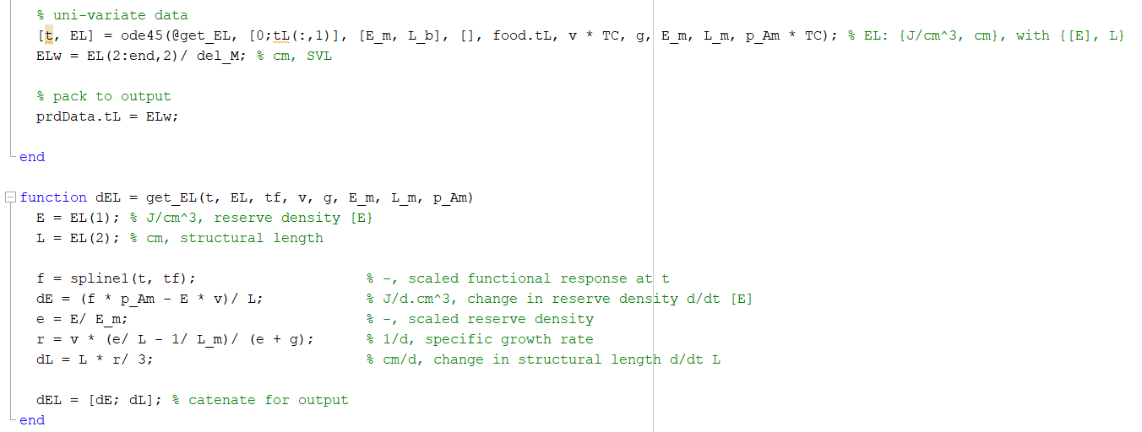
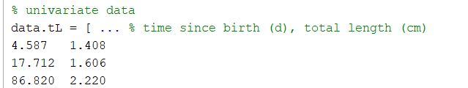
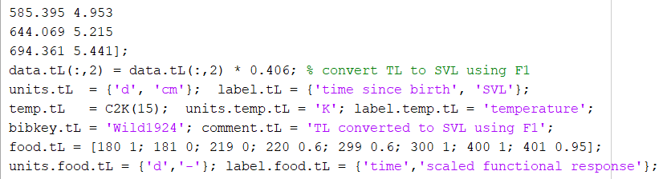
Dynamic food
Eurycea bislineata, Northern two-lined salamander
food data in auxData.food.tL
no food-parameters
Wilders 1924
J. Exp. Zool.
40: 1-112
f=1
f=0
f=.6
f=1
f=.95
predict-file
…
mydata-file
auxData = food;
Notes:
Remarkable: Qualitative info on food availability can be used to evaluate growth trajectories.

Slide 8
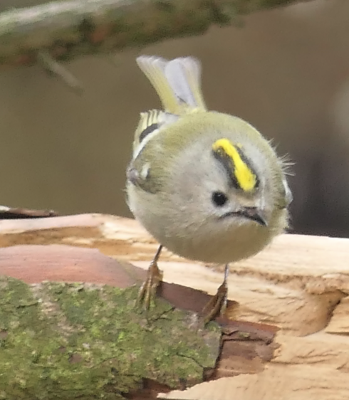
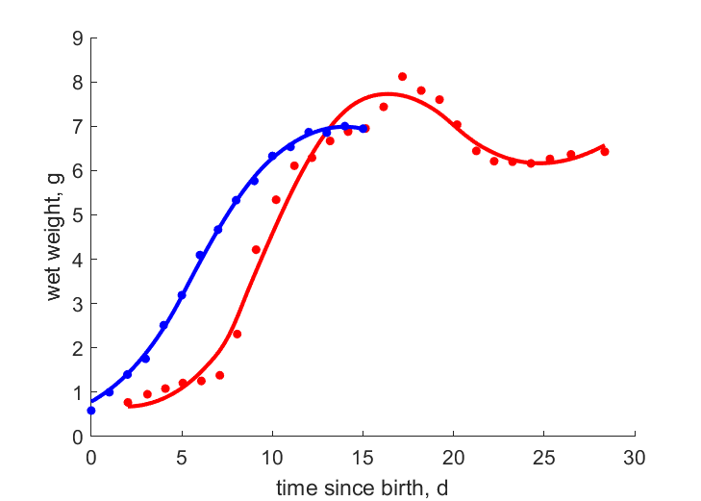
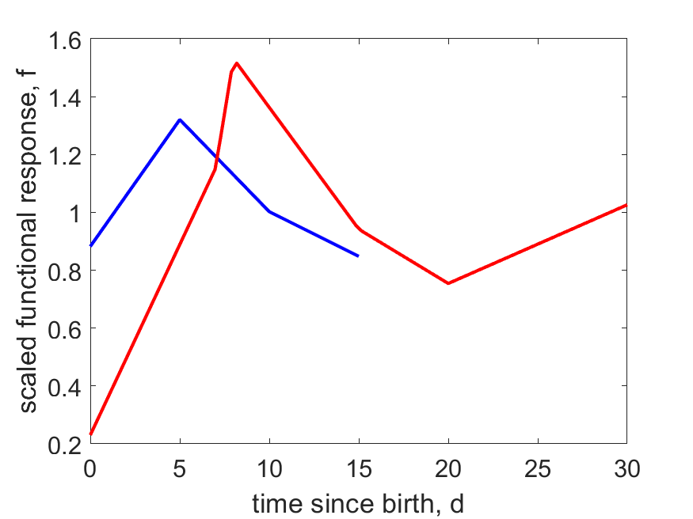
Regulus regulus, goldcrest
Data from
Haftorn 1978 Scand. J. Ornith. 9: 117-123
Thaler 1990 Ziemsen Verlag, Wittenberg Lutherstadt.
Vosges 1971
Notes:
Remakable: These growth curves for the same species show that it makes little sense to look for best fitting curve.
Interactions with the environment cannot be neglected.
Observed growth can be used to reconstruct feeding trajectories.

Slide 9
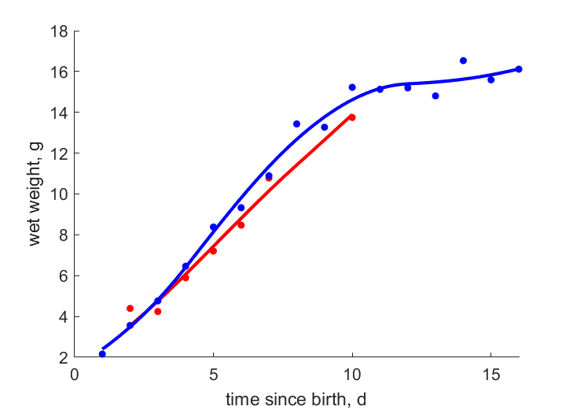
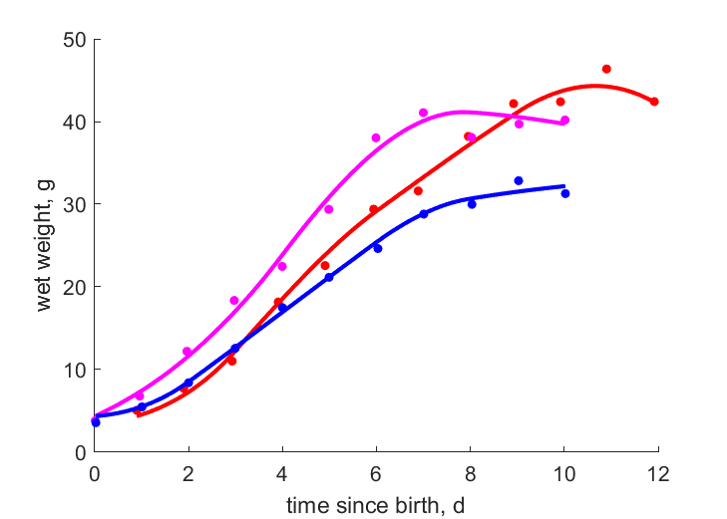
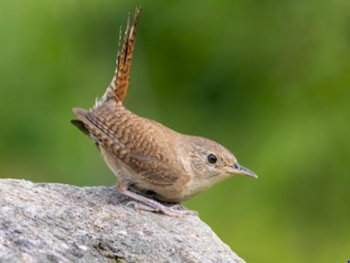
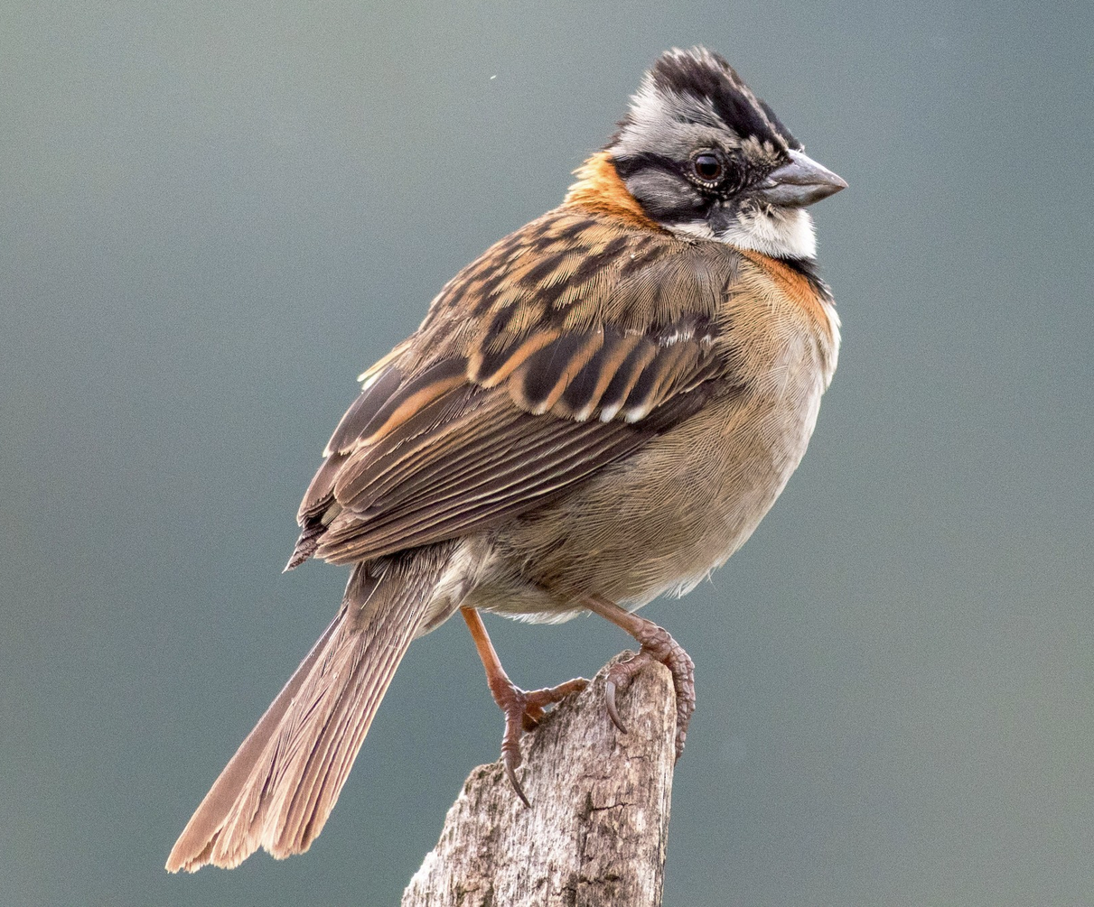
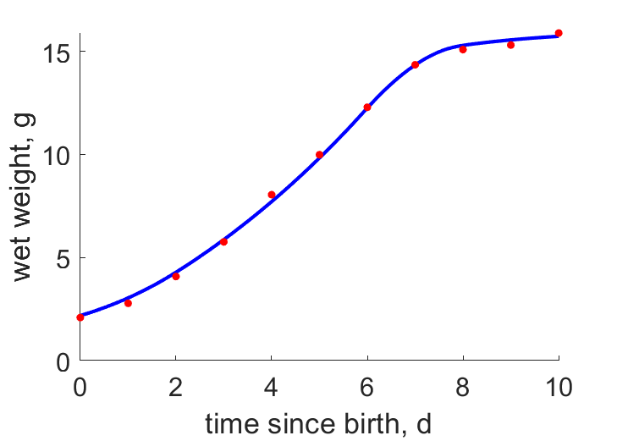
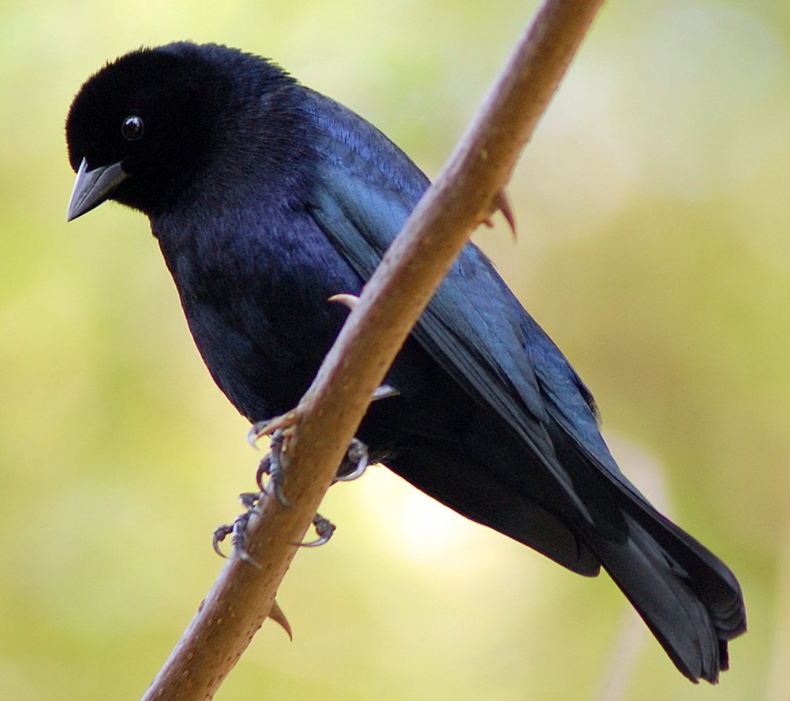
Molothrus bonariensis
Shiny cowbird (brood parasite)
Troglodytes aedon
House wren
Data from
Kattan 1996
J. Field Ornithol.
67:434-441
unparasitized
parasitized
2/nest sparrow
1/nest sparrow
1/nest wren
Zonotrichia capensis
Rufous-collared sparrow
No sparrow chicks survived 2 d
Data from
Kattan 1996 & King 1973
Data from
King 1973 The Auk, 90:19--34
The cowbird nestling hardly affected its wren’s sisters
But leads to starvation in the sparrow’s sisters,
while two of them was nearly too much for the sparrow host.
Notes:
Remarkable: Growth is retarded if 2 cowbirds are in a sparrow’s nest; the wren hardly suffers from the brood parasite

Slide 10
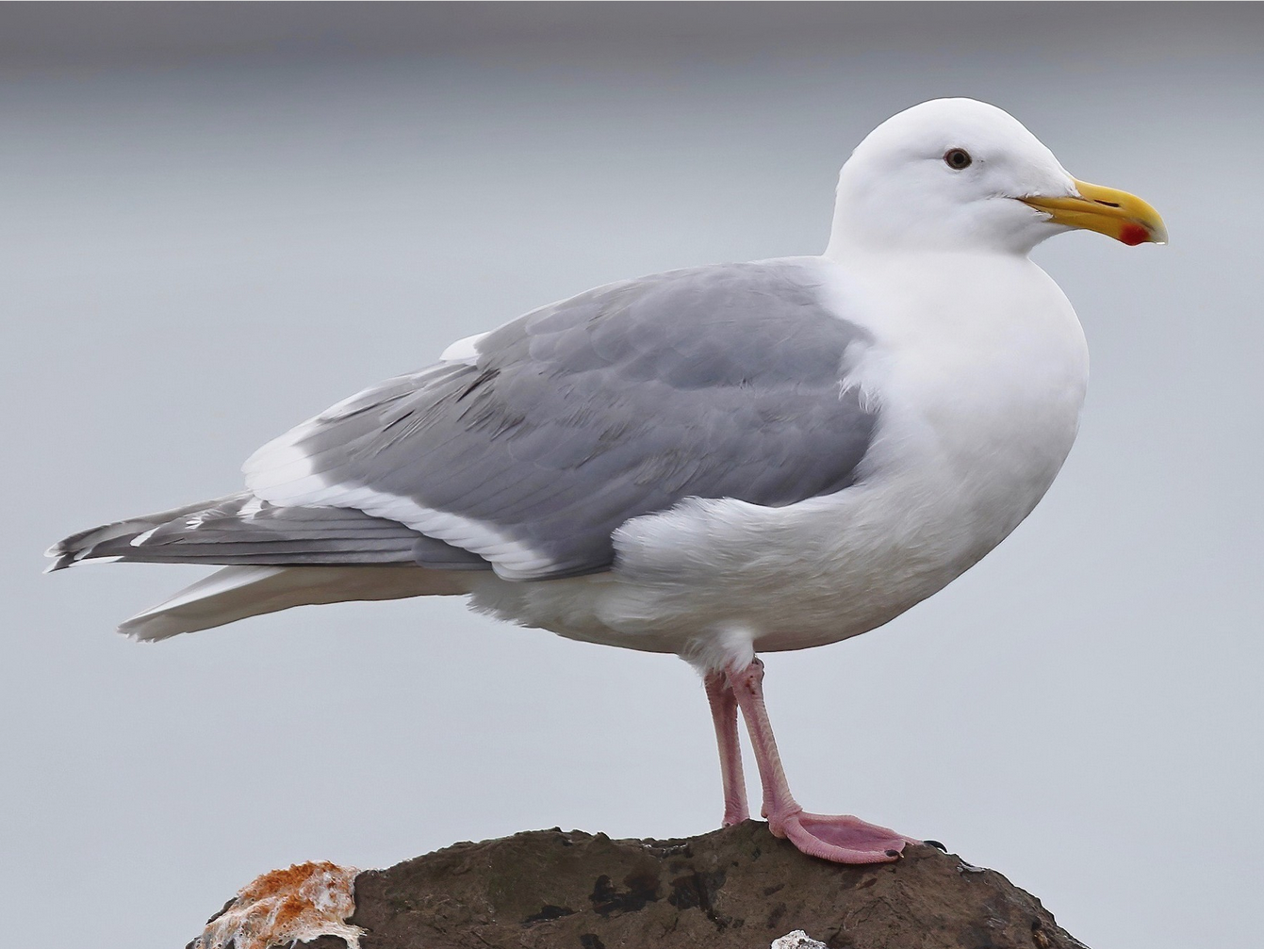
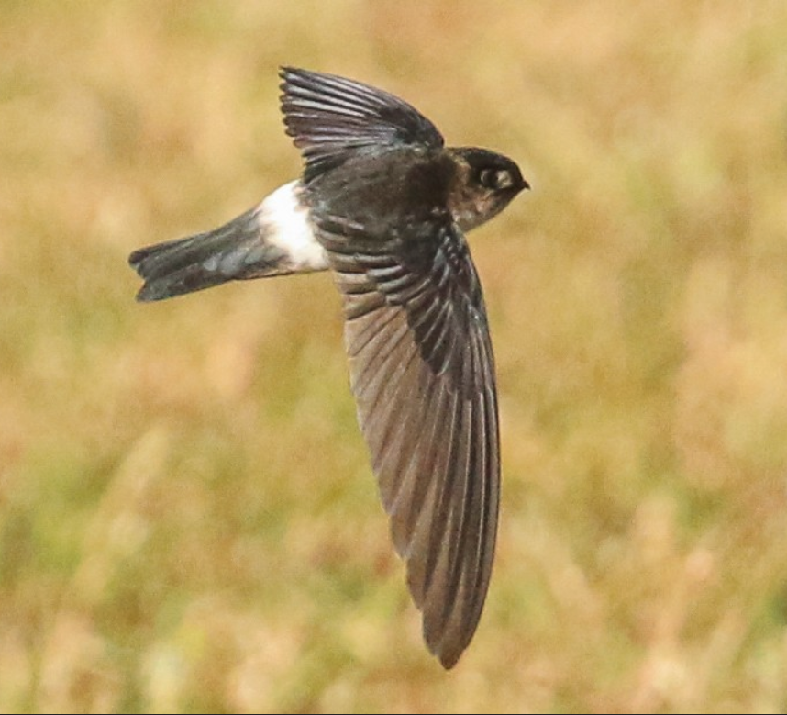
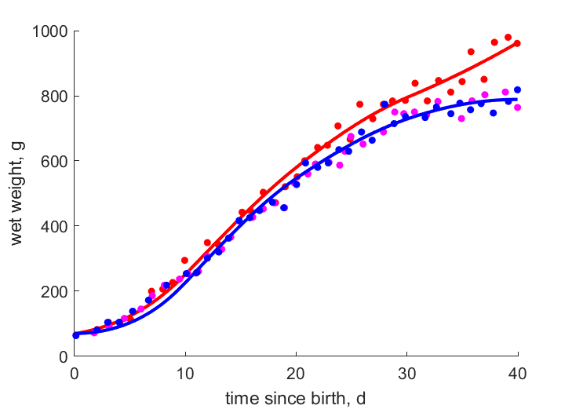
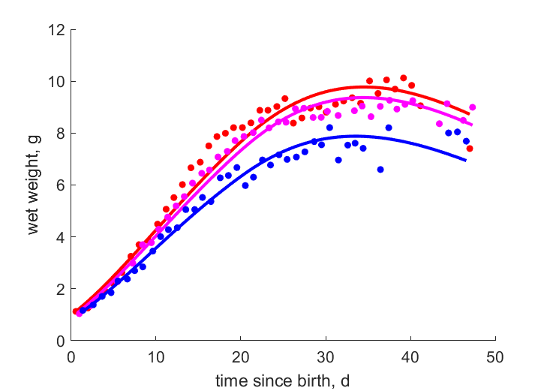
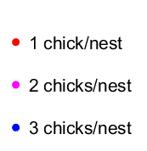
Larus glaucescens
Glaucous-winged gull
Aerodramus spodiopygius
White-rumped swiftlet
Photo: ebird
Photo: ebird
Data from Vermeer 1963
Occ. Pap. Br. Columb. prov. Mus.,
13:187--194
Notes:
Remarkable: food competition among nestlings can be quantified by growth curves

Slide 11
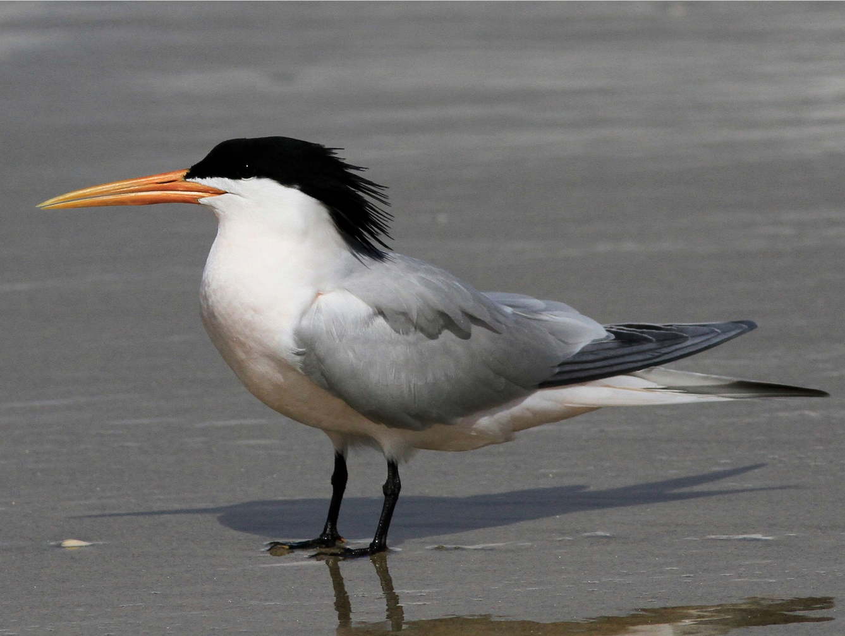
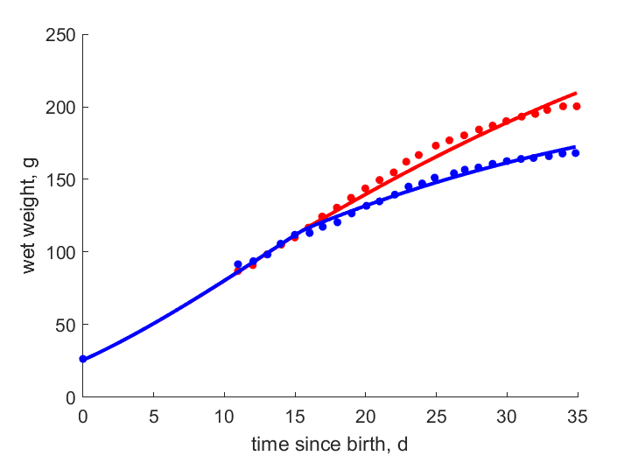
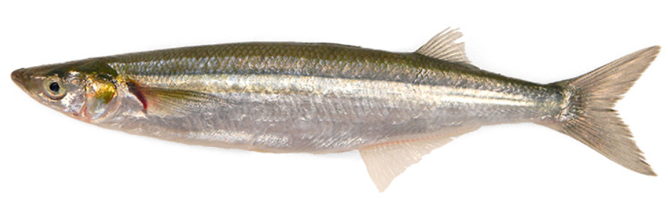
Thalasseus elegans
Elegant tern
Photo from ebird
topsmelt, Atherinops affinis
mixed topsmelt ↔ high/low energy topsmelt
Data from:
Dahdul & Horn 2003
The Auk, 120: 1069-1081
Notes:
Remarkable: food quality affects growth in cohorts of hand-fed terns

Slide 12
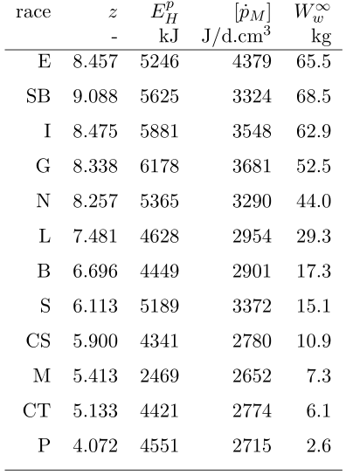
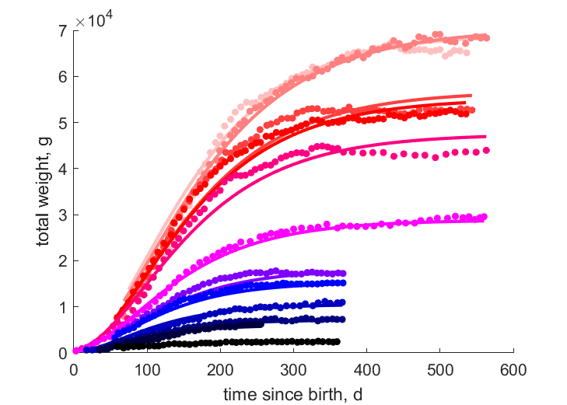
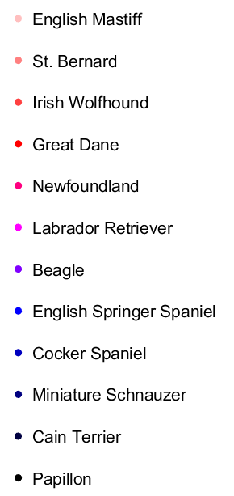
Canis familiaris, dog
Notes:
Remarkable: The simultaneous fit of growth in dog races requires small differences in specific maintenance, on top of difference in {p_Am}

Slide 13



Canis familiaris, dog
Sam
Dog races have a different {p_{Am}}, but the same v, so a different [E_{m}]
Reserve does not require maintenance
Vol-spec maint increases with struc vol, but weight-spec maint decreases with weight
Maturity at puberty does not depend clearly on ultimate size
Notes:
Remarkable: the volume-spec maintenance increases with structural volume, but the weight-spec maintenance decreases with weight.

Slide 14


Final slide
Thank you for your attention
Questions/remarks are very welcome
Also later during breaks
Download slides
https://www.bio.vu.nl/thb/users/bas/lectures/

