Slide 1


Life: from molecules
to system earth
Bas Kooijman
salm.kooijman@gmail.com
A-Life, VU University Amsterdam
School: 26 May - 3 Jun 2025
University of Crete, Heraklion, Greece

Slide 2
Space-time scales
Each process has its characteristic domain of space-time scales
space
system earth
ecosystem
When changing the space-time scale,
new processes will become important
other will become less important
This can be used to simplify models,
by coupling space-time scales
Complex models are required
for small time and big space scales and vv
Models with many variables & parameters
hardly contribute to insight
population
individual
cell
time
molecule
Notes:
Basic to DEB theory is the coherence between levels of organisation, using the life cycle of an individual as primary focus, from which sub- and supra-organismic levels are considered.
Space and time scales are tightly coupled methodologically.
Since many species are unicellular, the step to biochemical systems is not always big.
Populations are considered as sets of interacting individuals, ecosystems as sets of interacting populations.
While walking up- and down the time-space-scale, some processes loose their importance, others gain.
The primary motivation in my research on the theory is to answer the question:
how can we deal with the local coherence of levels of metabolic organisation, while avoiding the massive complexity of models with many variables and parameters;
I have never seen useful conclusions coming out of complex models.

Slide 3
Focus on individuals
population dynamics is derived from
properties of individuals + interactions between them
evolution according to Darwin:
variation between individuals + selection
individuals are the survival machines of life
material and energy balances:
most easy for individuals
Notes:
This lecture shows why models for individual-environment interactions, combined with food competition as only interaction between individuals,
need further modelling steps to become realistic for population dynamics in homogeneous space.

Slide 4
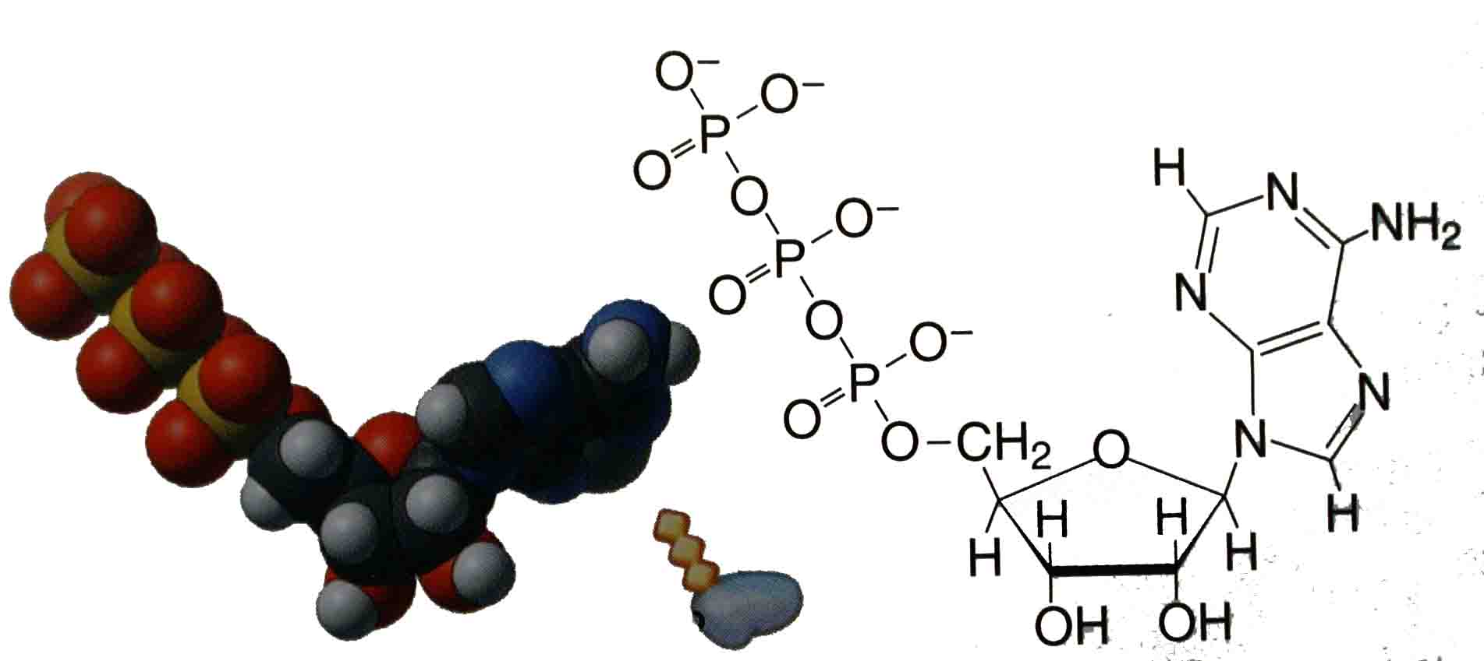
ATP generation & use
5 10⁶ ATP molecules in bacterial cell
enough for 2 s of biosynthetic work
Only used if energy generating &
energy demanding transformations
are at different site/time
If ADP/ATP ratio varies, then
rates of generation & use varies, but not
necessarily the rates of transformations they drive
Processes that are not much faster
than cell cycle, should be linked
to large slow pools of metabolites,
not to small fast pools
DEB theory uses reserve as large slow
pool for driving metabolism

Slide 5
Futile cycles
Example:
ATP + fructose-6-phosphate → Fructose-1,6bbisphosphate + ADP
Fructose-1,6-bisphosphate + H₂O → fructose-6-phosphate + P_{i}
+
ATP + H₂O → ADP + P_{i} + Heat
Known since Steinberg 1963: all organisms have the required enzymes
Biochemists seem to agree that the destruction of ATP is its sole function
Puzzle: why first synthesize ATP at considerable cost and then destruct it?
DEB answer: in this way organisms can boost their growth and reproduction, due to the κ-rule
Waste-to-Hurry (Kooijman 2013, Oikos 122: 348–357)
Key: by increasing somatic maintenance, you can eat lot while keeping small
Especially attractive if resources are abundantly available temporarily only,
but you need strategies for what to do between these peeks (torpor/migration)

Slide 6
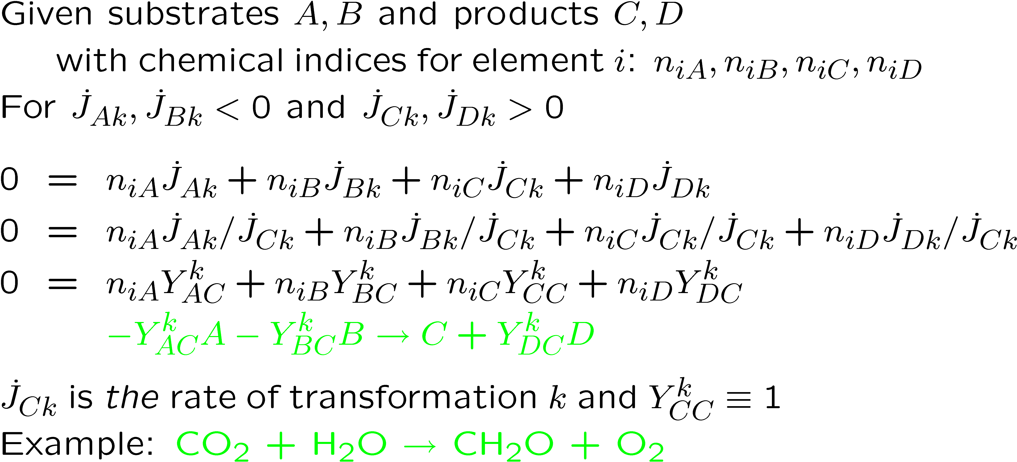
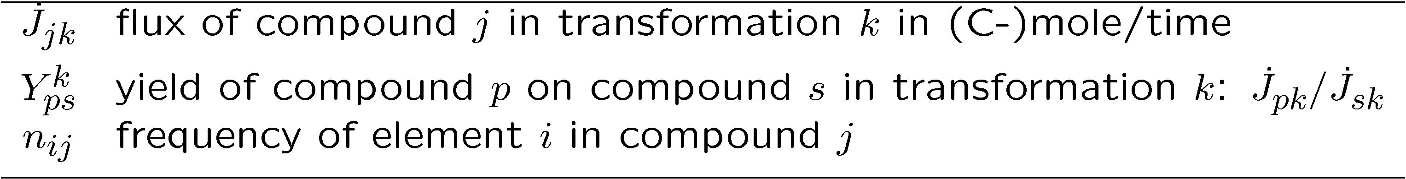
Macrochemical reaction eq

Slide 7
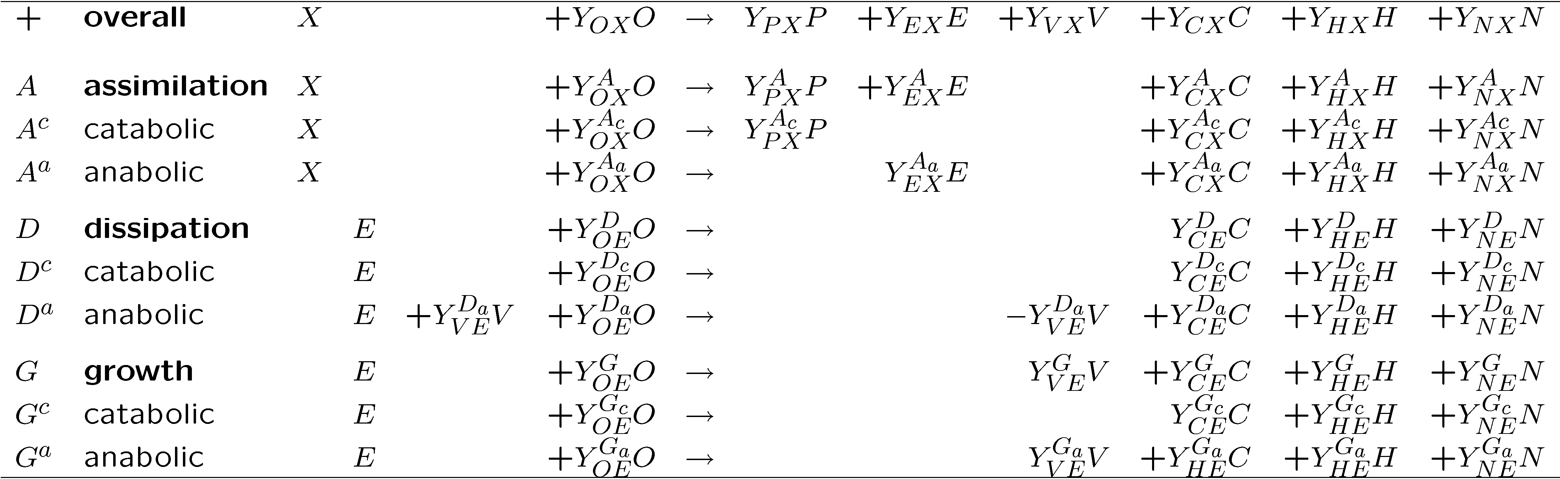
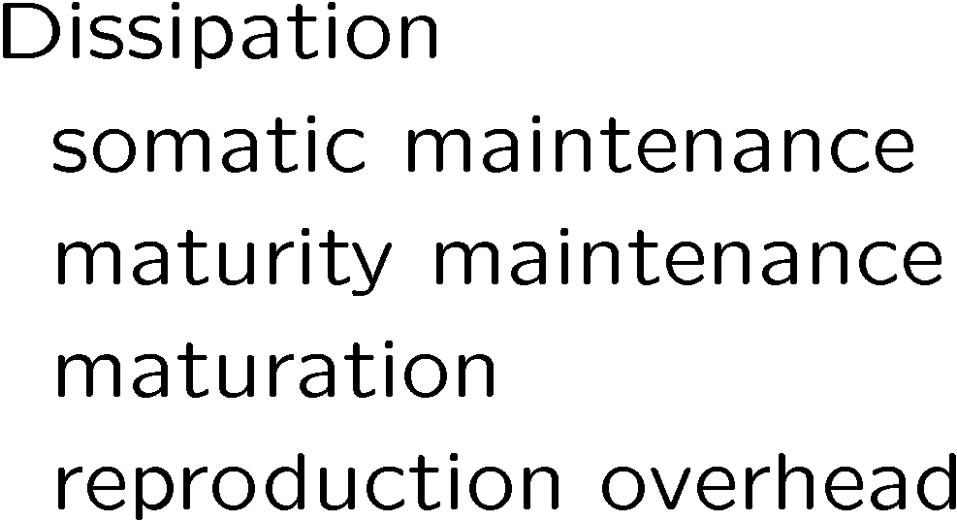
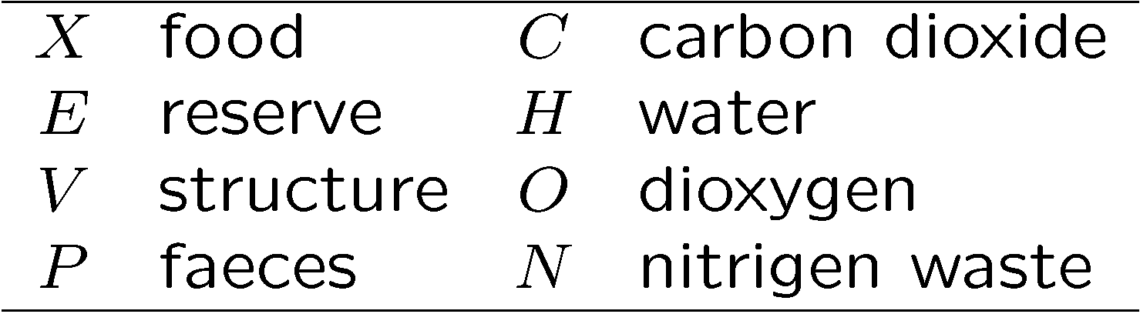
Macrochemical reaction eq

Slide 8
Synthesizing units
Generalized enzymes that process generalized substrates
and follow classic enzyme kinetics
E + S ↔ ES ↔ EP ↔ E + P
with two modifications:
back flux is negligibly small (due to active transport of products)
E + S → ES → EP → E + P
specification of transformation is on the basis of
arrival fluxes of substrates rather than concentrations
In spatially homogeneous environments:
arrival fluxes ∝ concentrations

Slide 9
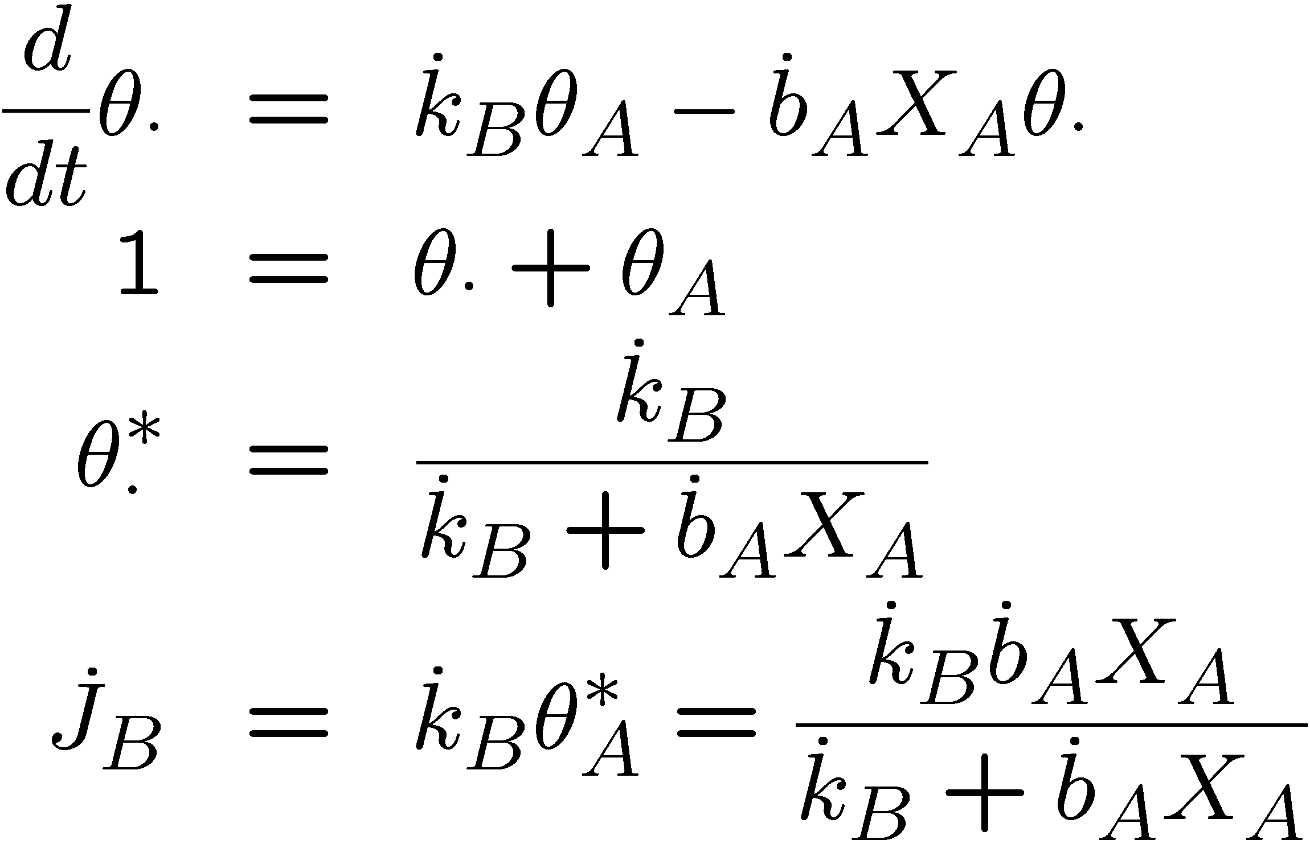
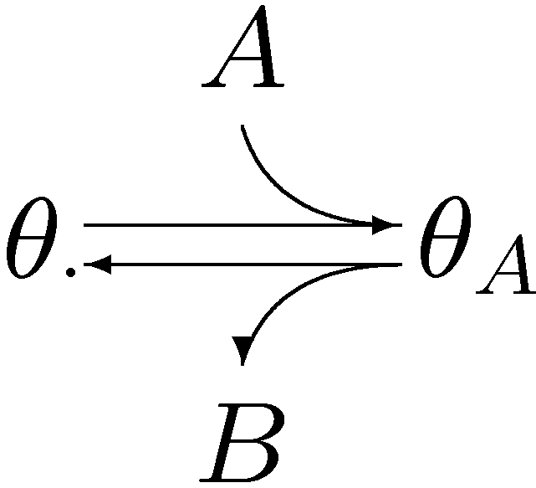
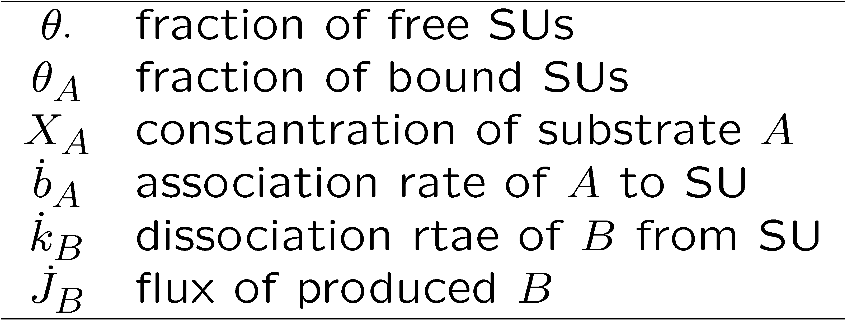
Transformation A → B
Classification of behavioural modes:
free & bound or searching & handling
Michealis-Menten (Henri 1902)
Holling type II (Holling 1957)
Notes:
SU-mediated transformation rates follow from changes in the various forms of bound fractions.
The simplest transformation is from substrate A to product B.
We use a diffusive transport model for when taking the association between A and SU proportional to the concentration of A.
We use a time scale separation argument when linking the rate of product formation to the steady state fraction of bound SUs.
SUs are generalized enzymes, including pure enzymes and individuals.
Essential is that time is partitioned in searching and handling only; Michaelis-Menten kinetics and Holling type II functional response follows.
Handling not only includes mechanical manipulation, but also digestive processing.
Since sleeping excludes searching for food, it counts as handling of food, irrespective of handling actually taking place.
A more realistic implementation of other behavioural states, apart of searching and handling, involves and extension of the number of states of the SUs.

Slide 10
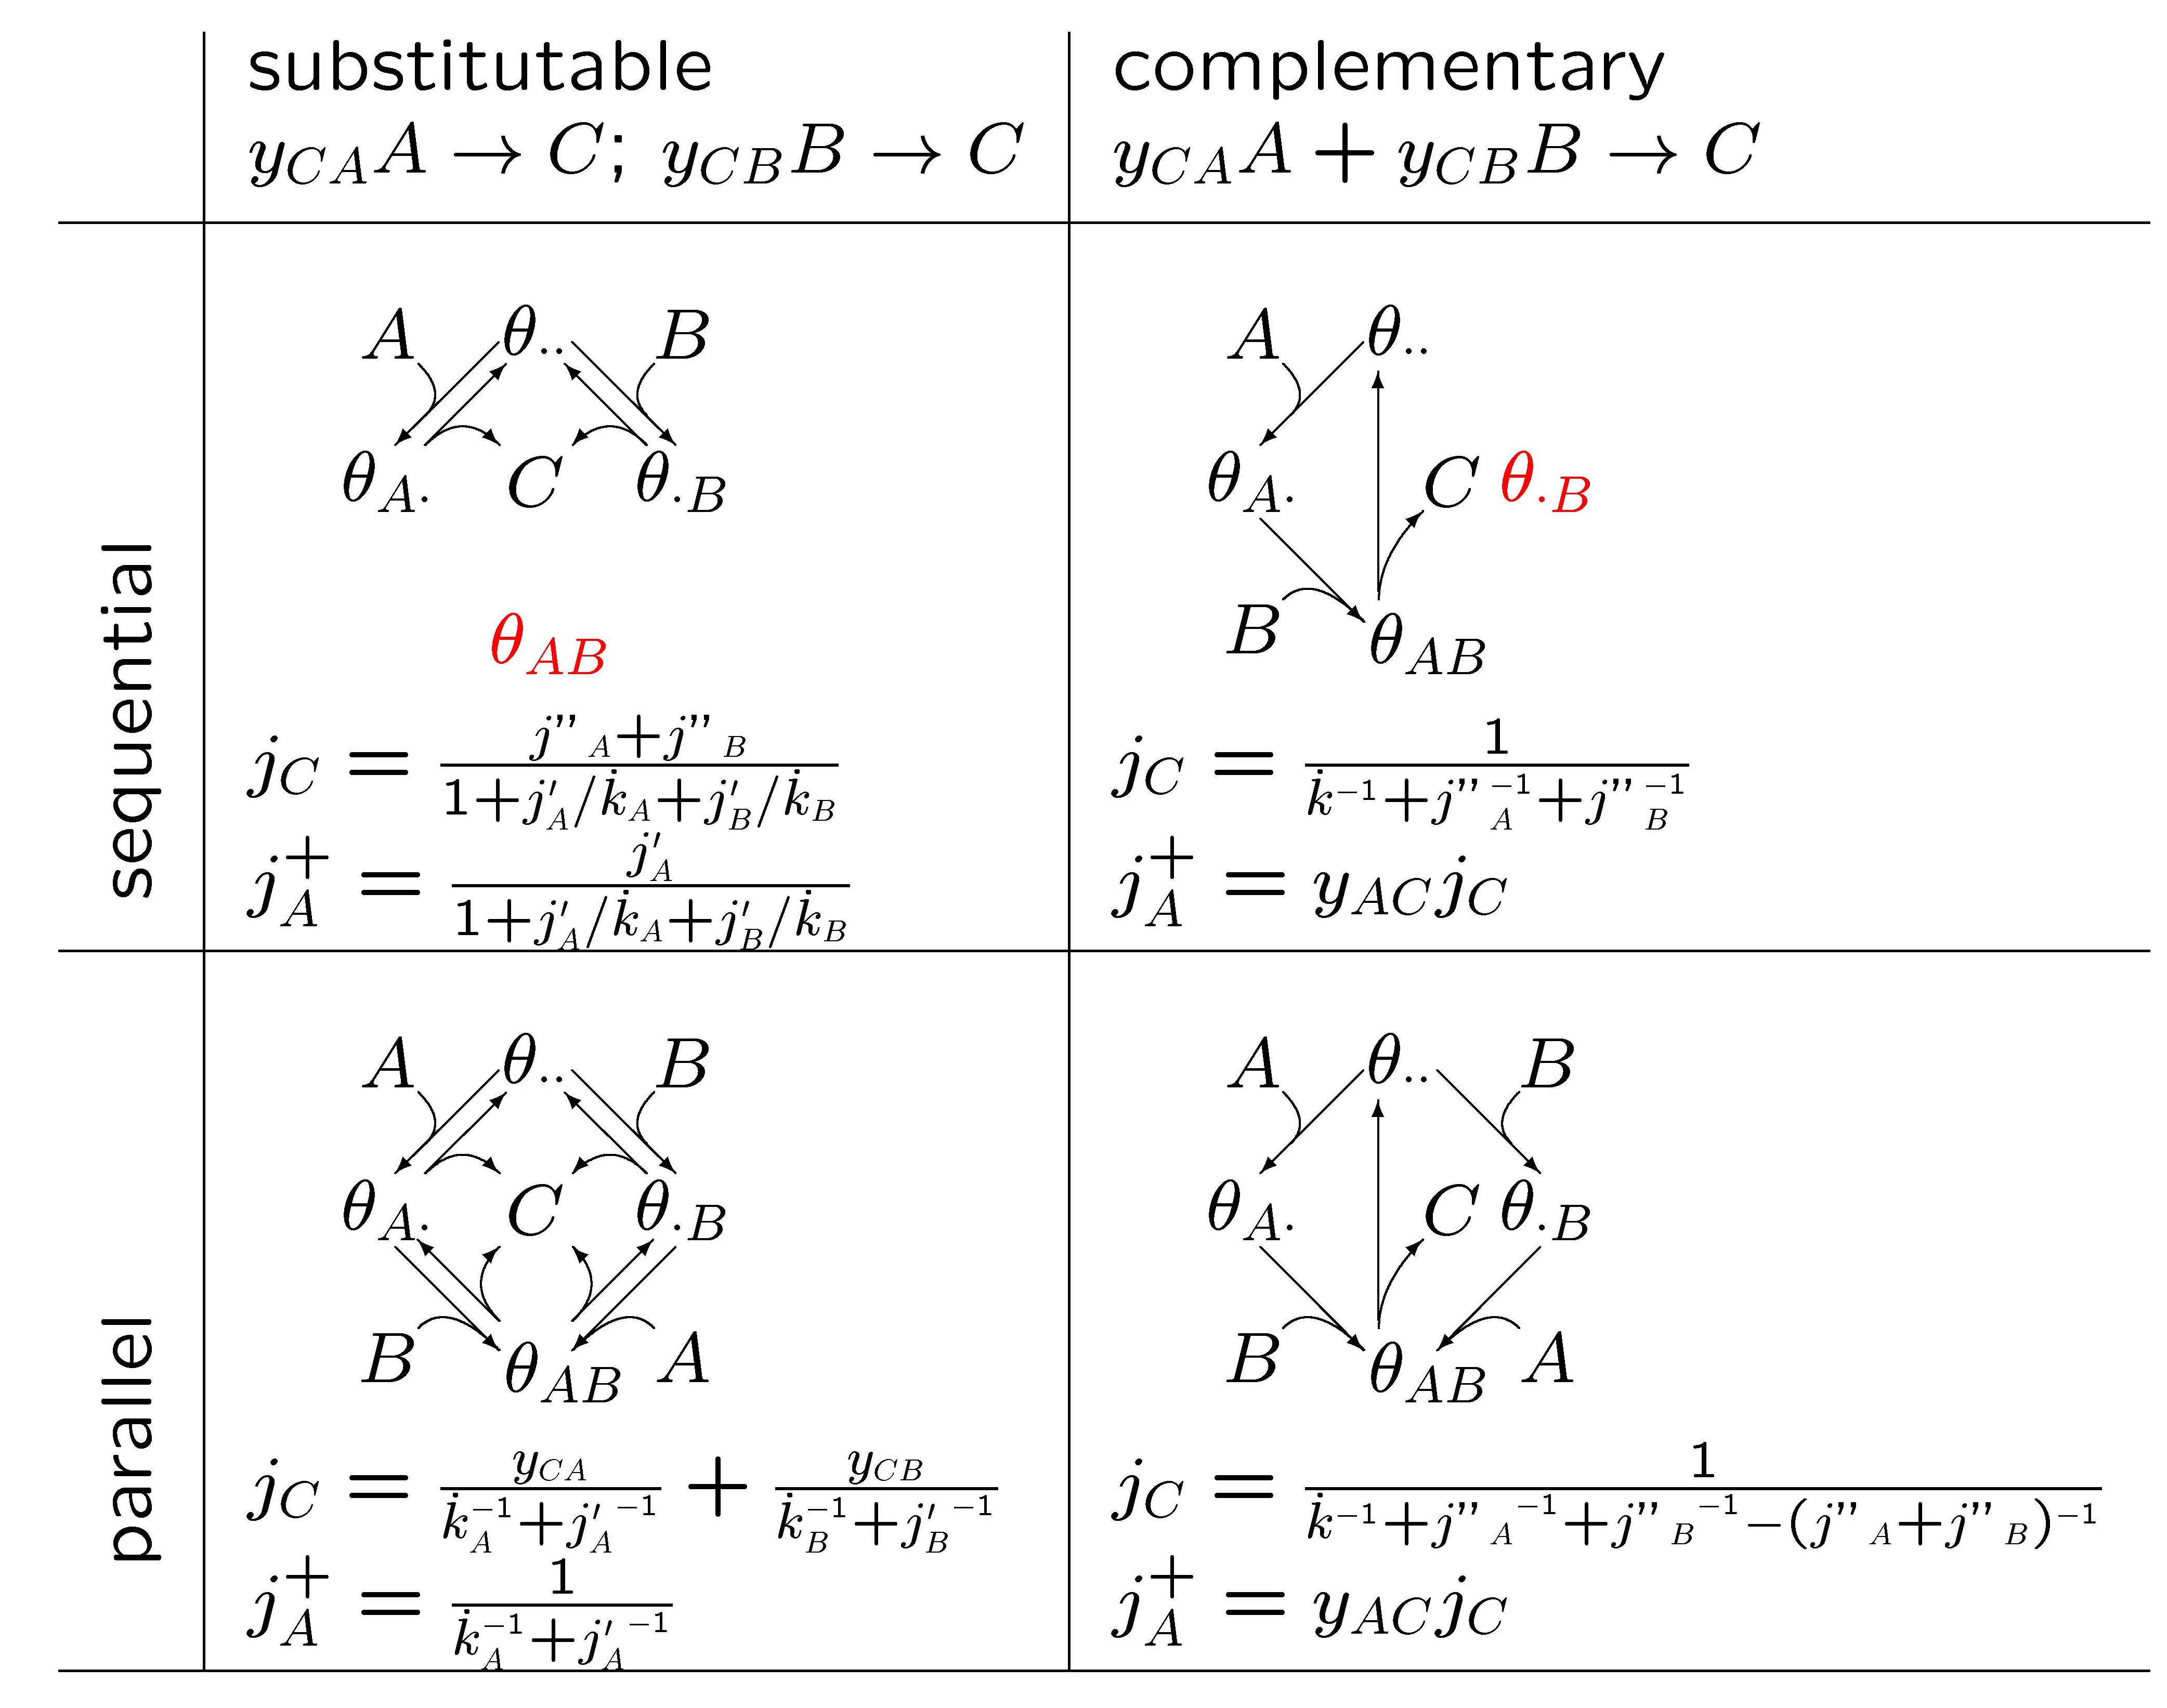
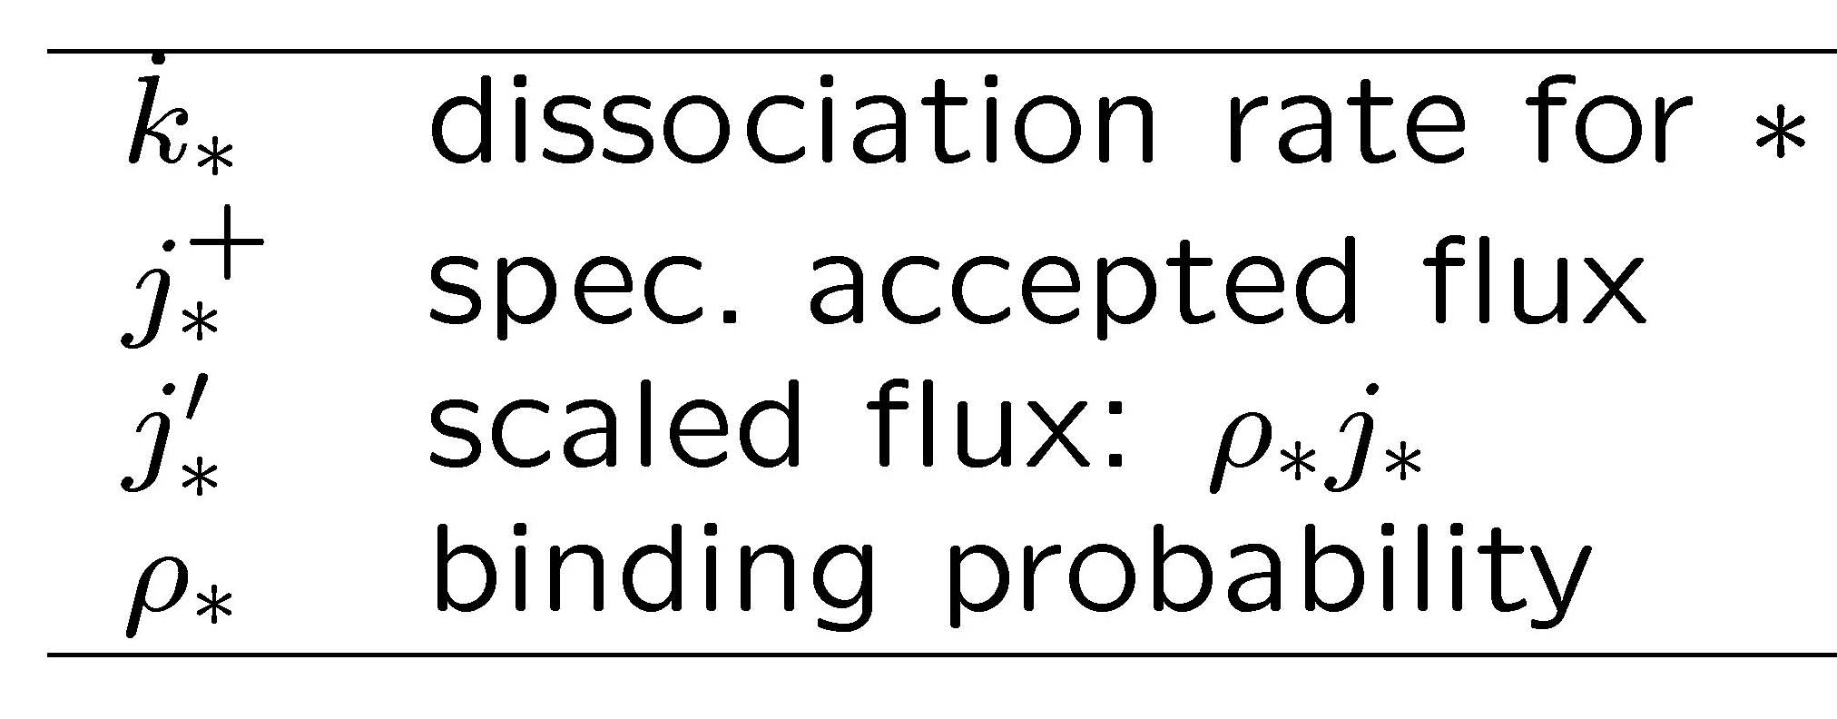
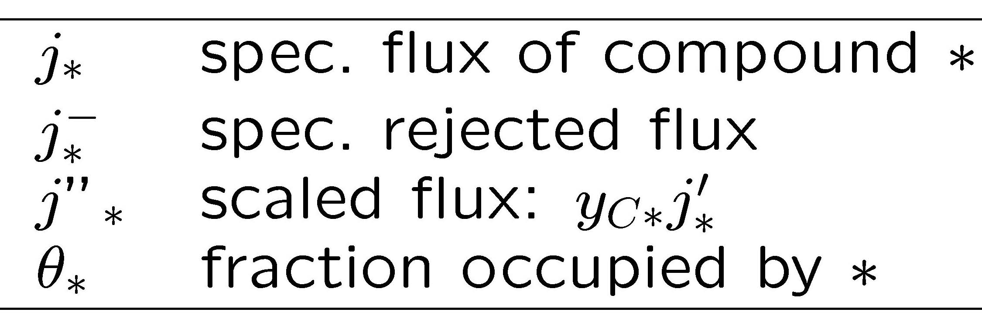
Interactions of substrates
Kooijman, 2001
Phil Trans R Soc B
356: 331-349

Slide 11
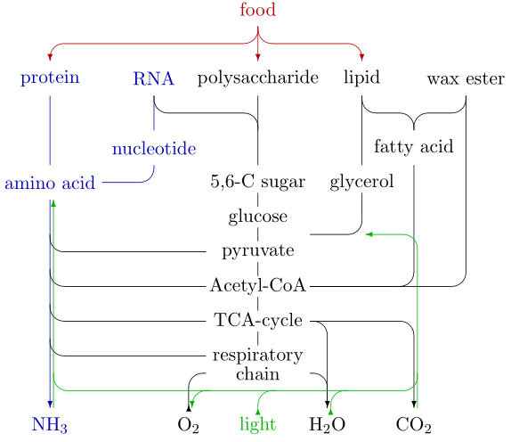
Modules of central metabolism
PP Pentose Phosphate cycle
glucose-6-P → ribulose-6-P,
NADP → NADPH
Gly Glycolysis
glucose-6-P → pyruvate
ADP + P → ATP
TCA TriCarboxcyl Acid cycle
pyruvate → CO₂
NADP → NADPH
RC Respiratory chain
NADPH + O₂ → NADP + H₂O
ADP + P → ATP

Slide 12
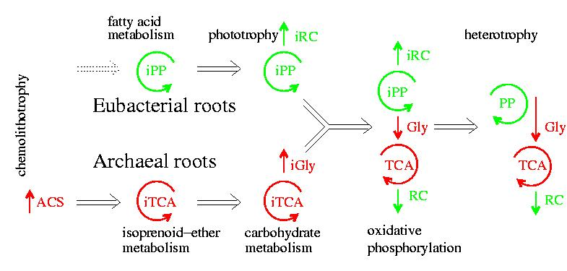
Evolution of central metabolism
in prokaryotes (= bacteria)
3.8 Ga
2.7 Ga
i = inverse
ACS = acetyl-CoA Synthase pathway
PP = Pentose Phosphate cycle
TCA = TriCarboxylic Acid cycle
RC = Respiratory Chain
Gly = Glycolysis
Kooijman & Hengeveld 2005
Kooiman & Troost 2007

Slide 13
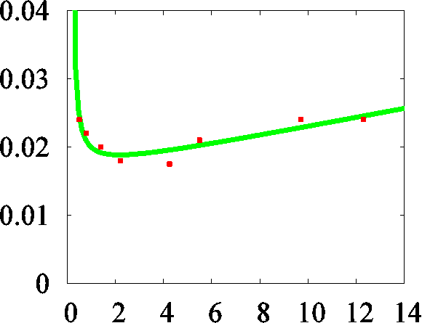
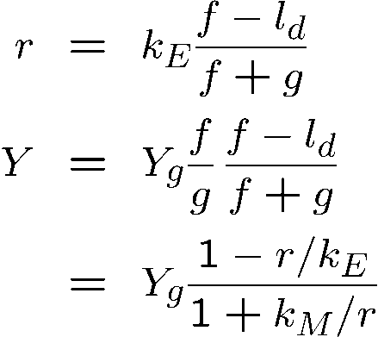
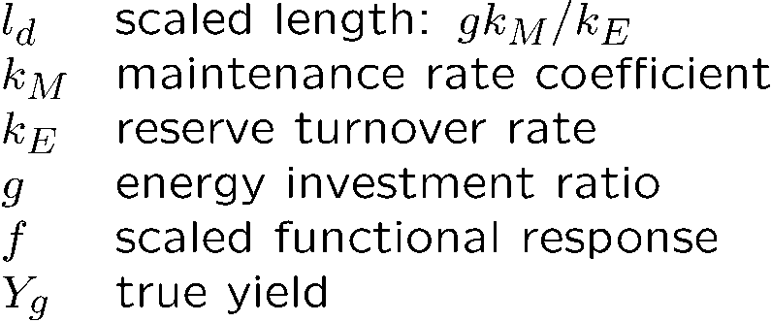
Structure vs Reserve
Streptococcus bovis, Russell & Baldwin (1979)
Marr-Pirt
(no reserve)
DEB
(reserve)
Effect of reserve
1/yield, mmol glucose/ mg cells
k_{M}
Effect of
maintenance
1/Y_{g}
spec growth rate
yield
1/spec growth rate, 1/h
Russell & Cook (1995): this is evidence for down-regulation
of maintenance at high growth rates
DEB theory: high reserve density gives high growth rates
structure requires maintenance, reserves do not

Slide 14
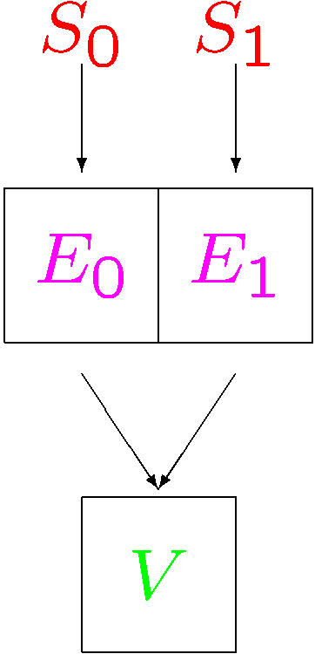
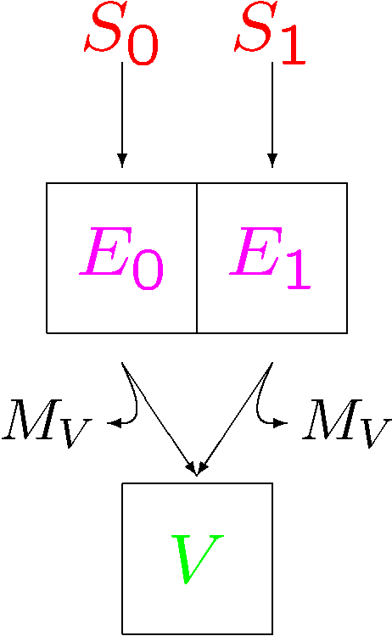
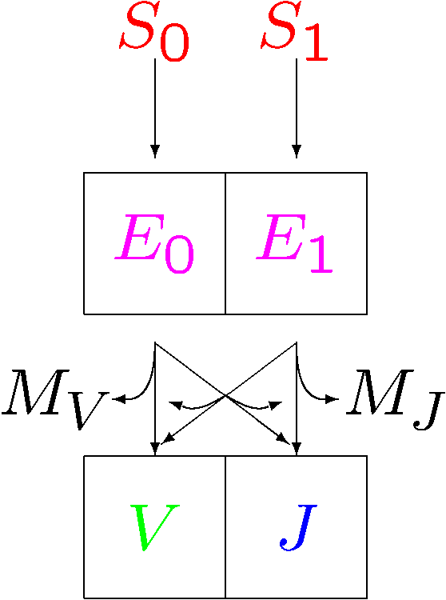
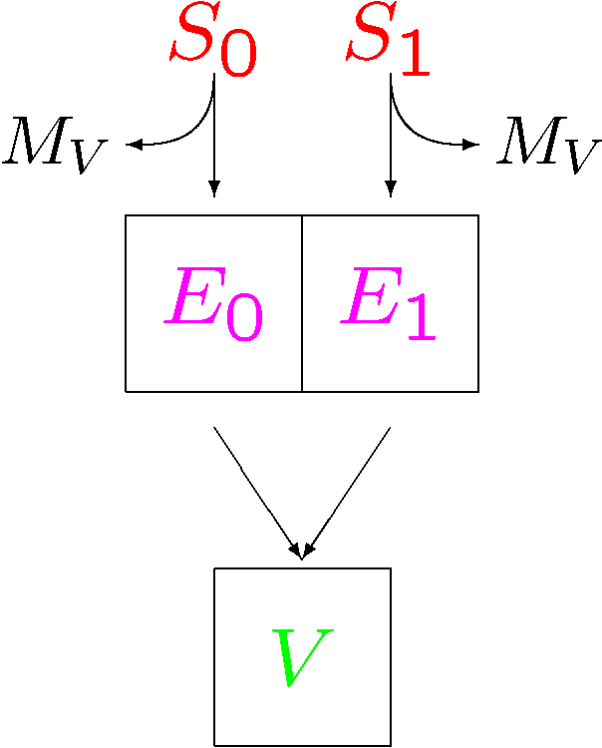
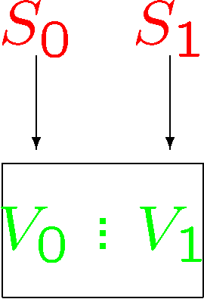
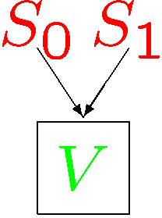
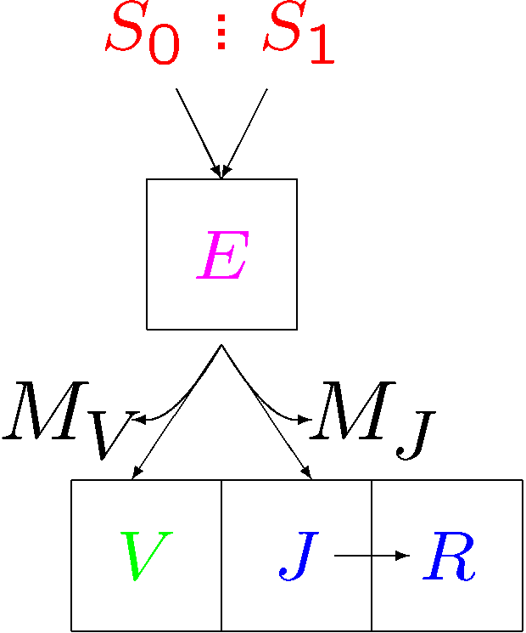
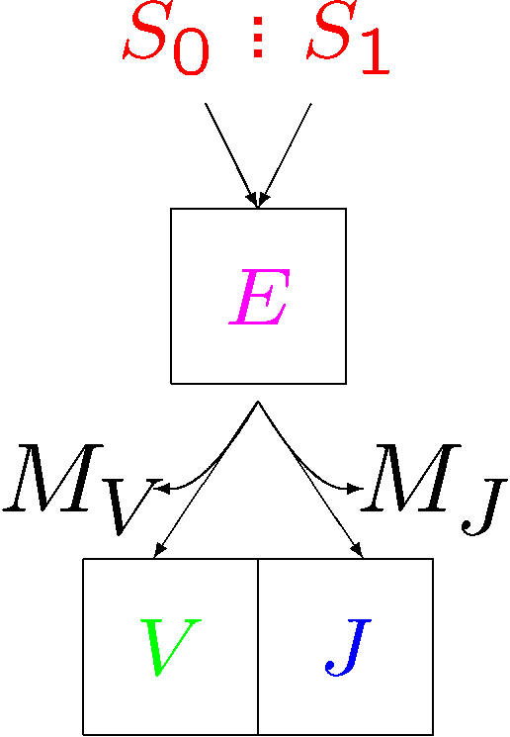
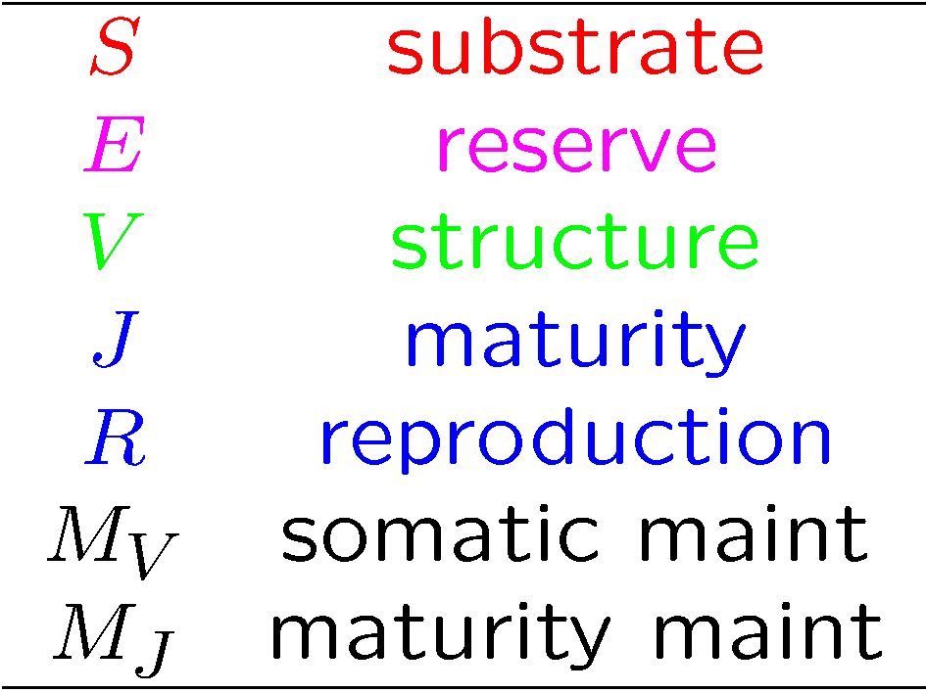
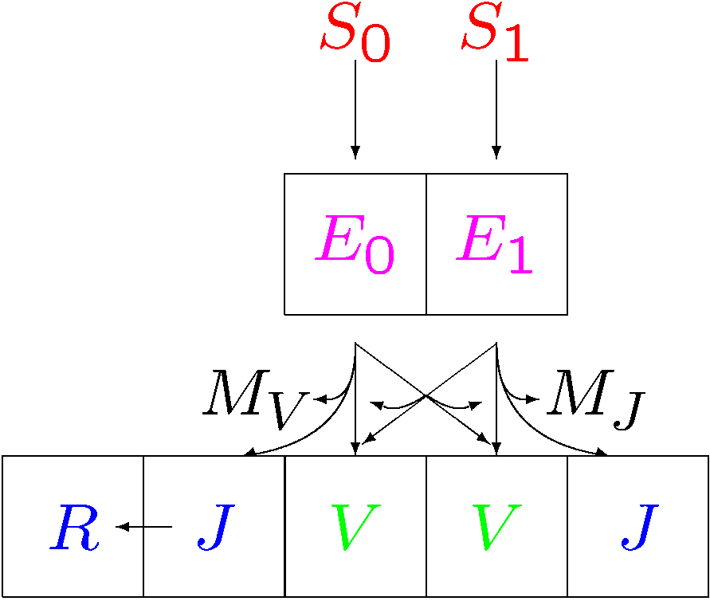
Evolution of reserves & structures
variable
structure
composition
strong
homeostasis
for structure
internalisation of
maintenance as
demand process
delay of use of
internal substrates
increase of
maintenance costs
installation of
maturation program
1
2
3
4
5
6
prokaryotes
7
plants
9
8
animals
Kooijman & Troost 2007
Biol Rev, 82, 1-30
reproduction
juvenile → embryo + adult
strong homeostasis
for reserve
specialization
of structure
Notes:
This scheme presents an evolutionary scenario for the metabolic organisation of an individual.
Only 2 of several reserves are shown.
Stacked dots (upper left) represent sloppy coupling between the various structural components
1: originally, strong homeostasis hardly applied and the various compounds from structure where formed from substrates, possibly will little transformation
2: the development of homeostasis comes with stoichiometric constraints on the uptake of substrates
3: since growth can only occur if all required substrates are present, and substrate concentrations vary in time, reserves develop, originally by delaying the processing of internalised substrates.
4: the increase of efficiency of protein-mediated substrate uptake involves maintenance costs.
The increased uptake efficiency increases the reserve pools, and the necessity developed to convert and store reserve (in polymers, or nutrients in vacuoles)
5: since substrates vary in concentration and are continuously required for maintenance, the payment of maintenance is internalised and done from mobilised reserve
6: size control comes with a need for a maturation program; defense systems are fuelled from maturity maintenance
Under starvation conditions, where maturity maintenance cannot be paid, rejuvenation occurs, and the hazard rate is increased.
Failure of paying somatic maintenance leads to shrinking of structure, but is a threshold is exceeded, death is instantaneous.
This situation applies to modern bacteria and many protoctists
7: The animal-line of development, which feed on other organisms, increased homeostasis and the number of reserves shrinks to 1.
8: Reproduction evolved and the juvenile stage gave rise to an embryo (no assimilation) and an adult stage (no maturation, but reproduction)
9: The plant-line of development increased the number of structures (roots and shoots), with specialised assimilation tasks
Reproduction evolved also here, typically in the shoot, and translocation evolved: a fraction of mobilised reserve is allocated to the other structure.

Slide 15
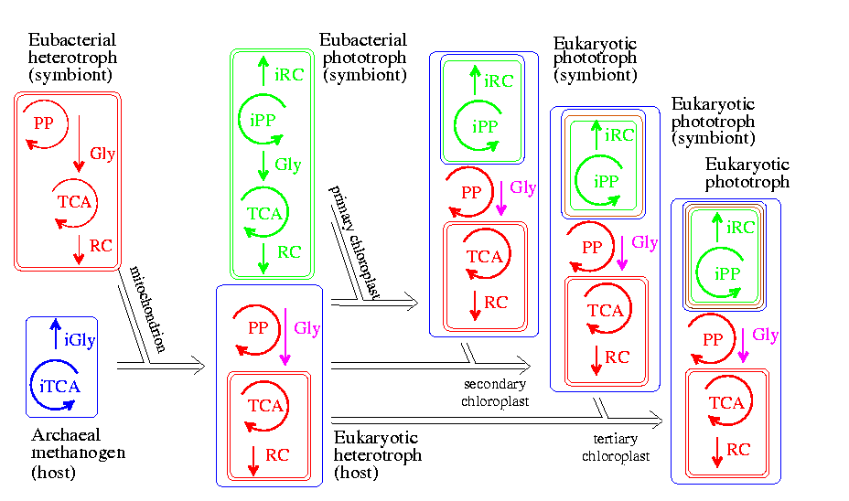
Symbiogenesis
2.7 Ga
2.1 Ga
1.27 Ga
phagocytosis
Notes:
The inclusion of an eubacterial symbiont into an archaeal host involved membrane rupture of the host and healing.
This is why some workers believe that it occurred only once in the evolution of life.
The color of the membranes relates to the origin of the membranes.
The eubacterial symbiont had already a respiratory chain, so was adapted to the presence of free dioxygen, meaning that the blue green bacteria already evolved. It might have helped the host to keep the dioxygen low inside its cell, for which dioxygen might have been toxic.
The inclusion event was followed by a re-organization of metabolism, and many genes of the symbiont moved to the genome of the host.
The symbiont evolved into a mitochondrion and the origin of the eukaryotes was a fact. They were heterotrophic.
Meanwhile phagocytosis evolved and the inclusion of blue-green bacteria into the eukaryote was relative smooth,
with less effect on the organization of metabolism: hetero- and autotrophic eukaryotes share a lot of machinery.
The symbiont evolved into a chloroplast, some genes moved to the host, but the chloroplast remained more independent,
compared to the mitochondrion.
The symbiotic entering occurred several times, but the effect on metabolic organization remains limited.

Slide 16
individuals → populations
Steady state: Euler-Lotka equation in constant environments
specified by model
specific growth rate

Slide 17
Conversion efficiency
Individual: Consider a young dog and an adult (fully grown) one
we daily give them both some food, which they eat all happily
efficiency of conversion food → dog > 0 for young; = 0 for adult
dog’s physiology controls efficiency
Population: Consider a manager of a carp pond who daily orders 1 lorry grain for his carps
if he does not harvest fish: efficiency of conversion grain → fish = 0 at steady state
if he takes 1 fish per day: efficiency of conversion grain → fish = very low at steady state
if he takes 100 fish per day: efficiency of conversion grain → fish = higher at steady state
manager controls efficiency, fish physiology only sets constraints for maximum efficiency
Conclusion: Control of conversion efficiency is sensitive to level of organisation

Slide 18
Intra-specific competition:
juvenile-driven cycles
Surface area-linked assimilation & volume-linked maintenance
causes out-competition of older cohorts in isomorphs (not realistic)
Partial repairs:
1) thinning: hazard such that increase of feeding by growth in a cohort of neonates
is exactly balanced by a reduction in numbers (no extra parameters)
2) parameters scatter between individuals (reduces synchronization)
problem: large scatter is required, lots of computation time
3) neonates need higher food quality, compared to adults
two types of food are required, adults can live of both types, juveniles not
4) temporal and spatial heterogeneity
problem: there are many ways to structure time and space

Slide 19
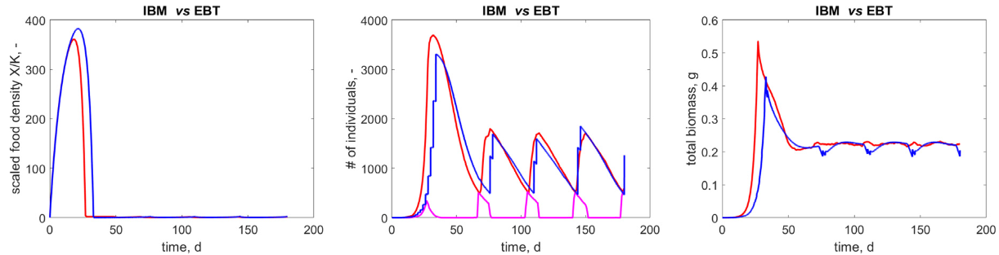

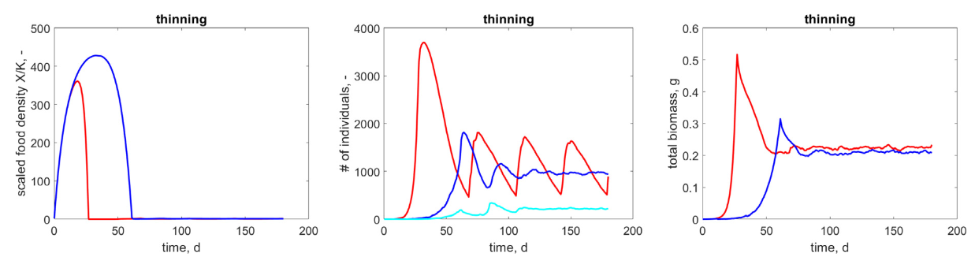
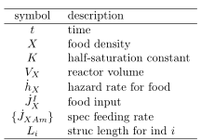
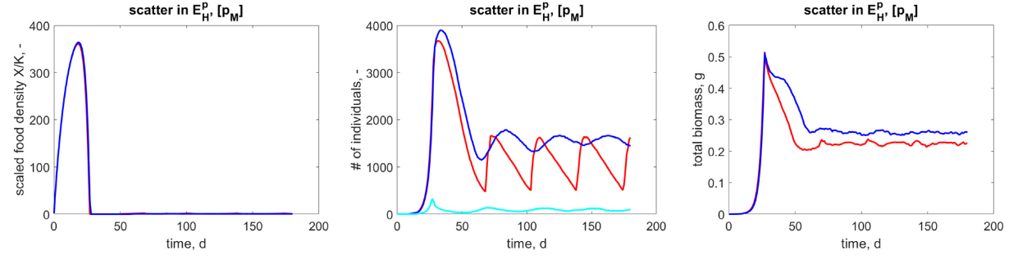
Juvenile-driven cycles:
Juveniles outcompete adults and synchronize
in homogenous environments (not realistic)
food dynamics in
stirred fed-batch reactor
EBT
IBM
adults for IBM
initial condition:
X(0) = 0; 1 neonate
par-setting: Daphnia magna at 20 C
IBM no thinning
IBM with thinning
adults
with thinning
IBM no scatter
IBM with scatter
adults
with scatter
Kooijman 2024
Ecol Mod 490 110649
SI for Kooy2024 has code on GitHub

Slide 20
Inter-specific competition:
Gause’s law: # of competing species < # of resources
Also known as the competitive exclusion principle (not realistic)
It is difficult to preserve biodiversity in community models:
No more recompeting species than resources
if feeding is a monotonous function of resource density
Repairs:
1) temporal and spatial heterogeneity
problem: there are many ways to structure time and space
2) exploit concept of syntrophy
3) more details in nutrition
4) make feeding also a function of population density: social inhibition

Slide 21

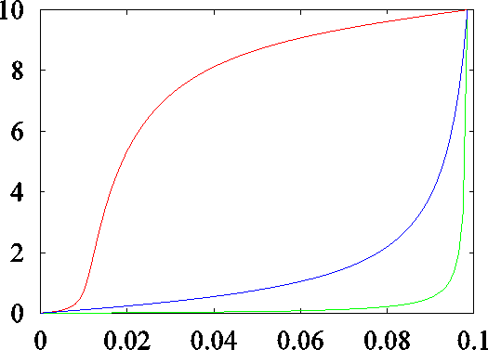
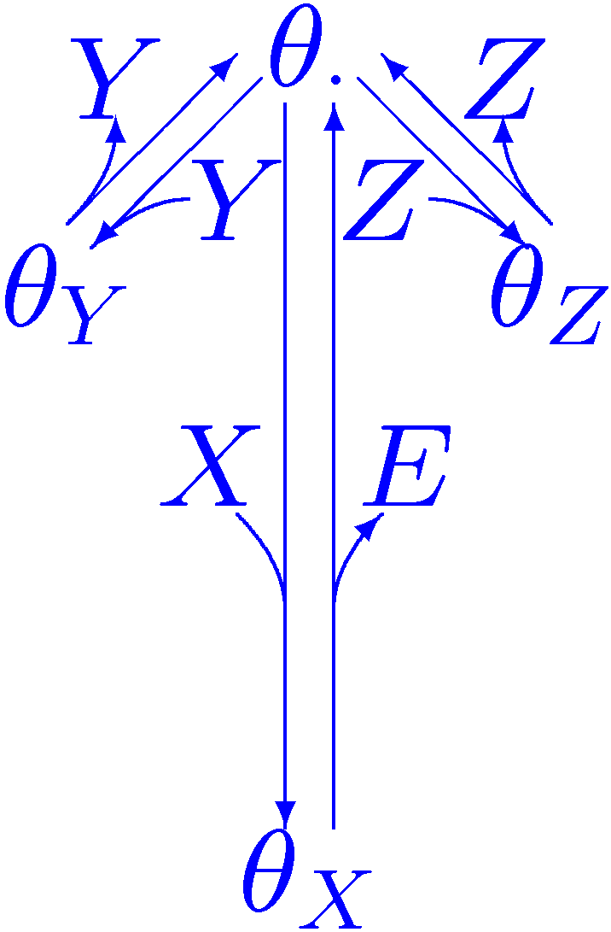
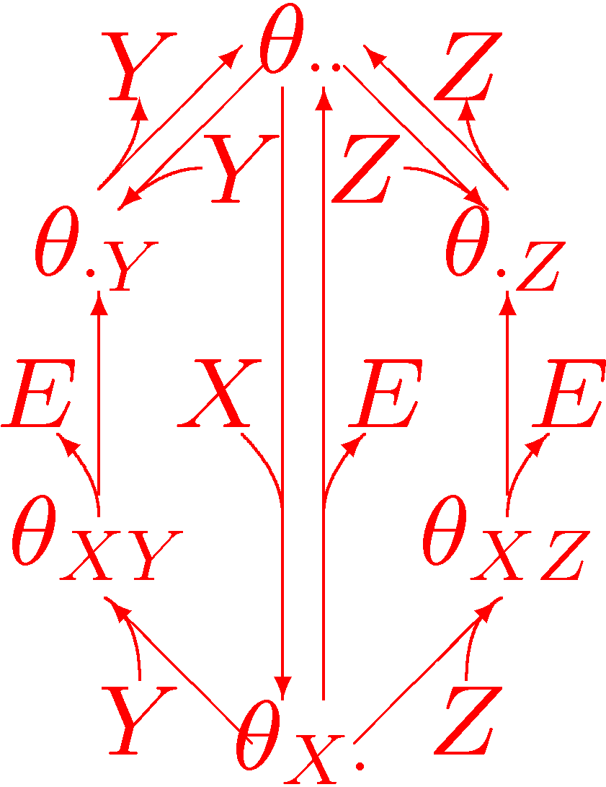
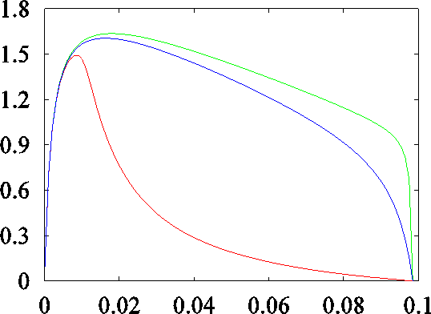
Social inhibition of X → E
sequential
parallel
substrate conc.
No socialization
X substrate
E reserve
Y species 1
Z species 2
Implications:
stable co-existence of
competing species
absence of paradox of enrichment
biomass conc.
dilution rate

Slide 22
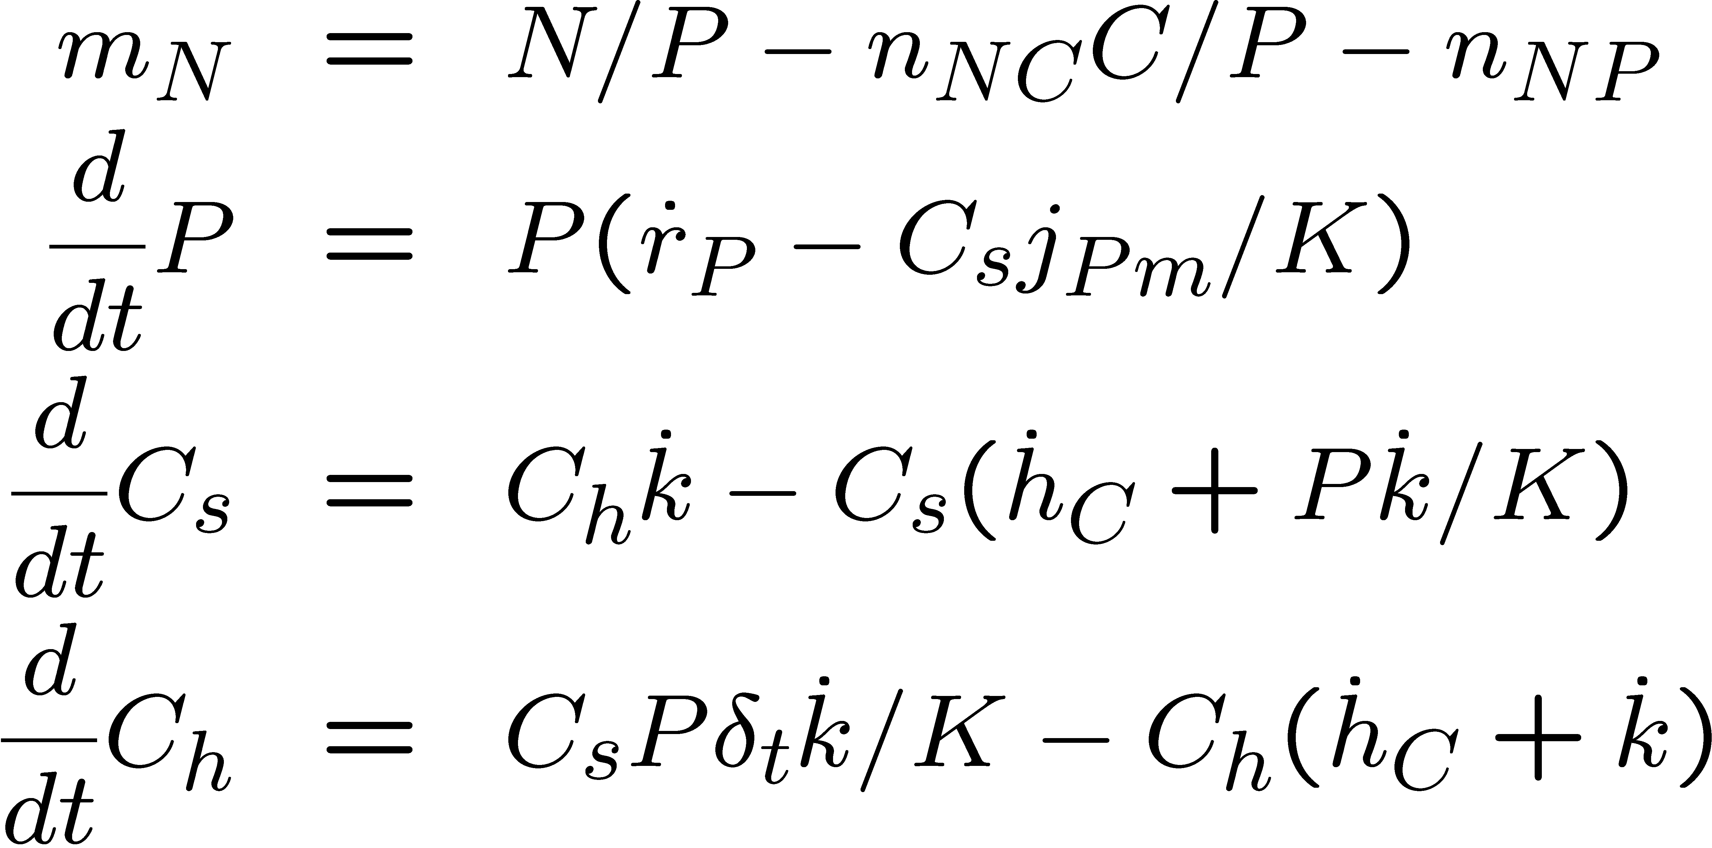
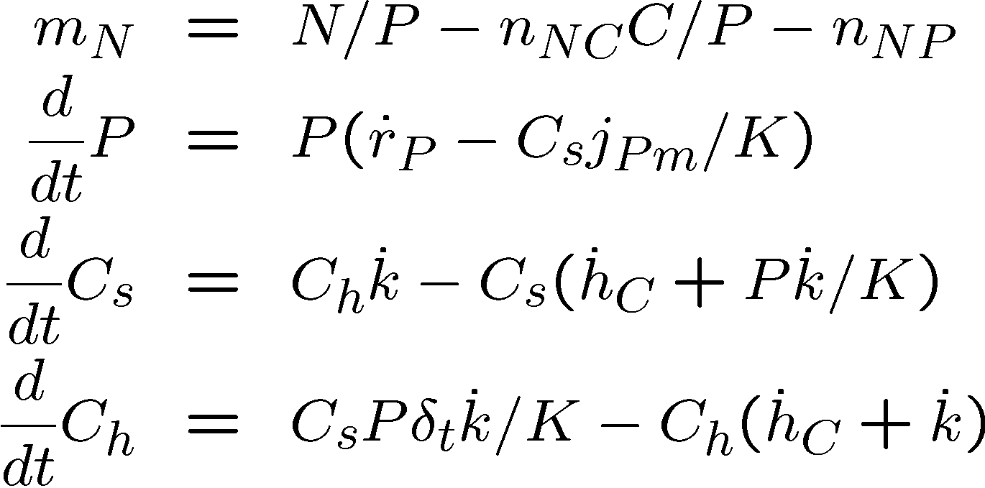
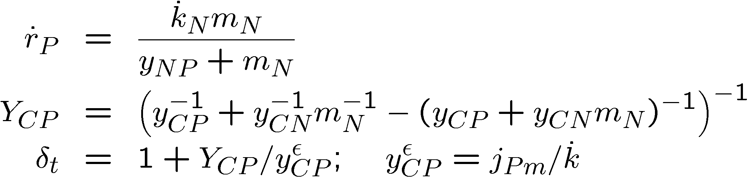
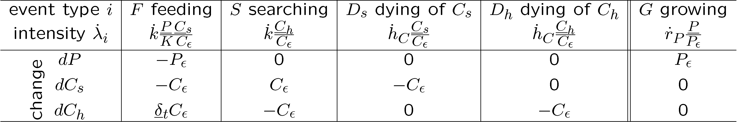
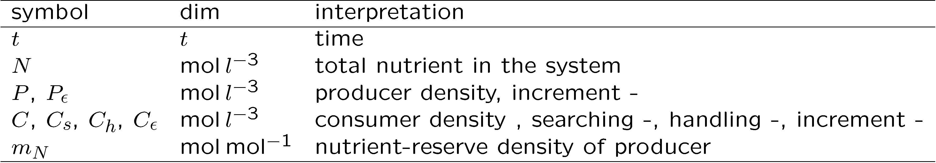
Paradox of enrichment 1
Deterministic model
in closed homogeneous system
Stochastic model
Rosenzweig1971
AAAS 171: 385–387.
Kooijman et al 2007
Math Biosci, 210, 378-394

Slide 23
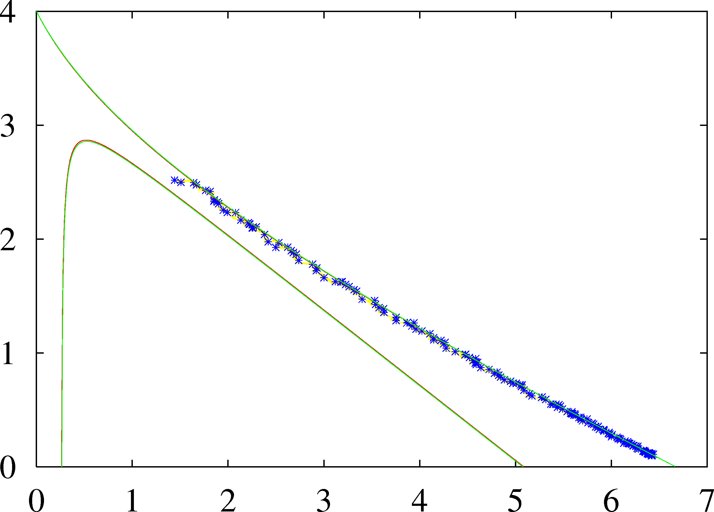
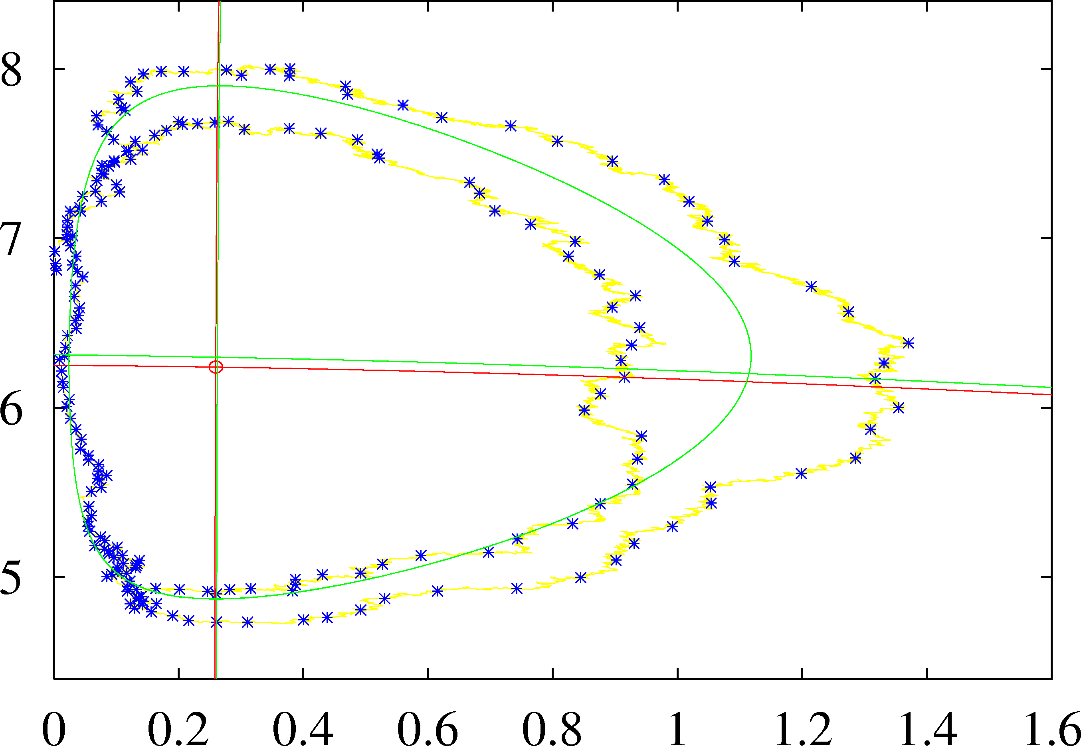
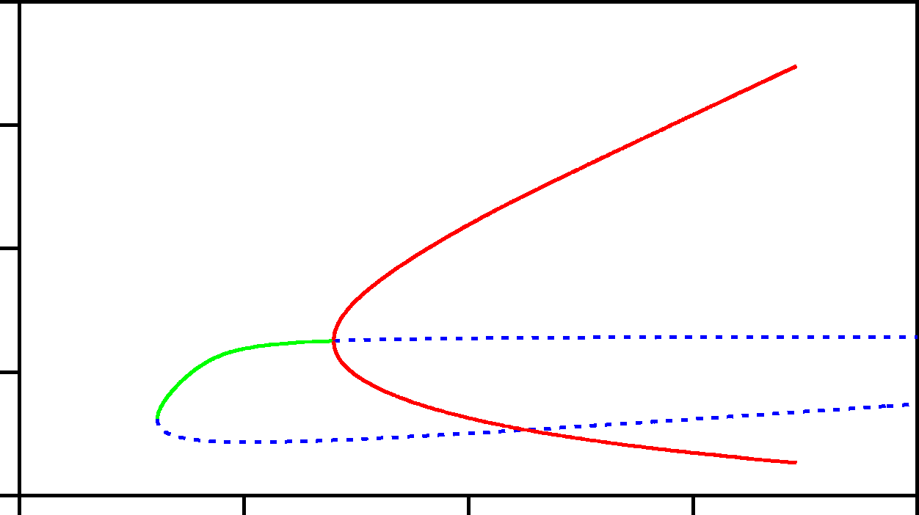
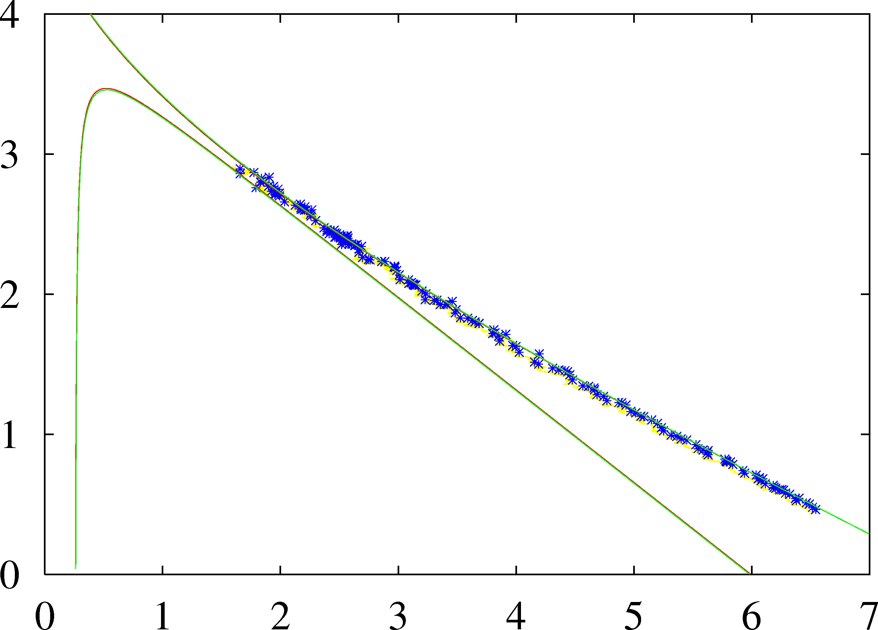
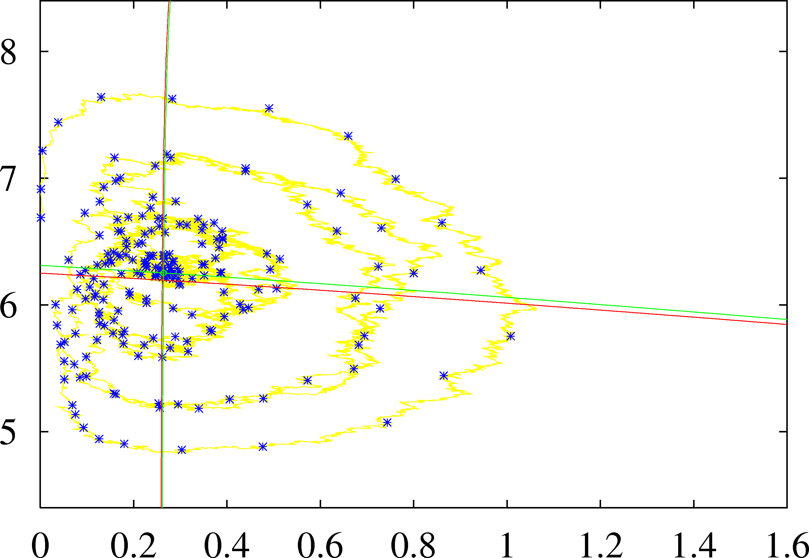
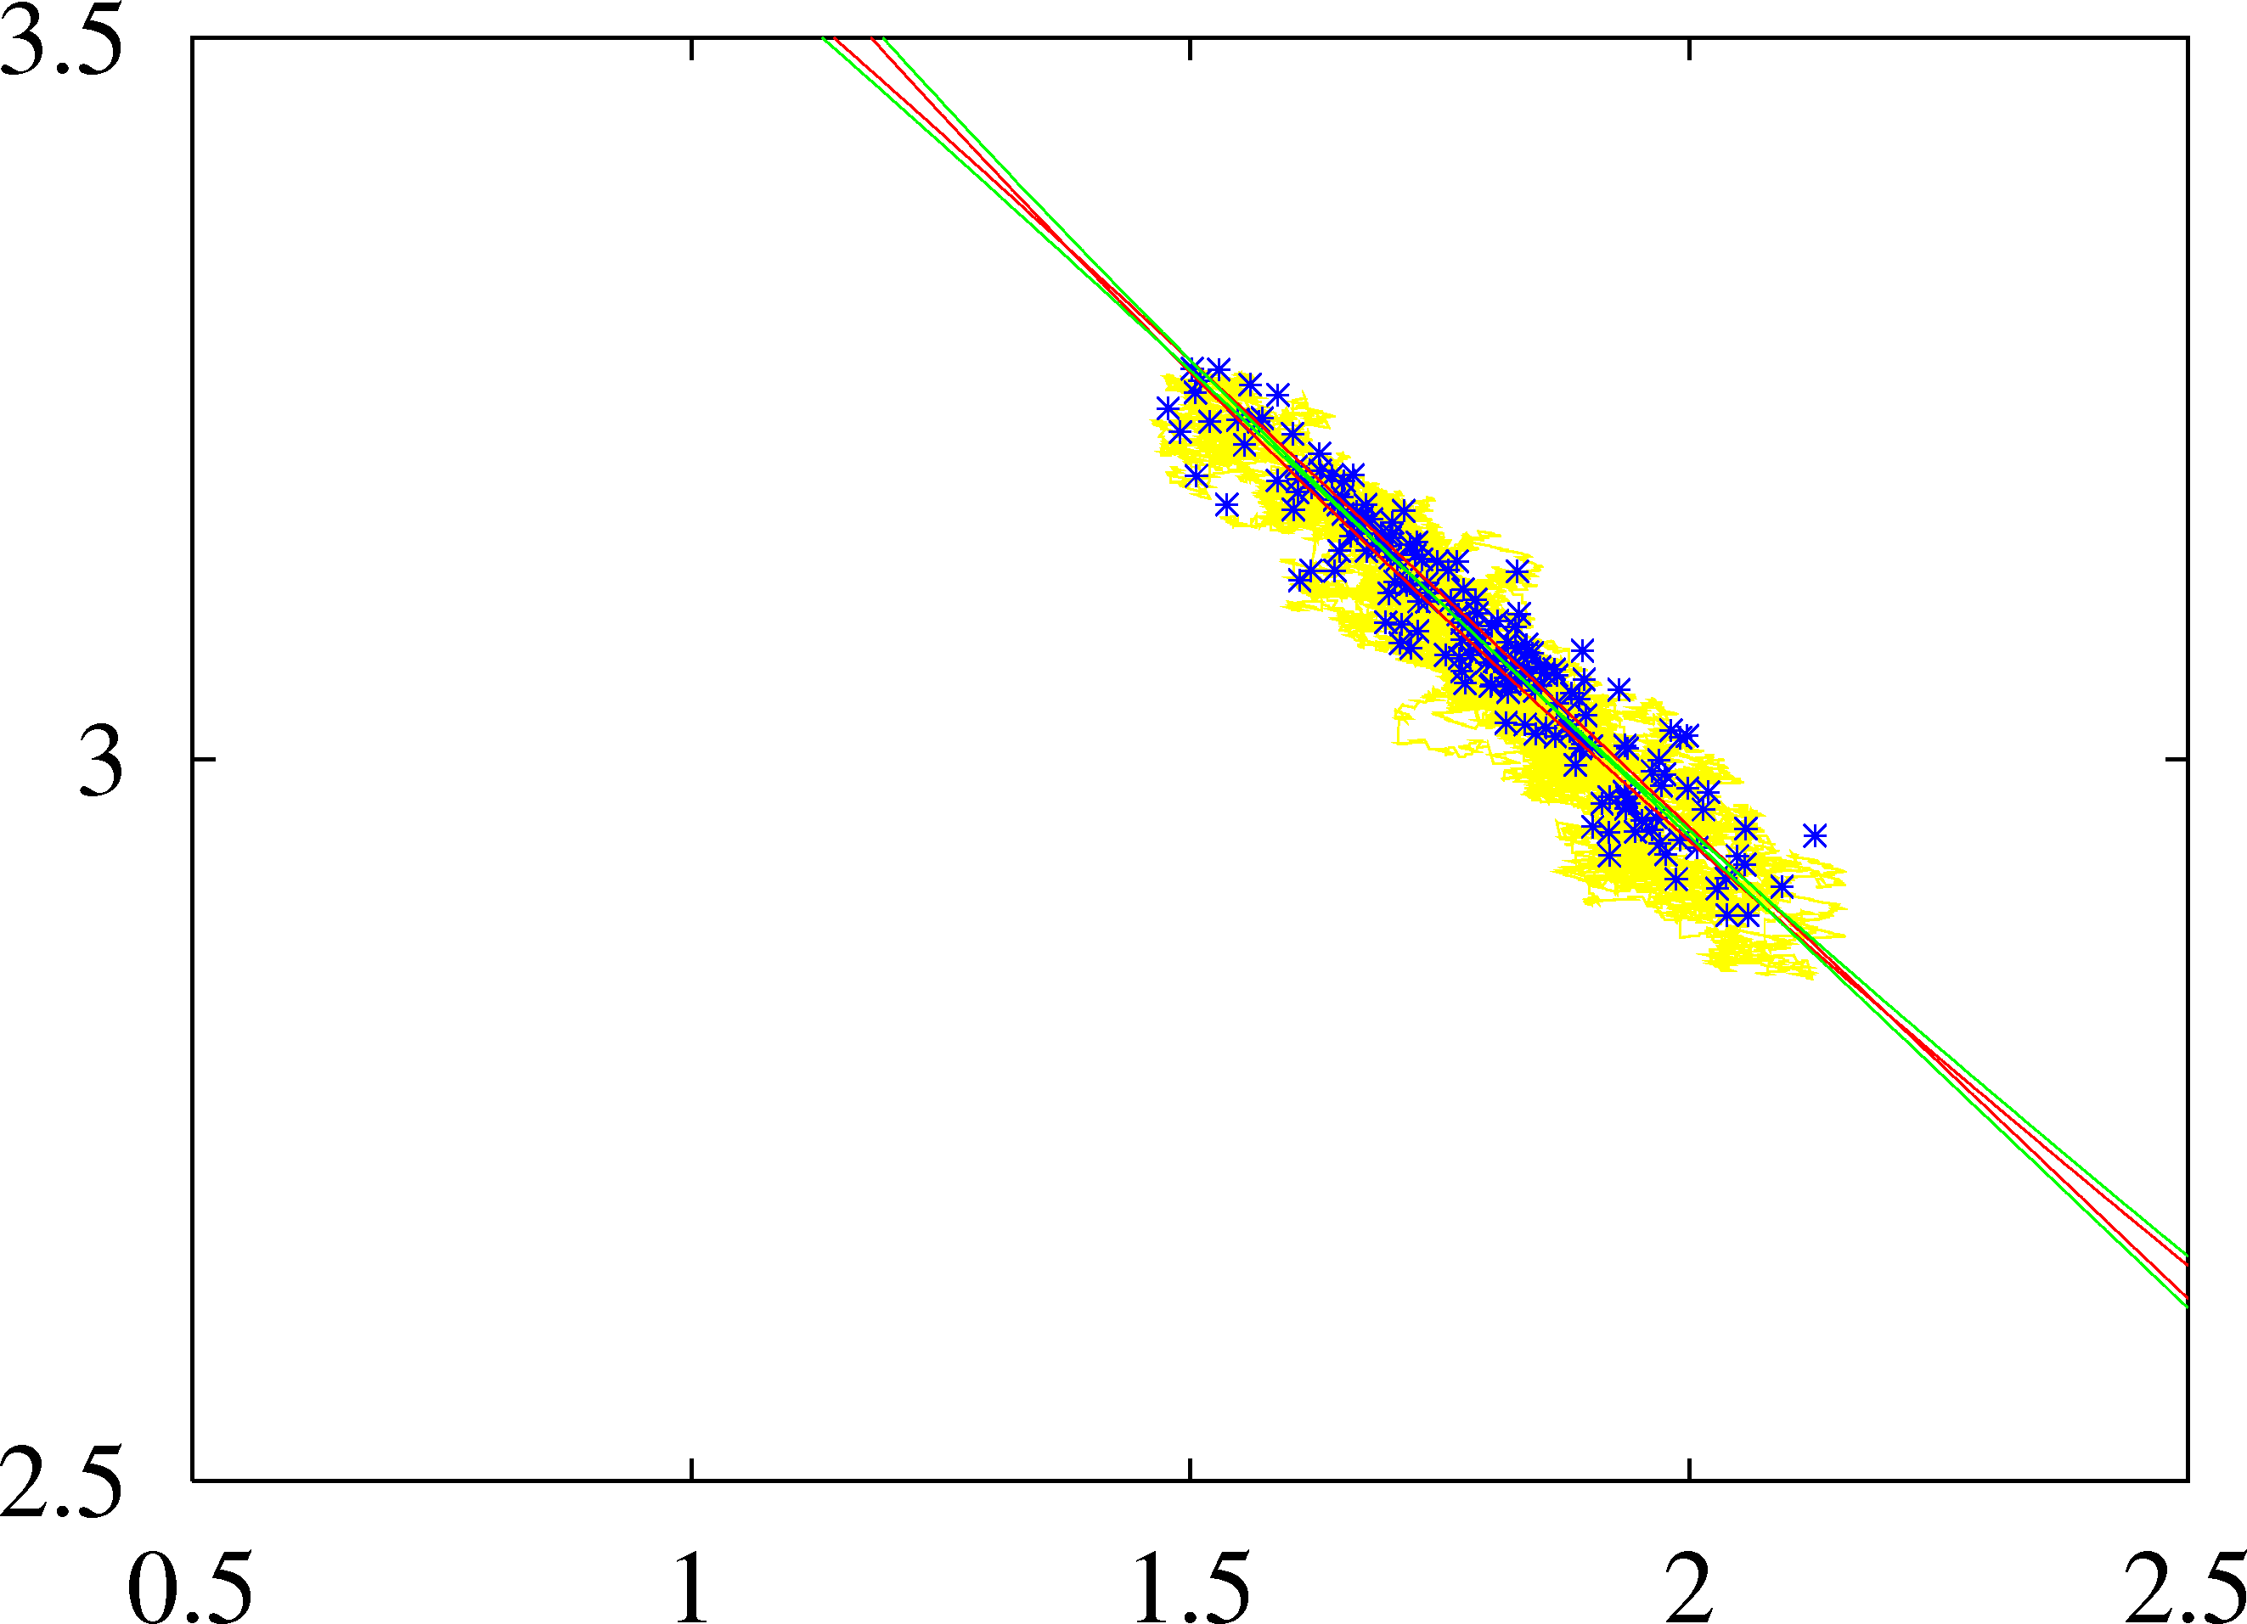
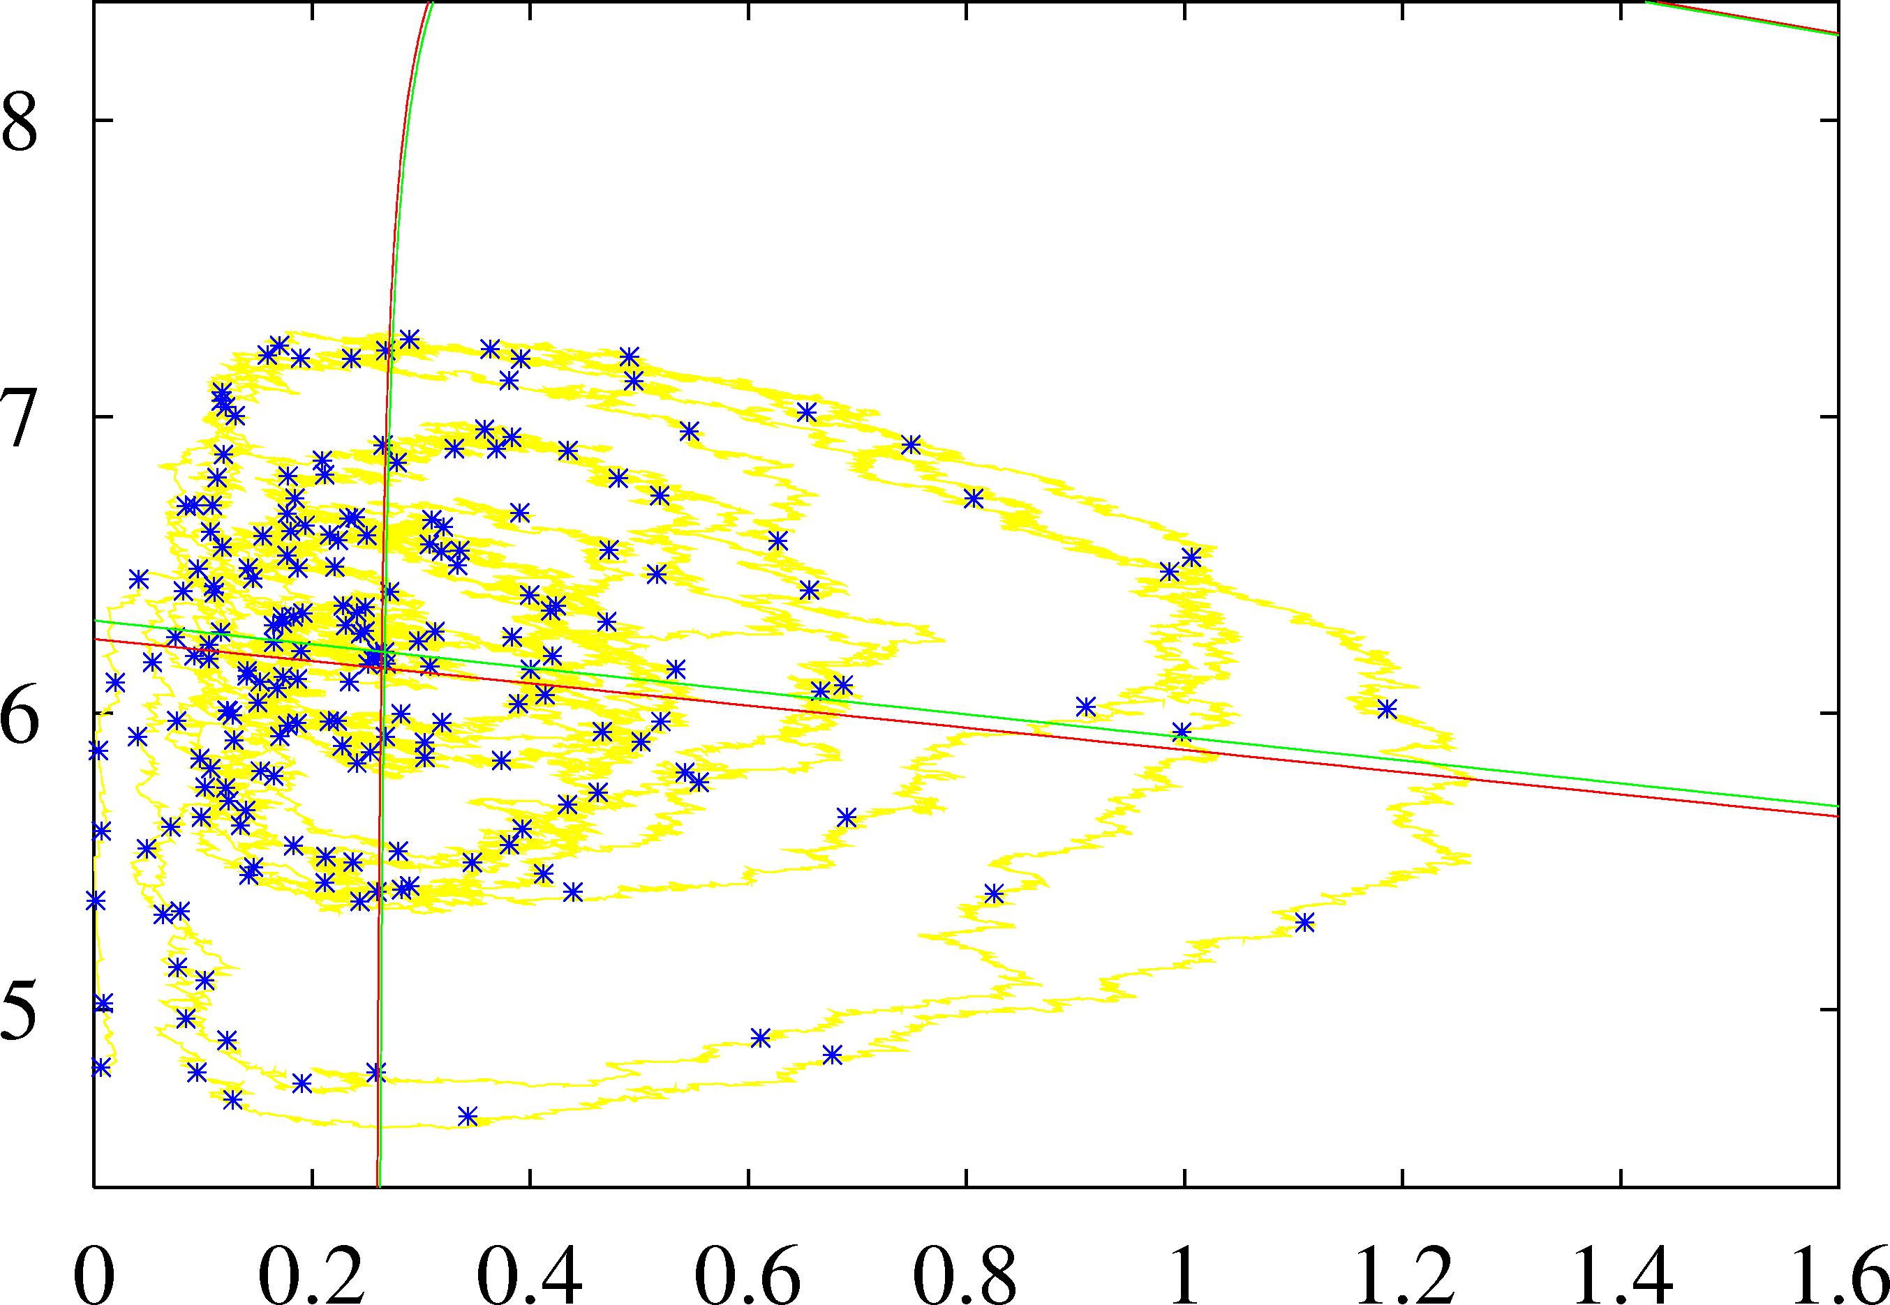
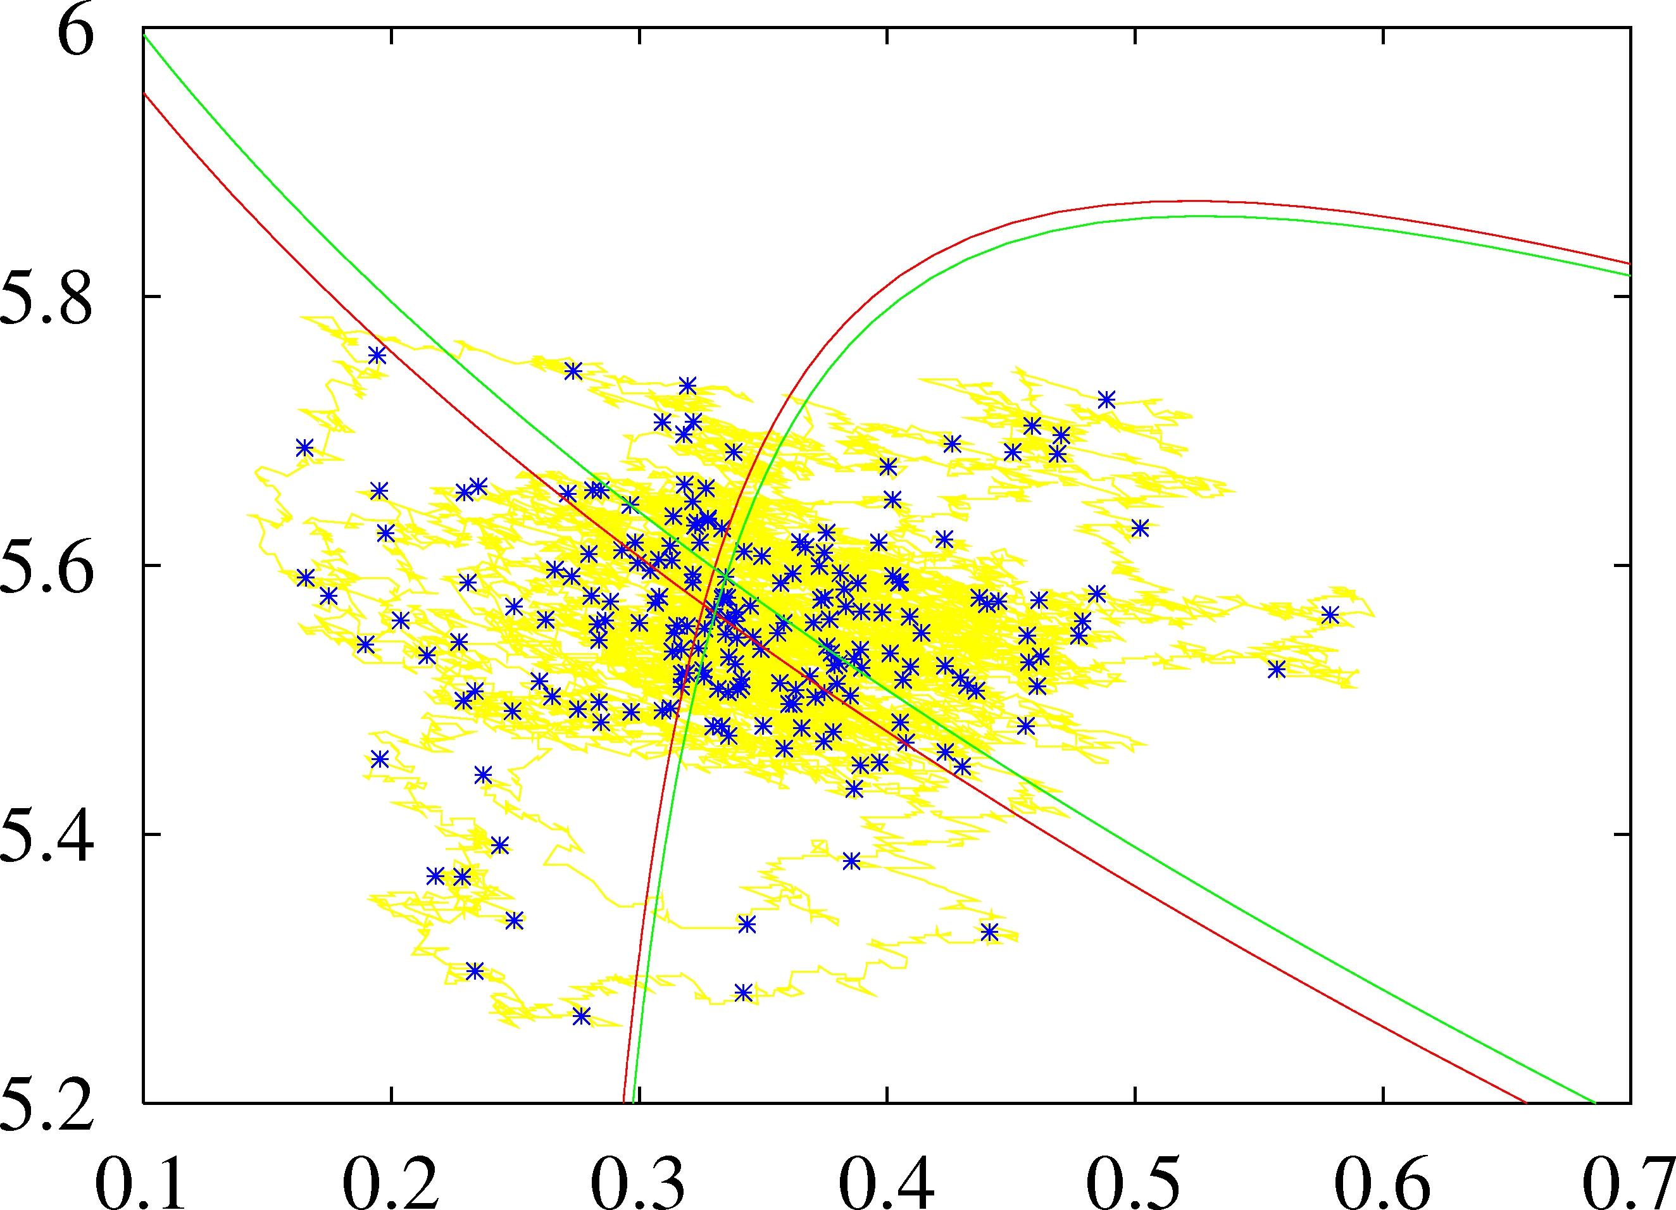
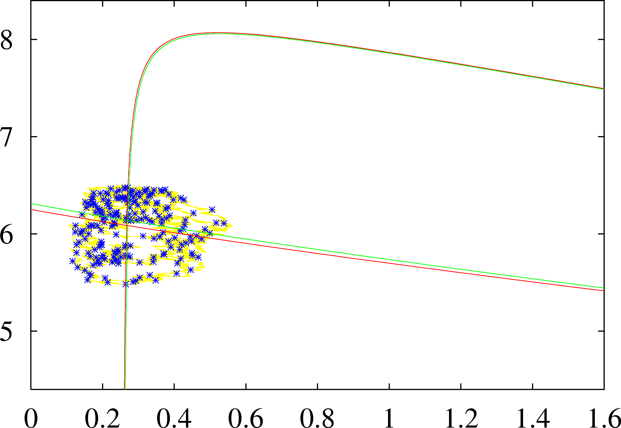

Paradox of enrichment 2
20
3.0
1.0
Bifurcation diagram
consumers
tangent
focus
Hopf
10
1.15
2.7
0
1.23
1.53
2.8
1.23
0
2
4
6
8
nutrient
2.5
1.75
2.3
2.4
isoclines

Slide 24




Resource dynamics
Nutrient
Notes:
Heterotrophs feed on autotrophs, which consume nutrients.
They also die, which returns nutrients for autotrophs

Slide 25





Resource dynamics
Nutrient
Notes:
Heterotrophs have a post-reproductive stage, which competes for food.
Predators have a preference for this stage, which reduced competition for the productive subpopulation.
The nutrients are released after death and become available for the autotrophs.

Slide 26

Resource dynamics
Nutrient
Notes:
Parasites of the heterotrophs have a preference for the weak and old individuals, as do predators.
Predators reduce the risk for the productive subpopulation of becoming parasitized.

Slide 27

Canonical community
Short time scale:
Mass recycling
in a community
closed for mass
open for energy
Long time scale:
Nutrients leaks and influxes
Memory is controlled by
life span (links to body size)
Spatial coherence is controlled by
transport (links to body size)

Slide 28
Marine plankton affects climate
organic carbon pump
transport of atmospheric CO₂ to deep ocean (1000 year memory)
linked to nutrient cycling, terrestrial ecosystems
calcification (inorganic carbon pump)
precipitation of CO₂ in CaCO₃ → burial by plate tectonics
albedo
emission of DMS → cloud formation, effects on radiation
Half rules:
Half of evaporation is from land (plants compensate land/sea difference)
Half of present primary production is from marine plankton
Half of carbonate precipitation is by reefs (corals),
the rest by plankton (forams and coccolithophores)
Kooijman 2004. On the coevolution of life and its environment.
In: Schneider et al, Scientists Debate Gaia; the next century, 343–351.
MIT Press, Cambridge, Mass

Slide 29

Rock cycle
2 CO₂ + 3 H₂O
out gassing
raining
evaporation
weathering
CO₂ + CaSiO₃
H₄SiO₄ + 2 HCO₃⁻ + Ca⁺⁺
sedimentation
burial
SiO₂ + CaCO₃
Photosynthesis: H₂O + CO₂ + light → CH₂O + O₂
Fossilisation: CH₂O → C + H₂O
Burning: C + O₂ → CO₂
Calcification: 2HCO₃⁻ + Ca⁺⁺ → CaCO₃ + CO₂ + H₂O
Silification: H₄SiO₄ → SiO₂ + 2H₂O
pH of seawater = 8.3
98 % DIC = HCO₃⁻
not available to most org.
After Peter Westbroek

Slide 30

Nutrients: rocks → plankton
by plants + micro’s

Slide 31



Organic carbon pump
Wind:
weak
moderate
strong
producers
bind CO₂
from atmosphere
and transport
organic carbon
to deep ocean
light + CO₂
“warm”
no nutrients
cold
nutrients
no light
readily degradable
recovery of
nutrients to
photo-zone
controls pump
poorly degradable
bloom
no growth
growth
poor growth

Slide 32

Final slide
Thank you for your attention
Download slides
https://www.bio.vu.nl/thb/users/bas/lectures/
Questions/remarks are very welcome
Also later during breaks

