Slide 1


Acceleration and its evolution
Bas Kooijman
salm.kooijman@gmail.com
A-Life, VU University Amsterdam
School: 26 May - 3 Jun 2025
University of Crete, Heraklion, Greece

Slide 2
Metabolic acceleration
Def: long-term increase of respiration relative to standard DEB expectation
Types of acceleration
R: maturation
X: food
A: assimilation
M: morph
T: temperature
Short-term increase in respiration (no metabolic acceleration)
heat increment of feeding
boosts of activity
migration
pregnancy/ lactation
Kooijman 2014
J Sea Res 94: 128-137
Notes:
Different types of acceleration of metabolism are presently recognised.
This was possibly because the standard DEB model quantifies the typical trajectory of respiration.
Reproduction hardly contributes to respiration directly, only indirectly

Slide 3
Type R acceleration
Def: Change in allocation to boost maturation
Increase in respiration
Decrease in growth
Hit maturity threshold earlier
at smaller size
Mueller et al 2012,
Comp. Biochem. Physiol. A
163: 103-110
Notes:
This type of acceleration of metabolism does not directly involve an increase in assimilation, the 4 other types do.

Slide 4
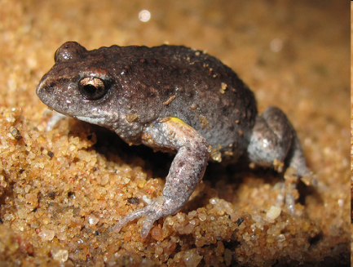
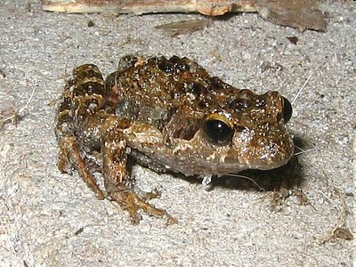
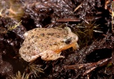
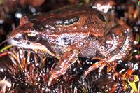
Type R acceleration
acceleration
development
no
yes
indirect
Pseudophryne bibronii
Crinia georgiana
direct
Geocrinia vitellina
Crinia nimbus
Notes:
The DEB definition of direct development: birth coincides with metamorphosis: tadpoles don’t assimilate.
Two species of myobatrachid frogs don’t accelerate and keep κ constant.
Two species of myobatrachid frogs accelerate development by lowing κ between hatch and birth, resetting κ after metamorphosis.
This change increases maturation and respiration and decreases growth.
The direct developers show that κ is not changed systematically between hatch and birth among myobatrachid frogs.

Slide 5
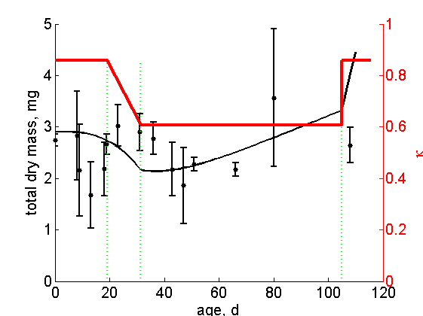
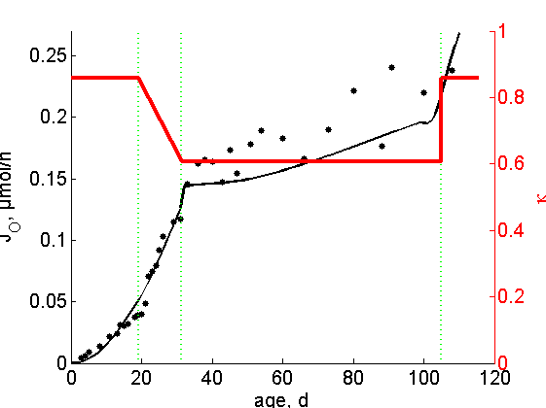
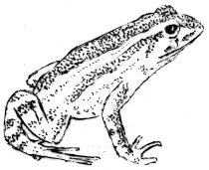
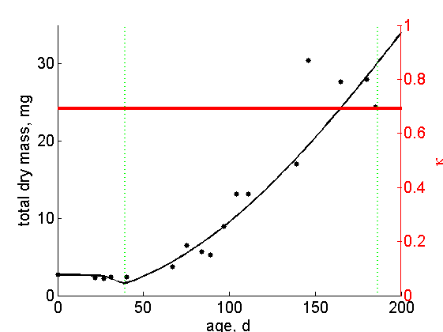
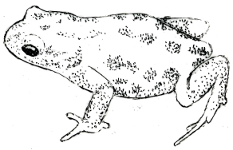
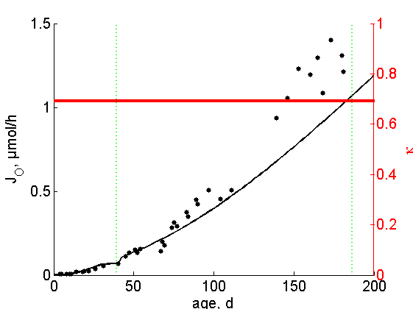
Type R acceleration
Crinia georgiana
Mueller et al 2012,
Comp. Physiol. Biochem. A,
163:103-110
max dry weight 500 mg
hatch
birth
hatch
birth
metam
metam
12 °C
Pseudophryne bibronii
age, d
max dry weight 200 mg
birth
birth
hatch
hatch
metam
metam
Notes:
These two myobatrachid frogs are very similar in many respects, but the tadpoles of P. bibronii live in permament pools, while that of C. georgiana in temporary ones that dry up, soon after their metamorphosis. The latter accelerate development by lowering κ temporarily, which also reduces growth.
In this way it can leave the pond at the age of 110 days, while P. bibronii needs 200 d. Hatch coincides with birth for P. bibronii.
C. georgiana is 4 mg at metamorphosis, P. bibrionii 35 mg dry, while the maximum weights are 500 and 200 mg, respectively.
Both frogs have a (constant) somatic maintenance rate of some 400 J/d.cm³.
The graphs in the middle just enlarge the graph on the right till birth.
The step-up in respiration at birth is due to the onset of assimilation.
Mueller C., Augustine, S., Kearney, M., Seymour, R. and Kooijman, S.A.L.M. 2011
Tradeoffs between maturation and growth during accelerated development in frogs
Comp. Physiol. Biochem. A, 163:103-110
Data: Casey Mueller
Model fit: Starrlight Augustine

Slide 6
Type X acceleration
Def: increase of food intake during ontogeny,
but no change in potential food intake
Known examples concern change in food type
Young (=growing) individuals need lots of protein,
older ones mostly energy.
Notes:
This is the first of 4 types of increase in assimilation.
Type X does not increase assimilation capacity, only actual assimilation

Slide 7
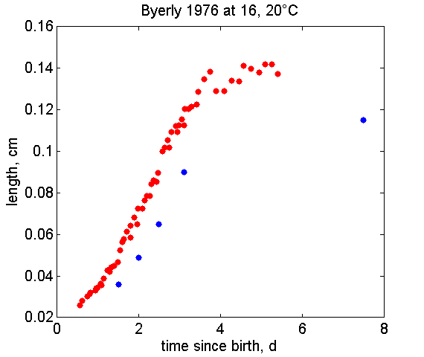
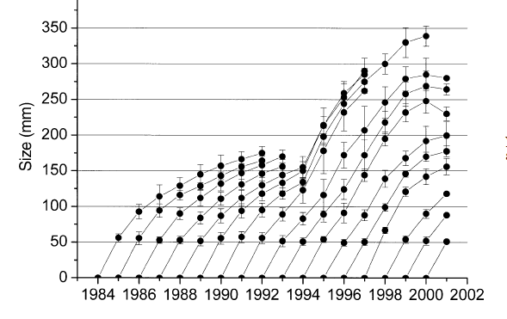
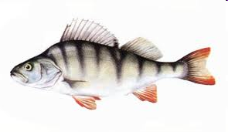
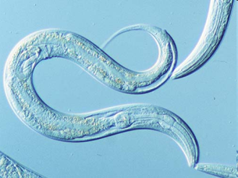
Type X acceleration
Caenorhabditis elegans
Byerly et al 1976
Developmental Biol. 51: 23-33.
Perca fluviatilis
Persson et al 2004
Ecol. Mon. 74: 135–157
organic compounds
→ bacteria
zooplankton
→ fish
Notes:
C. elegans initially feeds on organic compounds;
When its mouth is big enough, it feeds on bacteria
When perch are big enough, they can shift to piscivory, which increases their assimilation

Slide 8
Type A acceleration
Def: increase of potential food intake during ontogeny,
but no change in mobilisation
Known examples concern sex dimorphy
Increase in reserve capacity
Acceleration is confined to period bj
Quantifier: acceleration factor s_{M} = l_{j}/l_{b}
Siblings can be born equal, visit areas of different food availability
and remain unequal for the rest of their lives.
Notes:
This type of increase in metabolism increases assimilation capacity, so if enough food is available also actual assimilation and food intake.
The effect is that maximum reserve density is increased, since energy conductance, which controls reserve mobilisation is not increased.

Slide 9
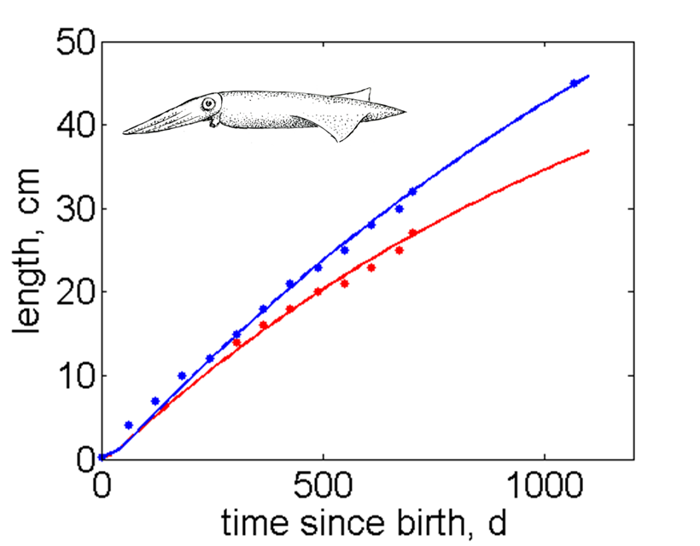
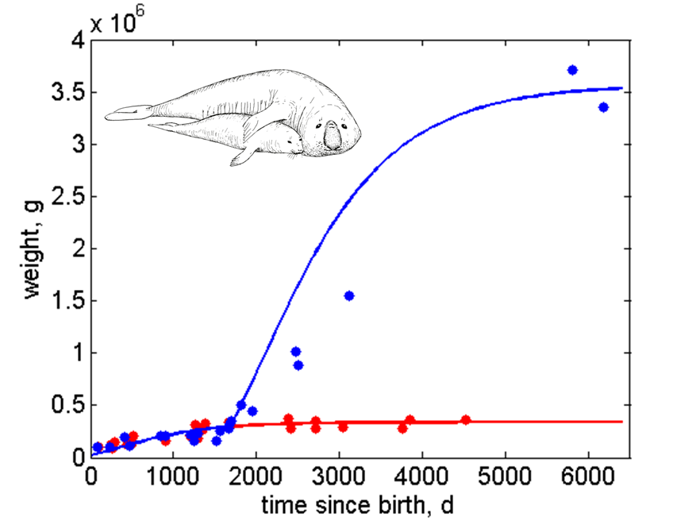
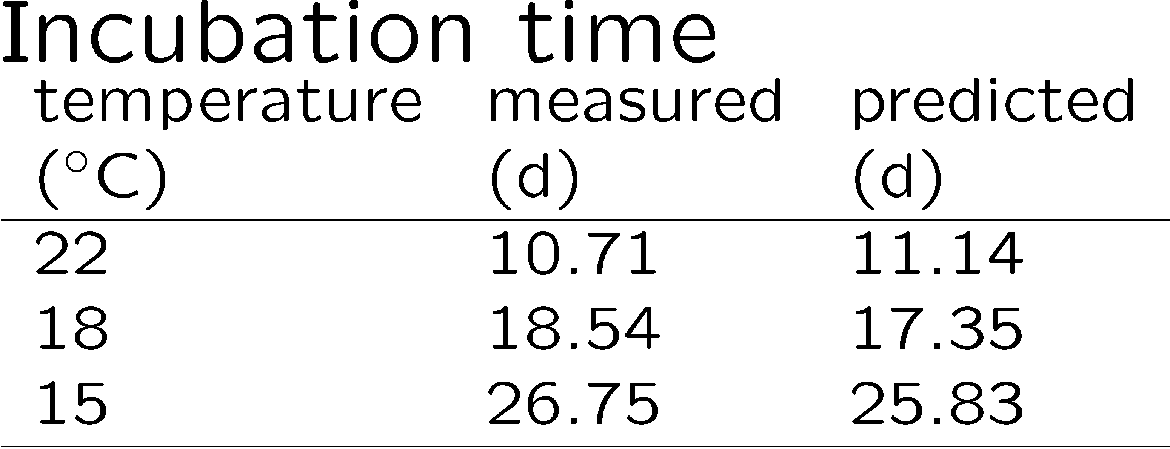
Type A acceleration
Doryteuthis pealei
longfin inshore squid
Mirounga leonina
southern elephant seal
Notes:
Male squid increase assimilation at birth, male elephant seals at puberty.
Squid sport not only type A acceleration, but also (a bit) type M acceleration.
This is not visible in the growth curve, but in the incubation times: embryos develop slower than juveniles and adults.
Details can be found in the add_my_pet collection.

Slide 10
Type M acceleration
Def: increase of potential food intake during ontogeny,
combined with increase in potential mobilisation
Increase of specific assimilation {p_{Am}} and energy conductance v
with length from birth to metamorphosis
no change in reserve capacity
One-parameter extension of standard DEB model:
maturity level at metamorphosis
DEB theory does not assumes isomorphy
Applies to most species with morphological metamorphosis,
but also to some taxa without
amphibians have metamorphosis, but no acceleration
Notes:
Type M acceleration is the most common type. About

Slide 11
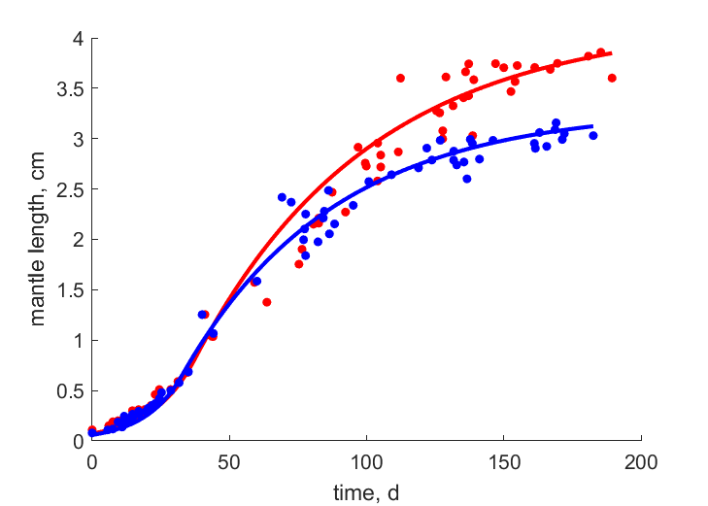
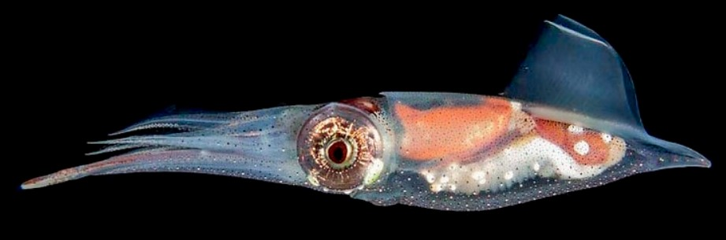
Recognize M acceleration by upcurving of L(t) at constant food
Abralia trigonura
Photo: tolweb
Data: Young & Mangold 1994
Marine Biology, 119: 413--421
Many cephalopods accelerate till puberty; shelled species do not accelerate (Nautilus, Argonauta)

Slide 12
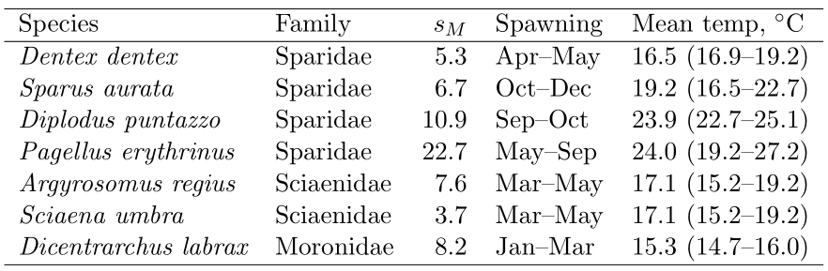
Life history might affect acceleration
Demersal Eupercaria members in Mediterranean waters
Energetics is rather similar after acceleration, so large acceleration factor means slow start
Acceleration might be linked to life history pattern: slow start in warm waters, when food is scars
Lika et al 2014
J Sea Res 94: 37-46

Slide 13
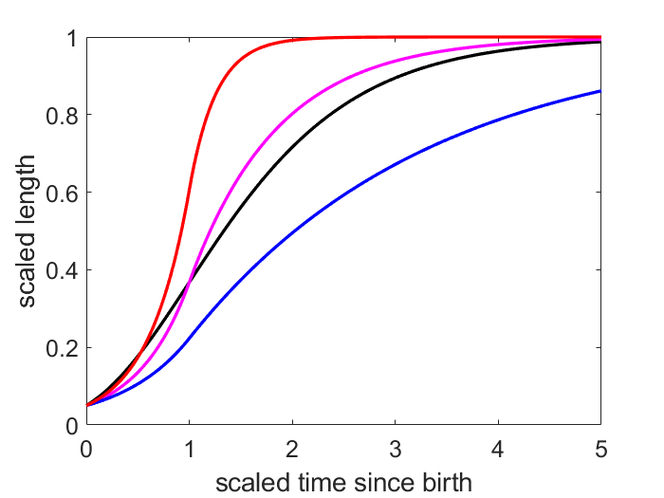
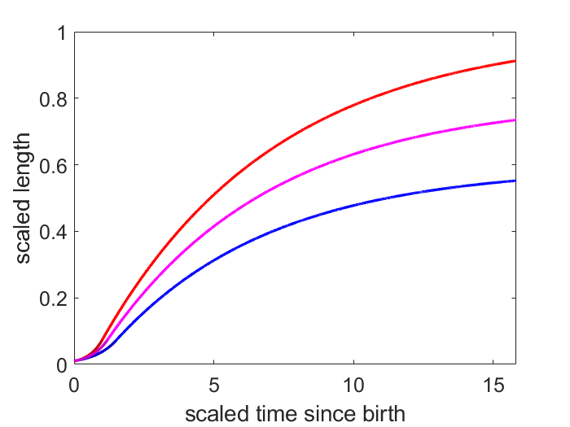

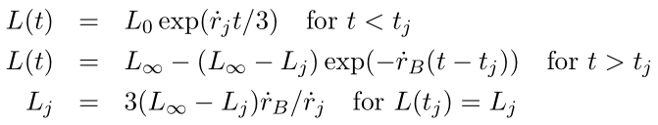
Gompertz expo-von Bertalanffy curves
Gompertz growth curve (1779–1865)
Expo-von Bertalanffy (= Pütter) growth curve

Slide 14
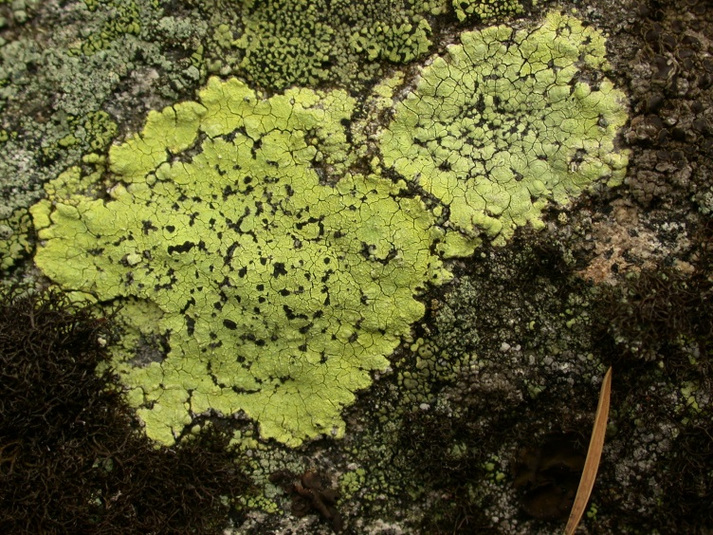

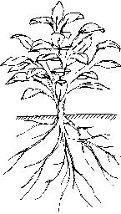
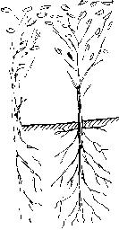
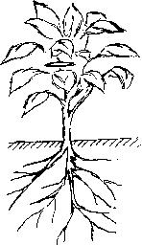

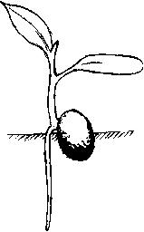
Mixtures of changes in shape
Dynamic mixtures between morphs
V1- V0-morph
outer annulus behaves as a V1-morph,
inner part as a V0-morph. Result: diameter increases ∝ time
Lichen Rhizocarpon
V1- iso- V0-morph

Slide 15
Arachnida
Platyhelminthes
Nematoda
Crustacea
Acanthocephala
Gastrotricha
Ecdysozoa
Tardigrada
Rotifera
Platyzoa
Entognatha
Bryozoa
Insecta
Lophotrochozoa
Spiralia
Annelida
Chaetognatha
Mollusca
Protostomia
Xenacoelomorpha
Echinodermata
Ctenophora
Tunicata
Mammalia
Bilateria
Mixini
Amphibia
Cnidaria
Deuterostomia
Radiata
Leptocardii
Sarcopterygii
Aves
Cephalaspidomorphi
Reptilia
Porifera
Chondrichthyes
Actinopterygii
1
2
5
10
Notes:
Metabolic acceleration in animal taxa, as quantified in the add_my_pet collection.
The legends to the colors refer to the acceleration factor L_{j} / L_{b}, with which {p_{Am}} and v at birth (start of acceleration) have to multiplied to arrive at the values at metamorphosis, (end of acceleration).

Slide 16
Ophidiimopharia
Holocentrimorphaceae
Batrachoidimopharia
Percomorphaceaei
Berycimorphaceae
Gobiomopharia
Scombrimopharia
Euacanthomorphacea
Carangimopharia
Eupercaria
Polymixiacea
Paracanthomorphacea
Acanthomorphata
Elopocephalai
Myctophata
Osteoglossocephlai
Osteoglossocephala
Ctenosquamata
Holostei
Aulopa
Chondrostei
Teleostei
Neopterygii
Clupeocephala
Neoteleostei
Cladistii
Actinopteri
Euteleosteomorpha
Otomorpha
Stomiati
Actinopterygii
1
2
5
10
Protacanthopterygii
Lepidogalaxii

Slide 17
Copepoda
Cirripedia
Euphasiacea
Branchiura
Decapoda
Notostraca
Isopoda
Diplostraca
Mysida
Eucarida
Ostracoda
Branchiopoda
Maxillopoda
Peracarida
Amphipoda
Malacostraca
Crustacea
1
2
5
10

Slide 18
Gastropoda
Bivalvia
Polyplacophora
Cephalopoda
1
2
5
10
Mollusca

Slide 19
Type T acceleration
Def: increase of all rates
due to ontogenetic increase in body temperature
Mostly confined to birds.
Embryos are ectothermic
Neonate heating capacity
not sufficient to maintain target temperature

Slide 20
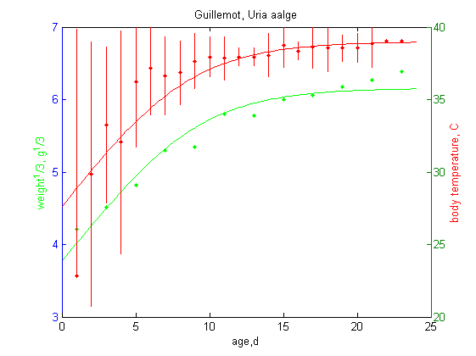
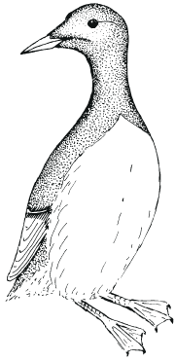
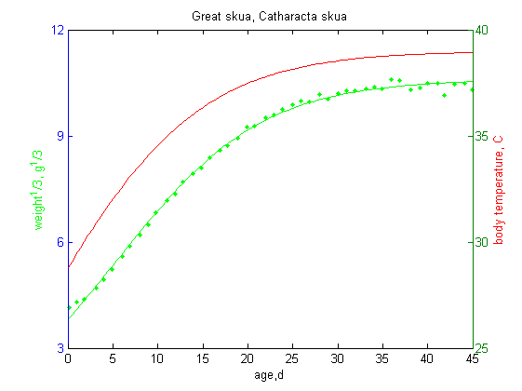
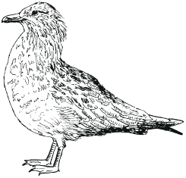
Type T acceleration
t-T inferred from t-L curve
t-T and t-L curves
fitted simultaneously

Slide 21
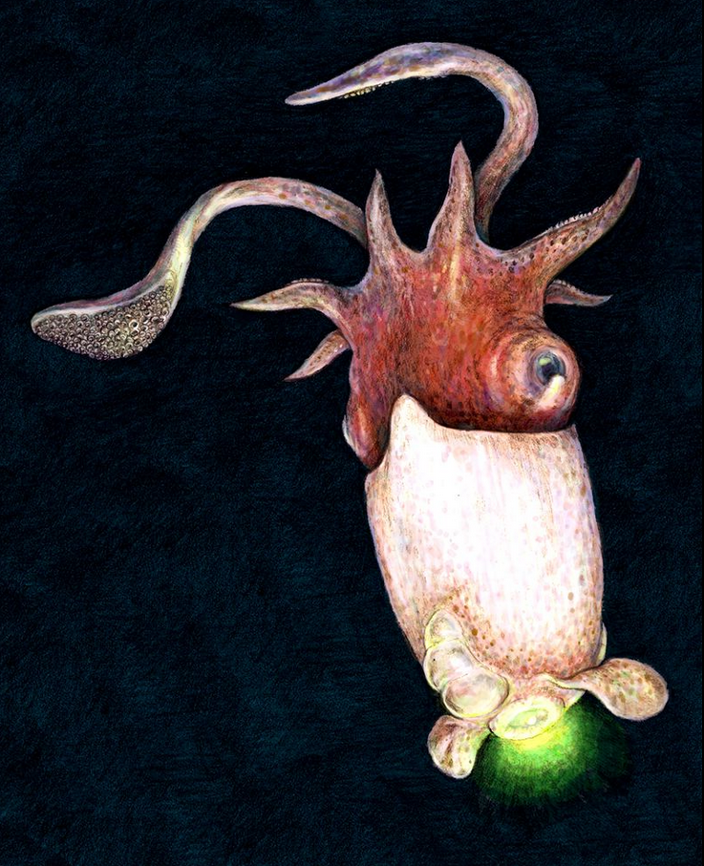
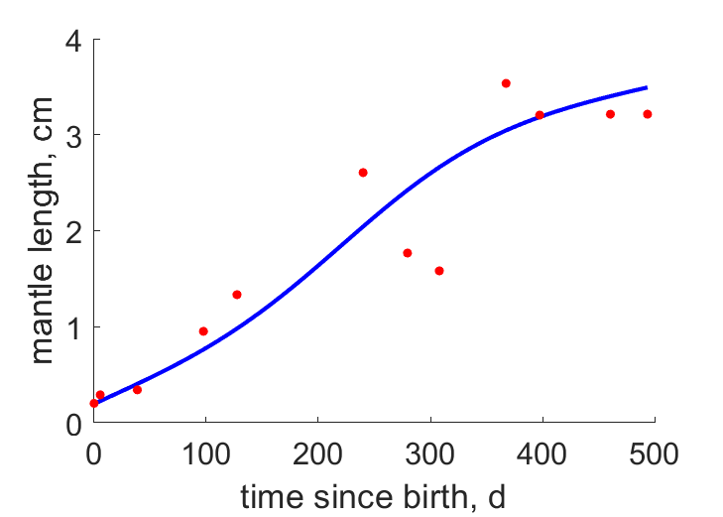
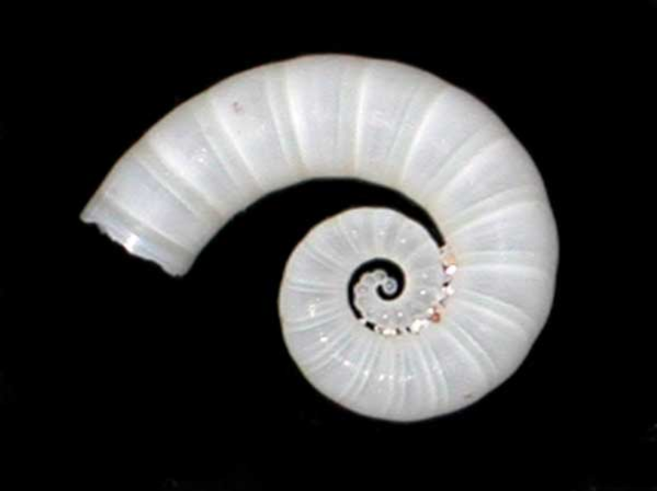
Type T acceleration
Ram’s horn squid, Spirula spirula
Data from Clarke 1970.
J. Mar. Biol. Assoc. UK 50: 53–64
Photophore points downwards
Born at the bottom of deep water: 4–6 ºC,
Migrates to mid ocean waters: 12–14 ºC,
Then back again bottom to spawn & die.
Internal shell 2.1 cm

Slide 22

Final slide
Thank you for your attention
Download slides
https://www.bio.vu.nl/thb/users/bas/lectures/
Questions/remarks are very welcome
Also later during breaks

