Slide 1
Closing lecture
Remarkable AmP entries
Developments
Bas Kooijman
salm.kooijman@gmail.com
A-Life, VU University Amsterdam
Symposium: 3-6 Jun 2025
University of Crete, Heraklion, Greece

Slide 2
Contents
Some highlights of symposium presentations
A small selection of remarkable AmP entries
Possible future developments

Slide 3
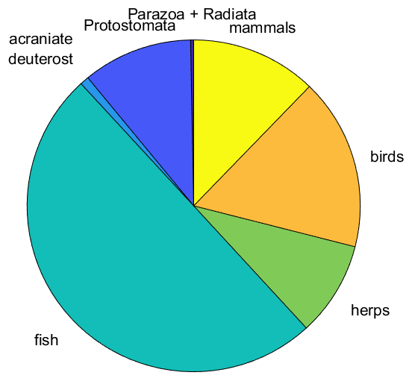
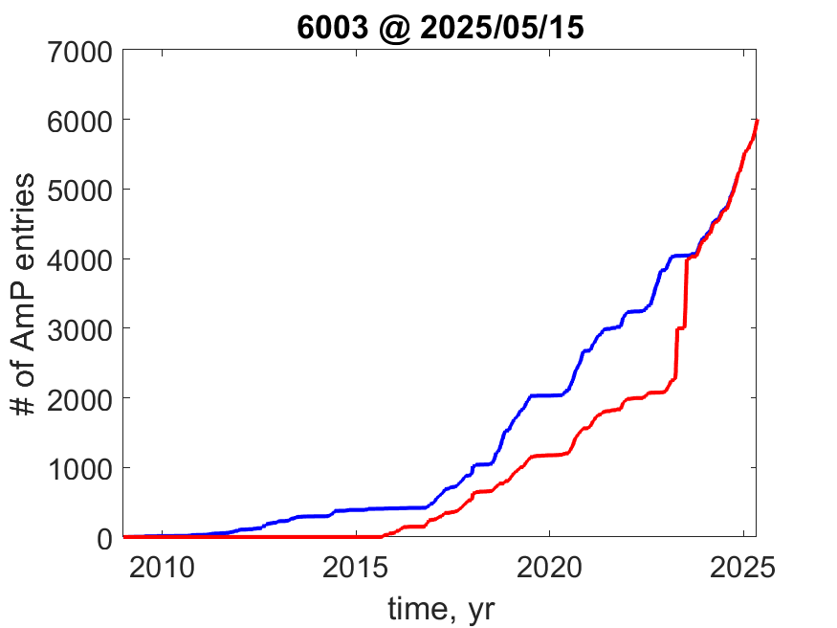
AmP
7e5 dependent data points
DEB Shiny
Apps
coupling with
NichMapR
curator
team
1st DEB
school
Class | Extant | AmP | coverage
Chondrichthyes | 1188 | 237 | 0.20
Actinopterygii | 26900 | 2745 | 0.10
Amphibia | 6000 | 207 | 0.03
Reptilia | 12162 | 346 | 0.03
Aves | 10000 | 1005 | 0.10
Mammalia | 5000 | 734 | 0.15
fish
herps
birds
mammals

Slide 4
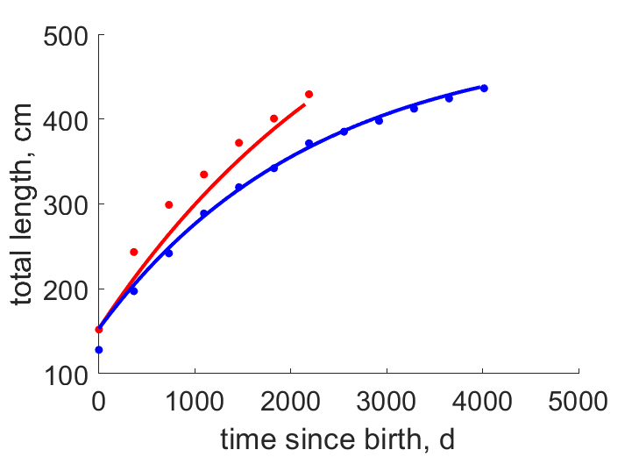
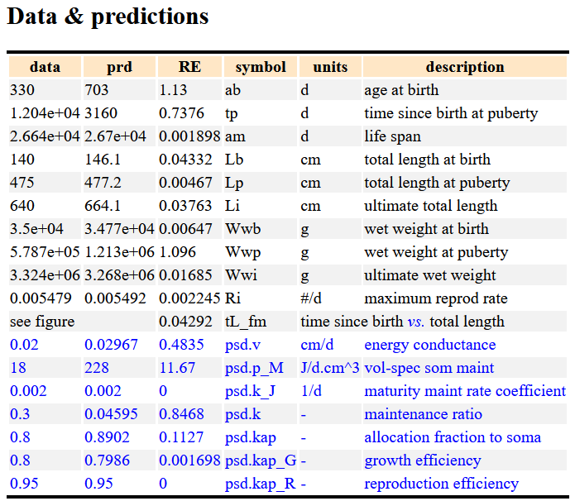
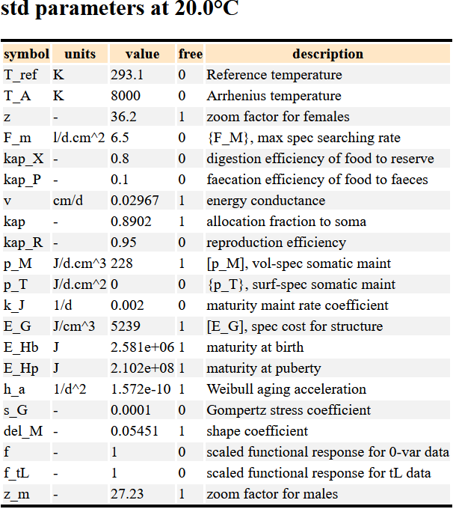
Carcharodon_carcharias (Great white shark)
Tanaka et al 2011
Mar. Fresh Res, 62:548–556

Slide 5
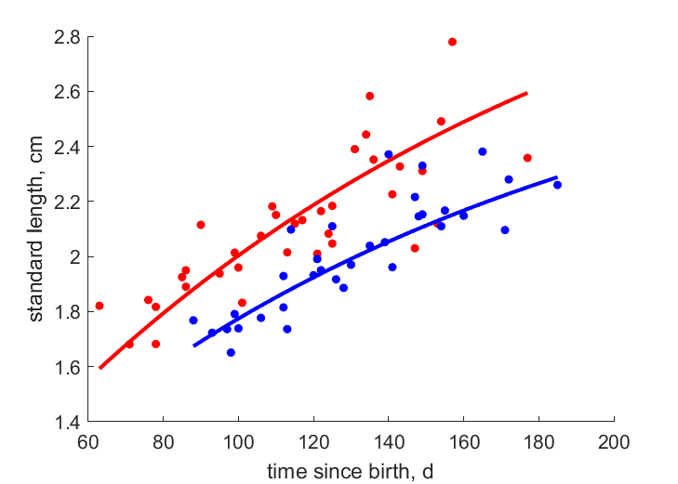
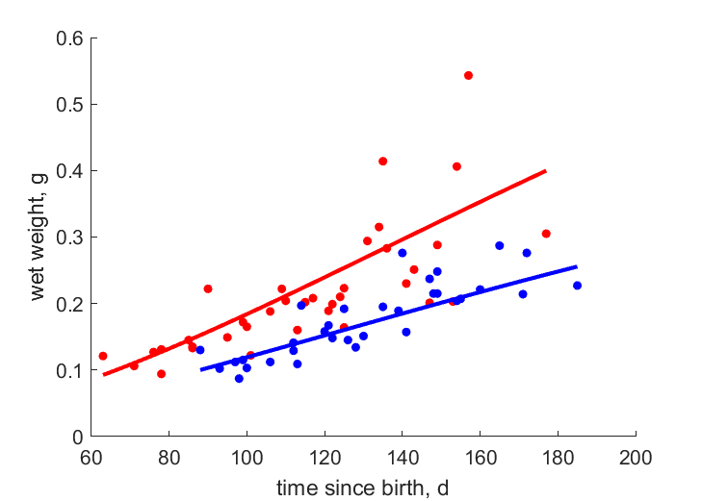
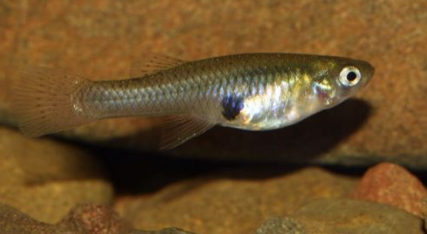
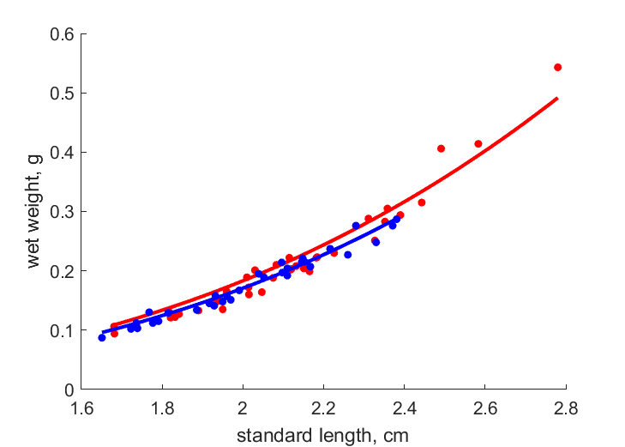
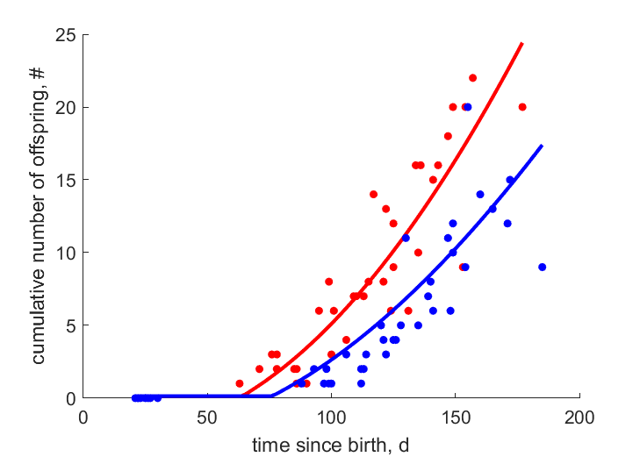
Poecilia reticulata from Yarra river in Trinidad (Guppy): females
high food: f = 0.85
low food: f = 0.71
condition
factor/
Data: Reznick & Bryant 1996 Am Nat 147: 339-359
Entry: Tomos Potter. 2020.
cf lecture by Tin Klanjscek; ecologists use condition factors since long and so weak homeostasis

Slide 6
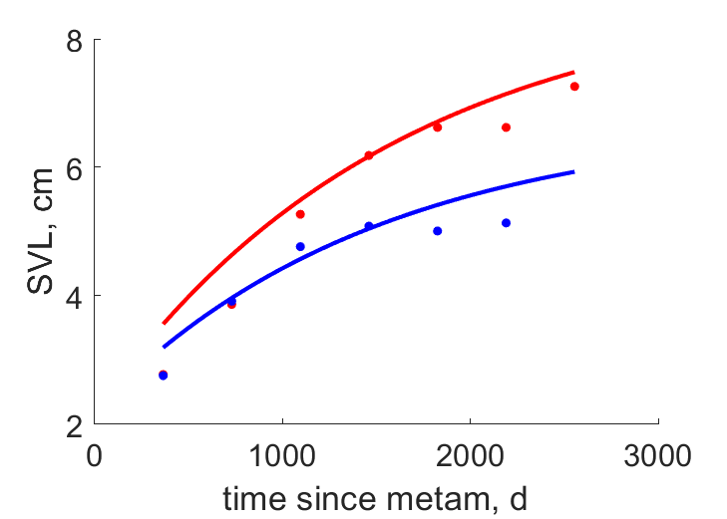
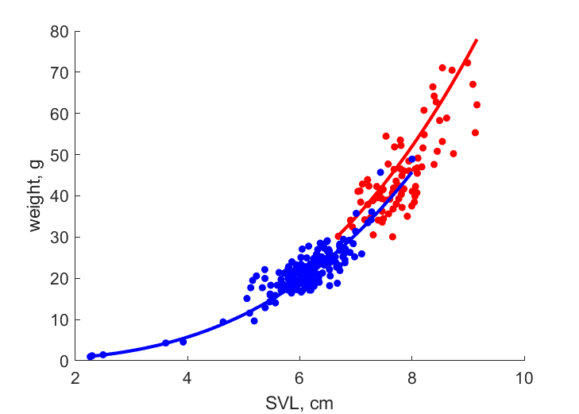
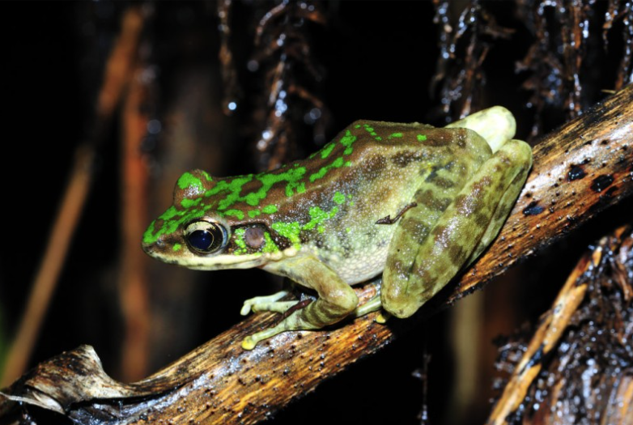
Odorrana_swinhoana (Taiwan odorous frog)
gender dimorphy
females
males
Lai et al (2005).
Zool. Sci., 22:653–658
Kam et al (1998).
J. herpetol., 32(3):447—452
Entry: Bas Kooijman 2023
cf comments on 1.2.2 of DEB3 on weak homeostasis
Lika & Kooijman 2024: Ecol. Mod. 488 (2024) 110591

Slide 7
Recent developments in AmP & DEBtools
Graphics in AmP entries
GitHub/SI m-files that were used to create figs in publications
treat {0/1, {labels}}: how to treat figures
txtData.(sub)title,plotyy; bi-,tri-multi-variate
txtData.label.treat: header for legend grpplot
txtData.label.set: header for legend; legend items as 3rd element of label
DEBtool_M/lib/misc/rotate3D using animated png assembler apngas6
AmPtool/DEBtool
AmPtool/curation/entries2local: copy all entries from AmP-website to local
AmPtool/list_taxa(taxon,3,10): genera (level 3) of taxon with ≥10 species
weights.psd.k_J=0; weights.psd.k=0.1; use when [p_M] < 18 J/d.cm^3
COLLECTION/links & ecoCodes pages on AmP-site: click on col-headers
CONTEXT/taxa: click on pictures to goto tree and again to reload if necessary
run-file: specify global refPets for comparison-species when results_output >4
multispecies: auto-generate pars_init_group file with res2pars_init_group
AmPtool/curation/cdEntry to cd and load source-files in Matlab editor
DEBtool/animal/get_tp, get_tj for L(t) or W(t) with variable f(t)
prt_tab to write table to html/excel, csv, txt, ….
gallery_jpg/gallery_png to get an html page with all photo’s, graphs

Slide 8
Future developments in DEBs
CODE for AmPtool/DEBtool
AmPsniffer project: AI-applications? DEB support from Lisbon, Melbourne, Brest
Julia-translation? In use:
languages: Matlab, Perl, Javascript, Java, C, bibtex, html
packages: wget, apngas6
DOI for zip-files
Direction MySQL database? (unstable in fishbase/EoL/CoL/..)
Method
Initial parameter estimates;
Interval estimation: link with elasticities
Diversify on multi-dimensional scaling
Science
Stylize/extend meta theory: review entries & multispecies methods
iso211, iso221; Invest in AmP entries for invertebrates (insect models), micro-organisms
Further develop DEBtheory to smaller/larger time/space scales
metabolic scope/ behaviour/ central metabolism (5 coupled SU modules)
super-individuals/canonical communities/ system earth science

