Slide 1
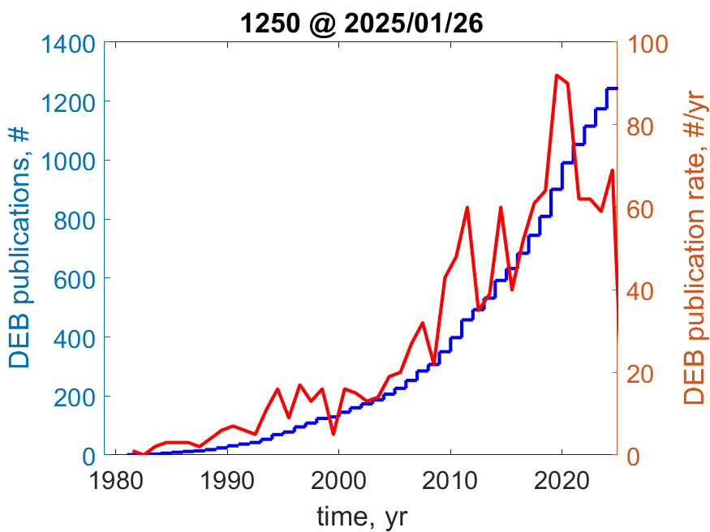
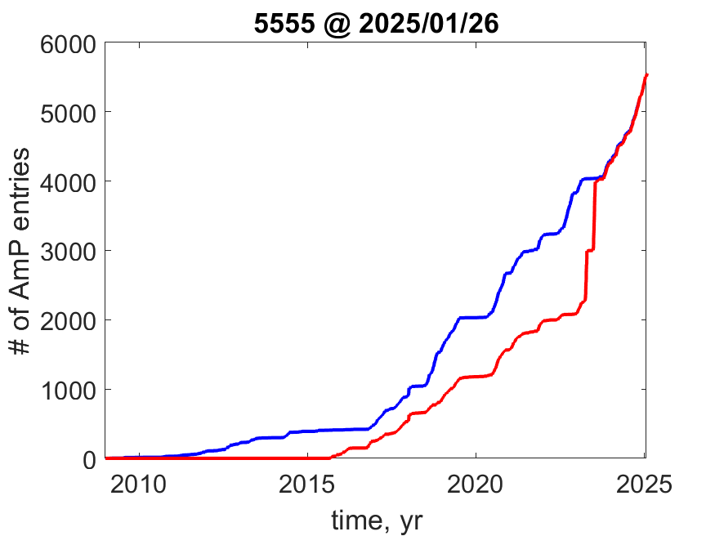
DEB publications
AmP entries
Exponential growth: growth in numbers ∝ numbers
Applies to first ≥ 40 years of DEB development
2025/01/31: 9 in 2025
Target for 2025/05/26:
6000 entries (probably too high)

Slide 2
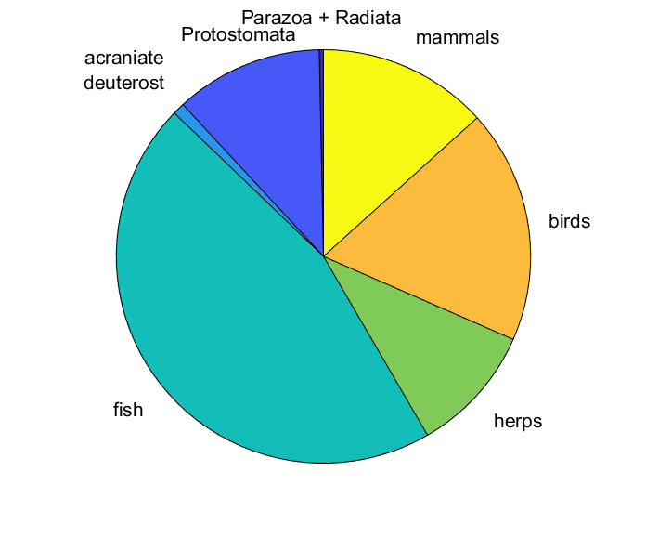
DEB2025
Class | Extant | AmP | coverage
Chondrichthyes | 1188 | 230 | 0.19
Actinopterygii | 26900 | 2310 | 0.09
Amphibia | 6000 | 207 | 0.03
Squamata | 12162 | 346 | 0.03
Aves | 10000 | 1005 | 0.10
Mammalia | 5000 | 733 | 0.15

Slide 3
New developments in DEBtool/AmPtool
AmPtool/curation/entries2local: copy all entries from AmP-website to local
Overleaf/AmPsniffer project: AI-applications?
Graphics
GitHub/SI m-files that were used to create figs in publications
treat {0/1, {labels}}: how to treat figures
txtData.(sub)title,plotyy; bi-,tri-multi-variate
txtData.label.treat: header for legend
grpplot
txtData.label.set: header for legend; legend items as 3rd element of label
DEBtool_M/lib/misc/rotate3D using animated png assembler apngas6
AmPtool/list_taxa(taxon,3,10): genera (level 3) of taxon with >9 species
weights.psd.k_J=0; weights.psd.k=0.1; use when [p_M] < 18 J/d.cm^3
COLLECTION/links & ecoCodes pages on AmP-site: click on col-headers
CONTEXT/taxa: click on pictures to goto tree and again to reload if necessary
run-file: specify global refPets for comparison-species when results_output >4
multispecies: auto-generate pars_init file
AmPtool/curation/cdEntry to cd and load source-files in Matlab editor
DEBtool/animal/get_tp, get_tj for L(t) with variable f(t)
AmPtool/trajectories/simu_my_pet: Dina

